Slide 1
Women’s Movements During Democratic Transitions: The Case of Tunisia
Maro Youssef, PhD
The University of Texas at Austin
Department of Sociology
Spring 2021

Slide 2
Key Concepts
Secularists/Liberals: Actors who wish to separate religion from politics. They draw on liberal democratic values and universal human rights.
Islamists/Conservatives: Actors who wish to incorporate elements of religion into politics. They draw on religion and democratic values that align with religious beliefs (Islam in Tunisia).
Political Insider: Actors who form relationships with key political actors and provide feedback on drafts of legislation.

Slide 3
Theories on Women’s Political Participation During Democratization
Women politically participate in revolutions and during early years of democratic transitions, but participation recedes after (Ferree 2012; Sadiqi 2016; Tadros 2020).
Women’s continuous political participation is ONLY in post-civil war contexts (Badri &Tripp 2017; Basu 2016; Viterna & Fallon 2008).
Conservative/Islamist women often join counter-movements to curtail women’s rights during democratization (Jad 2010, 2011 & 2018; Rinaldo 2008, 2013 & 2019; Somer 2017).
Notes:
MMC:ADD A CLAUSE LIKE BUT PARTICIPATION RECEDES AFTER ….OR SOMETHING TO MAKE THAT STATEMENT MORE EXPLICITLY CONNECTED TO YOUR PUZZLE/RESEARCH QUESTION.
Women often participate politically only in revolutions and early years of democratic transition; nationalists and conservatives sideline and silence them (Ferree 2012; Sadiqi 2016; Tadros 2020).
Women participate politically throughout democratic transitions in post-civil war contexts. Men’s exile and death creates a political power vacuum that women often fill (Badri &Tripp 2017; Basu 2016; Viterna a& Fallon 2008).

Slide 4
Gaps in the Scholarship
There is no explanation for women’s political participation throughout democratic transitions in non-civil war contexts.
Islamist-secularist women’s cooperation is under-studied in gender politics and area studies.
Yet, in the case of Tunisia, where I studied women’s political participation, I found that two women’s rights organizations (one Islamist and one secularist) became political insiders and remained active throughout the democratic transition.

Slide 5
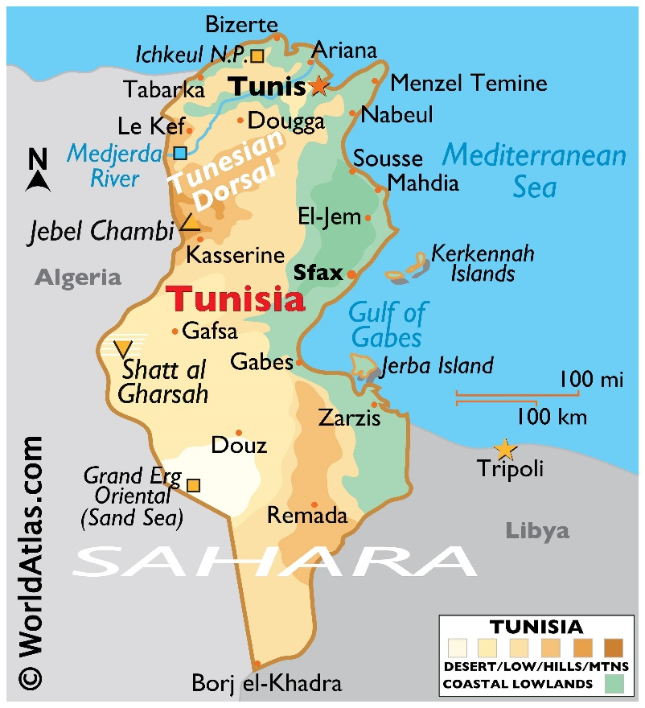
Tunisia

Slide 6
The Puzzle: Women’s Activism in Tunisia
Women participated in the 2010-2011 revolution.
They created 300 new organizations after the revolution. This included Islamists for the first time.
Most women’s rights organizations actively sought, and received, aid from foreign donors.
Twelve women’s advocacy organizations remained active throughout the democratic transition.

Slide 7
Research Question
Under what conditions do women’s rights organizations, founded immediately after a revolution, remain politically active throughout democratic transitions?

Slide 8
Methodology
Ethnographic Methods
69 In-person Interviews:
Women’s rights organizations, foreign donors, state officials, and Tunisia country experts.
Over 7 months in Tunisia and Washington D.C. (2018-2019).
Participant observations of organizational meetings, parliamentary sessions, and donor events.

Slide 9
The Case: LET and Tounissiet
Both
Created in 2011
Remain active today
Provided feedback on all gender-related draft legislation
Used foreign aid to professionalize
Formed a feminist coalition
Islamist Tounissiet focused on:
Electoral gender quotas
Transitional justice
Gender-based violence
Secularist la Ligue des Électrices Tunisiennes (LET) focused on:
Electoral gender quotas
Gender-based violence

Slide 10
Argument
I argue Tounissiet and la Ligue des Électrices Tunisiennes (LET) became political insiders and remained active throughout the democratic transition in Tunisia by:
Professionalizing their organizations
Forming an “unlikely feminist coalition”

Slide 11
Findings: Islamist Women’s Activism
Tounissiet advocated for reforms aligned with the democratic transition. However, they fought against reforms that challenged religion.
Transitional justice for past abuses under dictatorship
Eliminating violence against women
Implementing comprehensive electoral gender quotas.
They resisted reform to inheritance law, based on Islamic law
Scholarly contribution:
Conservative women’s rights organizations do participate in democratic transitions.
Not all of them join counter-movements. Tounissiet advocated for increasing women’s political rights, as long as those rights did not threaten religion.

Slide 12
Findings: Professionalization
LET and Tounissiet used foreign donor aid to:
Create headquarters in the capital & various branches in the interior
Engage different political actors through oral and written briefs
Draft annual reports for donors and the public
Learn to engage media
As professionalized organizations, LET & Tounissiet became political insiders and:
Made their ideas on political violence mainstream (which became part of the 2017 gender-based violence law)
Provided input on every draft piece of gender legislation since 2011
Some of their founders entered politics and became part of the state
Contribution to gender politics: Tunisia shows women’s organizations can become political insiders and remain active throughout the democratic transition.
Notes:
Evidence:
Tounissiet & LET created HQ in capital & various branches in the interior
Engaged multiple political actors
Made their ideas on violence mainstream
Provided input on every draft gender legislation since 2011
Drafted annual reports to donors and the public
Learned to engage media

Slide 13
Findings: An Unlikely Feminist Coalition
In 2018, LET and Tounissiet formed a short-term “unlikely feminist coalition” around similar threats, common tasks, a collective feminist identity, and shared gendered-grievances.
Lobbied for comprehensive electoral gender quotas (achieved)
Advocated for full implementation of 2017 gender-based violence law (remains ongoing concern)
Their cooperation showed some women’s issues were bipartisan, despite ideological differences
Contribution to gender politics & social movement coalition literature:
Women's rights organizations form conservative-liberal coalitions
I call this type of cooperation an "unlikely feminist coalition"
Notes:
Evidence: LET and Tounissiet worked to combat gender-based violence and implement comprehensive gender quotas.
They faced two threats: extremism and a return to authoritarianism.

Slide 14
Negative Case: Nissa Tounissiet
Established by Islamist women in 2011
Did receive foreign donor seed money (2011-2014)
Did become political insiders early on through specialization in transitional justice
Did not professionalize
Did not form a coalition with any secularist organization
Disappeared after 2014

Slide 15
Recap: Key Takeaways
LET and Tounissiet became political insiders and remained active throughout the democratic transition.
They used foreign donor aid to professionalize.
They formed an unlikely feminist coalition around similar threats, common tasks, a collective feminist identity, and shared gendered-grievances.

Slide 16
Policy Recommendations
Foreign Donors: support local women’s rights organizations throughout democratic transitions
Ask local women’s rights organizations about their needs.
Offer financial and technical assistance.
Support organizations across the ideological and political spectrum.
Engage local political actors on women’s issues.
Local Women’s Rights Organizations:
Identify a need and specialize in a few key issues.
Apply for and use foreign donor funds to professionalize.
Find common ground with others and form alliances to get bipartisan and broad support on gender issues.

