Slide 1
Conceptualizing Blackness in/through Tunisia
Shreya Parikh
Dual-Ph.D. candidate, Department of Sociology at UNC Chapel Hill and CERI - Sciences Po Paris

Slide 2
The social construction of Blackness in Tunisia
Shreya Parikh GRRI 2021
The goal of my dissertation research project is to understand
The social imagination of Blackness
The racialization of individuals based on skin-color (among other phenotypic traits)
The contestation of this racialization

Slide 3
The social construction of Blackness in Tunisia
My research is motivated by the following research questions:
What are the social imaginations linked with blackness?
What roles do other ethno-racial identities (like Arab and Amazigh), citizenship status (migrant versus citizen), ideas related to Muslimness, gender, and social class play in the making of the social construction of blackness?
What are the key sites or interactions where racialization is experienced?
How is racialization experienced, interpreted, and challenged by Black Tunisians and Sub-Saharan African migrants?
Shreya Parikh GRRI 2021

Slide 4
Methodology
My dissertation relies primarily on multiple types of qualitative data collected through intensive fieldwork (2020-22) in Tunisia. This includes semi-structured interviews, direct and participant observation, and focus-group data.
In addition, I will also collect journalistic pieces, public social-media posts, and cultural material (like films, music, theatre pieces) that represent ideas of blackness as present in the Tunisian society.
Shreya Parikh GRRI 2021

Slide 5
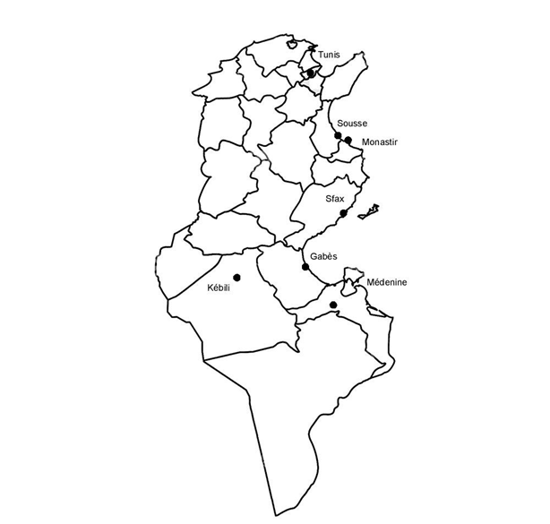
Key sites where interview and observation data will be collected:
Tunis (capital; Anti-racist organizations)
Sousse-Monastir (Sub-Saharan African students in universities)
Sfax (undocumented migrants from Sub-Saharan Africa)
Gabes-Medenine-Kebili (governorates with significant Black Tunisian population)

Slide 6
Methodology
As a GRRI Project Launch Fellow, I spent the year 2020-21 in Tunisia collecting qualitative data (including interviews, notes from informal conversations, and observation data). The pandemic-related constraints meant that I focused on collecting observation and media data for a significant part of the year. I was also able to interview key activists and civil society members in Tunis.
The collected exploratory data has allowed me to reframe my research questions. These will guide data collection over the next academic year.
Shreya Parikh GRRI 2021

Slide 7
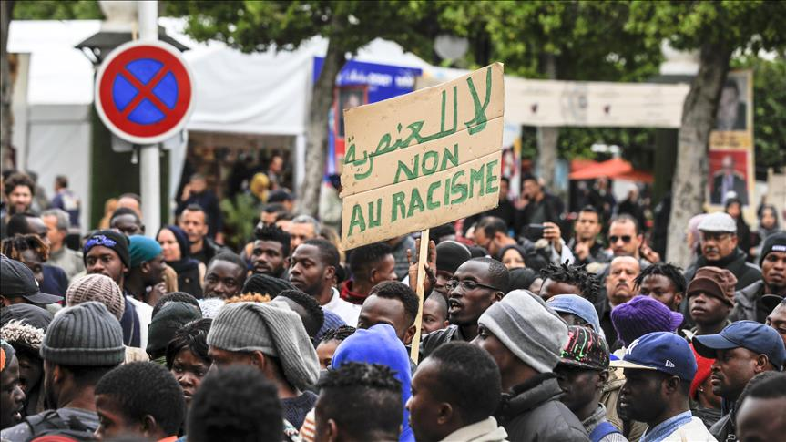
Translating Blackness
The term “blackness ,” in the context of this study, denotes a multitude; it denotes the state of being Black, of the identities and experiences of Black people, and the expression of these identities and experiences (through art, for example).
Source: https://www.aa.com.tr/fr/afrique/tunisie-des-%C3%A9tudiants-subsahariens-manifestent-contre-le-meurtre-d-un-ivoirien/1348552
Shreya Parikh GRRI 2021

Slide 8
Translating Blackness
Scholar-activist Huda Mzioudet (2018) has suggested the use of adjective “السواد” as a proximate to the idea of blackness. She has argued against the use of other terms like “اسمر/ سمرة” which mean “brown” or “tanned”, a term that is recurrently used by Tunisians to indicate a Black person in a politically correct manner. For Mzioudet, the latter is a “mischaracterization of blackness and Black people.”
Shreya Parikh GRRI 2021

Slide 9
Situating my research
In order to break away from US-centric discourses on blackness, which itself is “theorized and mediated by the US empire” (García-Peña 2015), and the association of blackness with the Black-white binary (also coming from the theorization of blackness in the US), I engage with the global study of racialization, especially with that produced by/on the Global South.
Shreya Parikh GRRI 2021

Slide 10
Situating my research
I engage with studies of caste systems in South Asia (Beteille 1990; Dumont 1980; Moffatt 1979; Rao 2009), as well as colorism and métissage in Latin America (Andrews 2010; Degler 1971; Gudmundson and Wolfe 2010; Paredes 2018; Sue and Sue 2013; Telles 2004, 2014) and the Caribbean (Bahadur 2015; Garrigus 2006; Giraud 2004; Glissant 2001).
Shreya Parikh GRRI 2021

Slide 11
Situating my research
The discourse linking blackness with Africanness at a global level, especially in the African diaspora, generates a social imagination of a homogeneous Africa. To highlight the heterogeneity as well as the particularity of the experiences of different ethnic or national groups, I engage with the literature on racialization in various parts of Africa, including Ghana (Pierre 2012), South Africa (Marx 1997; Posel 2001), and Zimbabwe (Hughes 2010).
Shreya Parikh GRRI 2021

Slide 12
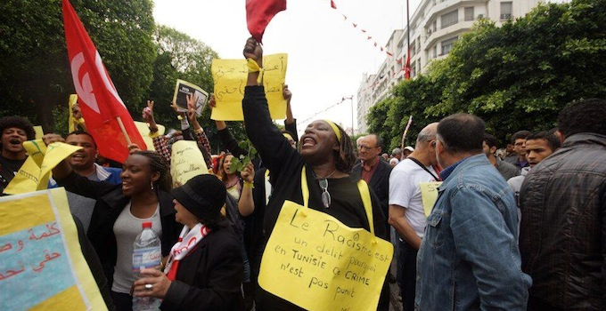
Situating my research
I build upon the emerging field of study of blackness in contemporary MENA region, especially in Tunisia. In Tunisia, this includes the works of scholar-activists Maha Abdelhamid (Abdelhamid 2018; Abdelhamid, Elargi, and Elwaer 2017; Abdelhamid and Hamrouni 2016), Afifa Ltifi (2020), and Huda Mzioudet (2020); and scholars Ines Mrad Dali (2005, 2015), Stephanie Pouessel (2012b, 2012a), and Marta Scaglioni (2017, 2020).
Source: https://nawaat.org/2014/03/21/tunisie-deni-de-racisme-ou-banalisation/
Shreya Parikh GRRI 2021

Slide 13
Who is considered Black in Tunisia?
Those who are perceived as having Sub-Saharan African-origins, but who (in reality) may or may not have direct ancestry in that region, come to be racialized as Black.
Both phenotypically darker Tunisians (many originating from southern Tunisia) and Sub-Saharan migrants (including guest workers, transit migrants, students, and diplomats, among others) come to be racialized as Black.
Given that slavery was practised in Tunisia (prior to abolition in 1846), many Black Tunisians are descendants of slaves. This history plays into racialised ideas (like being submissive or fit for work as servant) of Black individuals.
Shreya Parikh GRRI 2021

Slide 14
Who is considered Black in Tunisia?
Estimates that have been recurrently quoted by Black Tunisian activists as well as in journalistic pieces indicate that around 15 percent of the Tunisian population is Black. Yet, this number remains disputed.
‘Black’ is not a stable category. The racialization of an individual depends on the context in which she finds herself in. For example, someone who is considered dark-skinned or Black in Tunis might not be perceived in the same way in Gabès.
Shreya Parikh GRRI 2021

Slide 15
Who is considered Black in Tunisia?
The Tunisian state does not collect ethno-racial data in the census, hence making it difficult to provide exact numbers of Black Tunisians. While many Black Tunisian activists continue to push the Tunisian state to collect this type of census data, the question remains – how does one define ‘Black’ as a stable category? As many of my interlocutors have pointed out, if we were to define ‘Black’ using the ‘one drop rule’ as present in the United States, the whole of Tunisian population would be considered Black.
Shreya Parikh GRRI 2021

Slide 16
Arabness-Muslimness-Blackness
The link between Arabness, Muslimness, and Blackness (all three of which I see as racialized identities) has driven my curiosity throughout this research.
Before arriving in Tunisia, I had hypothesised that Blackness is constructed in opposition to Muslimness in Tunisia.
What I have come to realise through interviews and observations here is that the link between Blackness and Muslimness is mediated through ideas of Arabness.
Shreya Parikh GRRI 2021

Slide 17
Arabness-Muslimness-Blackness
One key reflection from interviews is that Arabness and Muslimness are imagined as synonymous, especially among groups who face marginalization in the society (like atheists, LGBTQ individuals, etc).
Shreya Parikh GRRI 2021

Slide 18
Arabness-Muslimness-Blackness
While many Tunisians deny the link between the Tunisian identity and Arab identity, many non-Black Tunisians would indicate, with a certain sense of pride, that their last names are of Arab-origin, signifying Arab ancestry. Their narratives about the genealogies of their families would deny the high probabilities of mixed marriages between their Arab ancestors and Amazigh groups in North Africa.
Hence, Arabness, Muslimness, and Tunisianness are constructed as overlapping identities.
Shreya Parikh GRRI 2021

Slide 19
Arabness-Muslimness-Blackness
Blackness as a racialized and marginalized identity is, like other marginalized identities, constructed in opposition to Tunisianness.
A recurrent example of this is that most Black Tunisians whom I interviewed mentioned that many non-Black Tunisians perceive them as non-Tunisians. Many of my Black Tunisian interlocutors mentioned that they passed for someone from central Africa and the assumption was that they didn’t speak Tunisian Arabic.
This meant that non-Black Tunisians spoke with them in French or English, and (in some cases) they would make racist remarks in Tunisian Arabic with the assumption that the person they were commenting about was not Tunisian and didn’t speak Arabic.
Shreya Parikh GRRI 2021

Slide 20
Concluding remarks
Ideas of Arabness and Muslimness indicate the presence of social imagination of the “Arab world” as homogeneous.
This social imagination exists both within and outside this region seen as the “Arab world.”
The study of Blackness in the region is one way to put to question this dominant social imagination.
Shreya Parikh GRRI 2021

Slide 21
Works cited
Abdelhamid, Maha. 2018. Les noirs tunisiens après la révolution de 2011 - Retour sur les prémices d´un mouvement contre le racisme. Euromesco Policy Brief. 84. Barcelona, Spain: EuroMeSCo.
Abdelhamid, Maha, Amel Elargi, and Moutaa Amin Elwaer. 2017. Etre noir, ce n’est pas une question de couleur : Rapport d’enquête : les représentations du racisme chez les noirs de Tunisie. Ariana, Tunisia: Nirvana.
Abdelhamid, Maha, and Mansour Hamrouni. 2016. “L’émergence du mouvement des jeunes Noirs contre le racisme en Tunisie après la révolution du 14 janvier 2011.” P. 17 in La constitution de la Tunisie: Part 3. Tunisia: UNDP.
Andrews, George Reid. 2010. Blackness in the White Nation: A History of Afro-Uruguay. Univ of North Carolina Press.
Beteille, Andre. 1990. “Race, Caste and Gender.” Man 25(3):489–504. doi: 10.2307/2803715.
Degler, Carl N. 1971. Neither Black Nor White: Slavery and Race Relations in Brazil and the United States. Univ of Wisconsin Press.
Dumont, Louis. 1980. Homo Hierarchicus: The Caste System and Its Implications. Chicago and London: University of Chicago Press.
Shreya Parikh GRRI 2021

Slide 22
Works cited
García-Peña, Lorgia. 2015. “Translating Blackness.” The Black Scholar 45(2):10–20. doi: 10.1080/00064246.2015.1012993.
Garrigus, J. 2006. Before Haiti: Race and Citizenship in French Saint-Domingue. Palgrave Macmillan US.
Giraud, Michel. 2004. “Racisme Colonial, Ethnicité et Citoyenneté. Les Leçons Des Expériences Migratoires Antillaises et Guyanaises.” Caribbean Studies 32(1):161–83.
Gudmundson, Lowell, and Justin Wolfe. 2010. Blacks and Blackness in Central America: Between Race and Place. Duke University Press.
Hochman, Adam. 2019. “Racialization: A Defense of the Concept.” Ethnic and Racial Studies 42(8):1245–62. doi: 10.1080/01419870.2018.1527937.
Hughes, D. 2010. Whiteness in Zimbabwe: Race, Landscape, and the Problem of Belonging. Springer.
King, Stephen J. 2019. “Black Arabs and African Migrants: Between Slavery and Racism in North Africa.” The Journal of North African Studies 0(0):1–43. doi: 10.1080/13629387.2019.1670645.
Ltifi, Afifa. 2020. “Black Tunisians and the Pitfalls of Bourguiba’s Homogenization Project.” Project on Middle East Political Science. Retrieved June 17, 2020 (https://pomeps.org/black-tunisians-and-the-pitfalls-of-bourguibas-homogenization-project).
Shreya Parikh GRRI 2021

Slide 23
Works cited
Marx, Anthony W. 1997. Making Race and Nation: A Comparison of South Africa, the United States, and Brazil. Cambridge University Press.
Moffatt, Michael. 1979. An Untouchable Community in South India: Structure and Consensus. Princeton University Press.
Mrad Dali, Inès. 2005. “De l’esclavage à La Servitude: Le Cas Des Noirs de Tunisie (From Slavery to Servitude: ‘Blacks’ in Tunisia).” Cahiers d’Études Africaines 45(179/180):935–55.
Mrad Dali, Inès. 2015. “Les mobilisations des « Noirs tunisiens » au lendemain de la révolte de 2011 : entre affirmation d’une identité historique et défense d’une « cause noire ».” Politique africaine n° 140(4):61–81.
Mrad-Dali, Ines. 2009. “Identités multiples et multitudes d’histoires: les « Noirs tunisiens » de 1846 à aujourd’hui.” Thèse doctorat, École des hautes études en sciences sociales, Paris, France.
Mzioudet, Huda. 2018. “أبعاد العنصرية: تابوه التمييز العرقي في تونس” UltraTunis.7 June.
Mzioudet, Huda. 2020. “Être ‘Noir’ Dans l’Afrique Du Nord et Le Moyen-Orient.” July 23.
Oualdi, M’hamed. 2020. A Slave Between Empires: A Transimperial History of North Africa. Columbia University Press.
Shreya Parikh GRRI 2021

Slide 24
Works cited
Pouessel, Stéphanie. 2012a. “Les marges renaissantes : Amazigh, Juif, Noir. Ce que la révolution a changé dans ce « petit pays homogène par excellence » qu’est la Tunisie.” L’Année du Maghreb (VIII):143–60.
Pouessel, Stéphanie, ed. 2012b. Noirs Au Maghreb: Enjeux Identitaires. Paris, France et Tunis, Tunisie: IRMC et Karthala.
Rao, Anupama. 2009. The Caste Question. Berkeley: University of California Press.
Scaglioni, Marta. 2017. “‘I Wish I Did Not Understand Arabic!’ Living as a Black Migrant in Contemporary Tunisia.” doi: 10.14672/67056040.
Scaglioni, Marta. 2020. Becoming the ’Abid: Lives and Social Origins in Southern Tunisia.
Sue, Christina A., and Christina A. Sue. 2013. Land of the Cosmic Race: Race Mixture, Racism, and Blackness in Mexico. OUP USA.
Telles, Edward. 2014. Pigmentocracies: Ethnicity, Race, and Color in Latin America. UNC Press Books.
Telles, Edward Eric. 2004. Race in Another America: The Significance of Skin Color in Brazil. Princeton University Press.
Shreya Parikh GRRI 2021

