Slide 1
After the Last ‘Firman’:
Victimhood, Survival and Societal Transformation among the Yezidis
Global Religion Research Initiative International Collaboration Grant (2018-2019)
Güneş Murat Tezcür, Jalal Talabani Chair and Professor, University of Central Florida
Zeynep Kaya, Lecturer, Sheffield University
Bayar Mustafa Sevdeen, Dean, University of Kurdistan Hawler

Slide 2
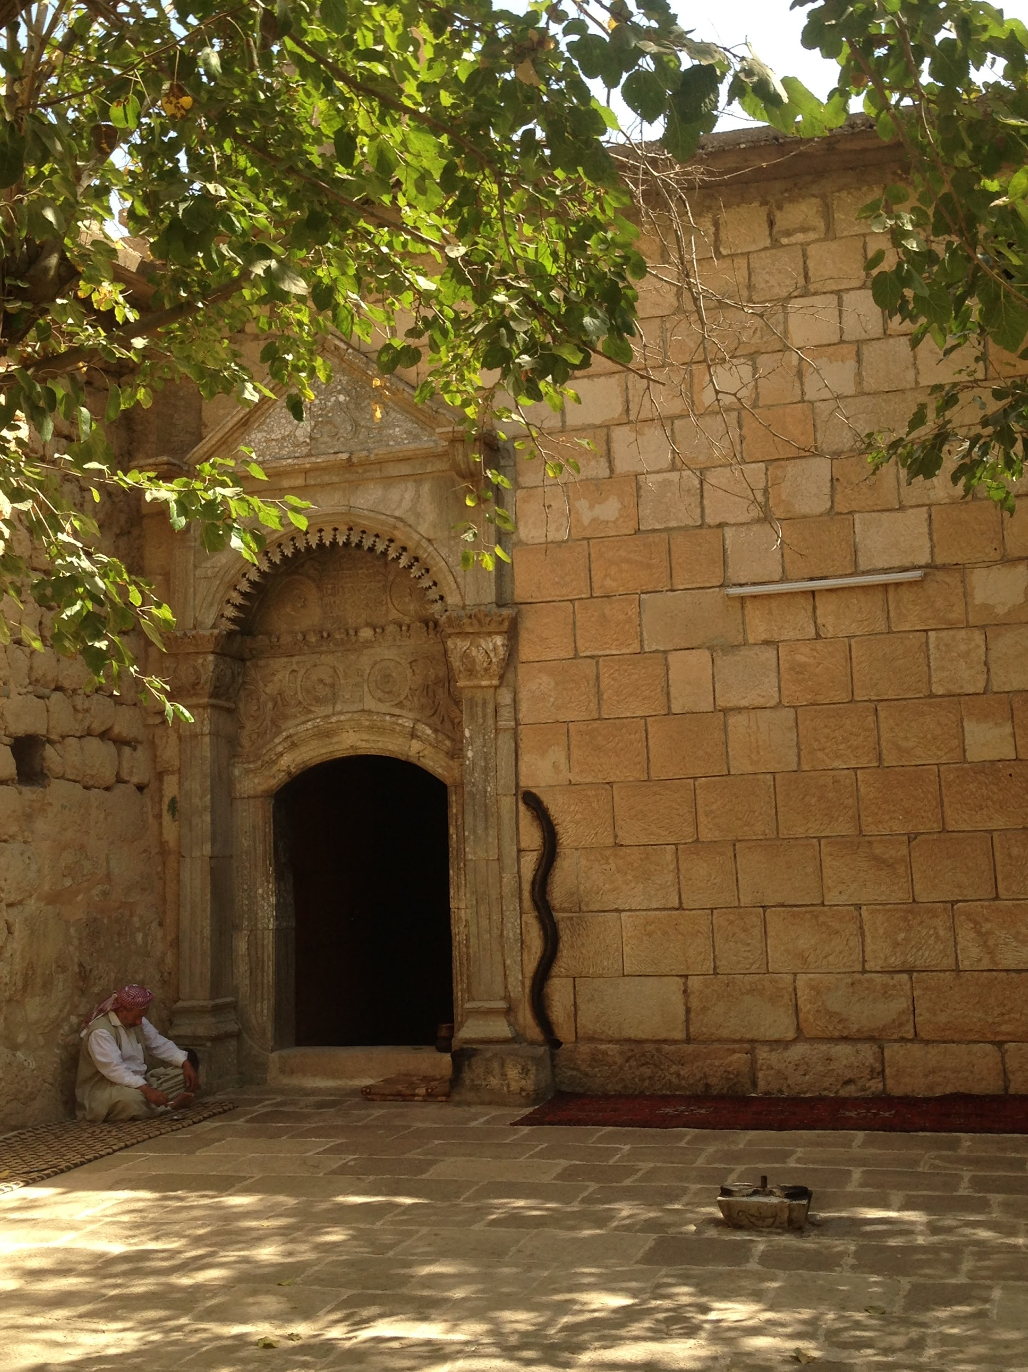
Project Description
In 2014, the Yezidis- a monotheistic religious community with historical roots in the Sinjar area of northern Iraq – became the target of the self-styled Islamic State (IS). Thousands of Yezidis were executed and large numbers of women and children were taken hostages and subsequently sold as slaves. The IS assault has pushed the already marginalized community to the brink of survival. Most of Sinjar remains inhabitable and many surviving Yezidis continue their existence as displaced people and refugees in Iraqi Kurdistan and Western countries.
This international collaborative project has brought together scholars from the United States, Iraqi Kurdistan, and the United Kingdom to offer a unique social science perspective on the Yezidi religious community in the wake of genocidal violence. The research team conducted more than a hundred of in-depth interviews with Yezidis in Dohuk province of Iraqi Kurdistan to analyze the group’s experience. The project aims to advance the study of a persecuted religious minority by adopting cutting-edge social science perspectives.
Lalish Temple - the Holiest place in Yezidi religion

Slide 3
Research Questions
How has Yezidi political identity evolved in the wake of genocidal violence?
How do Yezidi women cope with the experience of sexual violence and displacement?
What factors led to the collapse of interreligious coexistence between Sunni Muslims and Yezidis ?

Slide 4
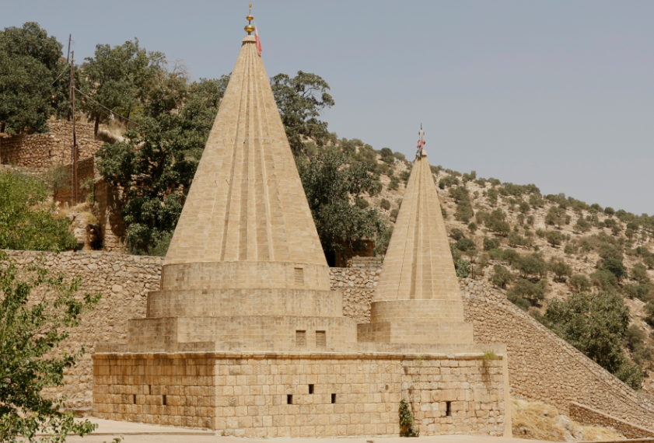
Historical Context: The Yezidi Experience
Sheik Adi (b. in 1075), a well-known Muslim scholar, reorganized Yezidism and established a hierarchical clerical order, in a way similar to monolithic religions
Yezidis during the Ottoman times
An unrecognized and persecuted religious community since the 16th century (lacking the status of “People of the Book”)
Ottoman expeditions to Sinjar motivated by security concerns as well as religious stigmatization
Yezidis in Iraq until 2003
Remaining a peripheral community but not subject to mass killings until the end of the Saddam era
Yezidis in post-Saddam Iraq
Targets of mass violence in an environmental of fierce sectarian polarization: the 2007 suicide attacks in Sinjar & the 2014 genocidal campaign in Sinjar
Yezidis - a pawn in the Kurdish-Arab territorial struggle over the disputed territories in northern Iraq
Lalish Temple

Slide 5
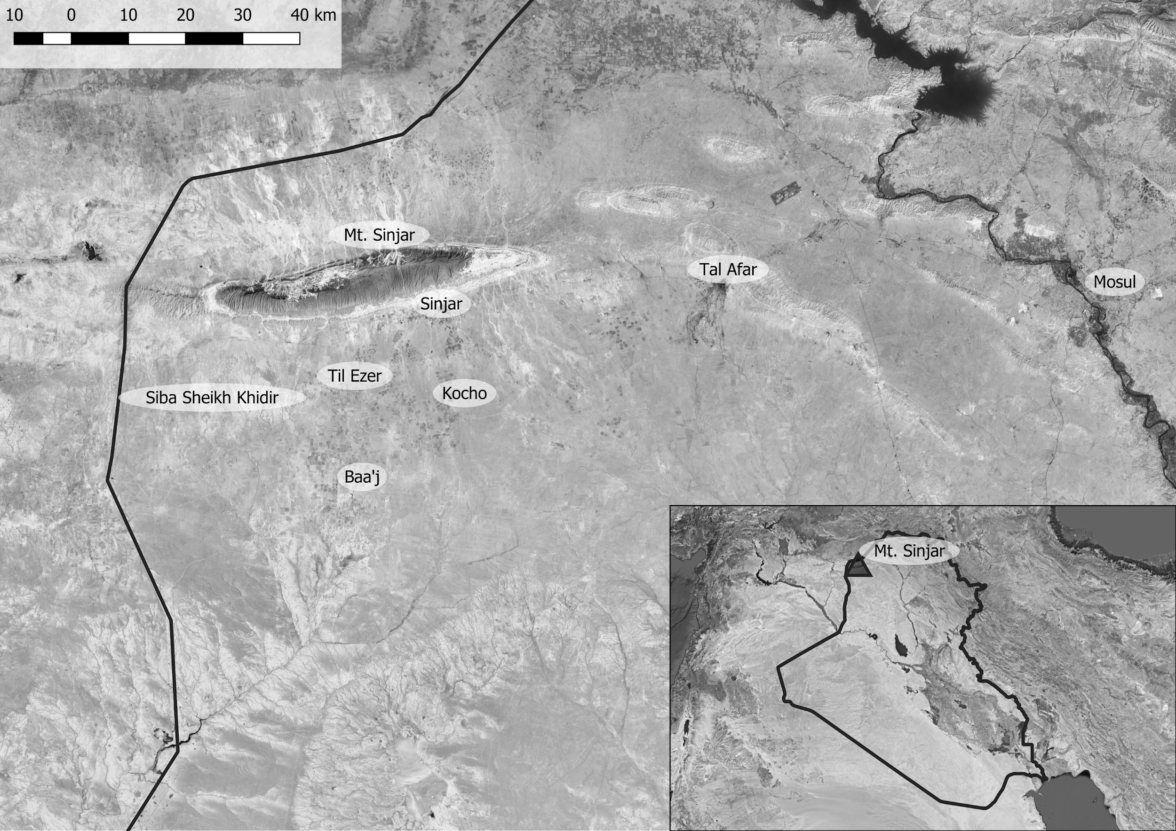
Historical Context: The IS Assault on Sinjar in August 2014
The fall of Mosul and Tal Afar to the IS in June 2014 and the vulnerability of Yezidis in Sinjar.
The IS assault, the Kurdish Peshmerga flight, and Yezidi desperateness.
Some Yezidis taking refugee on Mt. Sinjar; many others captured or killed
The intimate nature of violence: neighbors and kreef as murderers, enslavers, and looters.
Extreme practices including sexual slavery explicitly justified on religious grounds.
Many Yezidis being displaced to camps in Iraqi Kurdistan.
Sinjar, August 2014

Slide 6
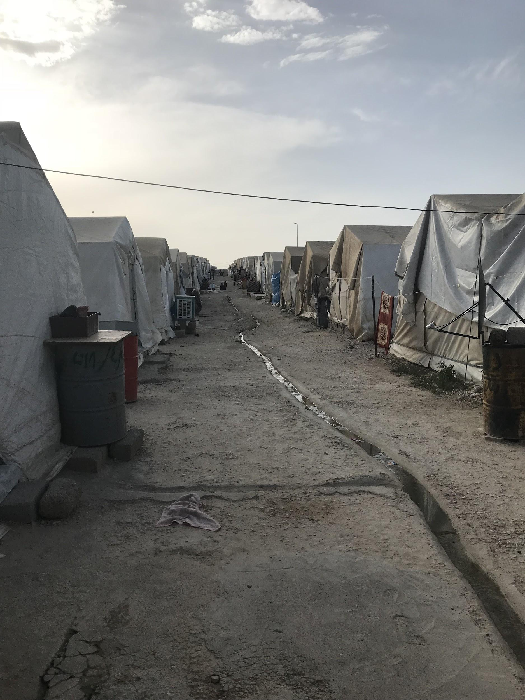
An Overview of the Fieldwork
A teamwork effort involving Tezcür, Kaya, Sevdeen, Tutku Ayhan (PhD Candidate at UCF) and research assistants
Four categories of in-depth interviews (n=~110):
Displaced Yezidis (survivors), non-displaced Yezidis, Yezidi leaders, and non-Yezidi politicians, activists, aid workers, intellectuals.
Primary research site: Duhok province of Iraqi Kurdistan (September 2017, May-June 2018, May-June 2019)
Four IDP camps: Mam Rash, Khanke, Sharya and Qadya.
Sampling techniques to diversity the interviewee pool
Intersectionality & positionality - with utmost concern for ethical issues
A Yezidi camp, May 2018

Slide 7
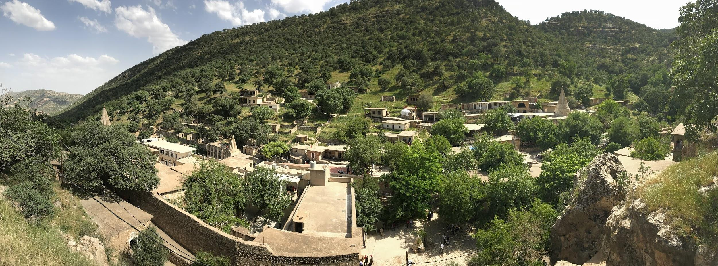
Navigating the Challenges of Talking to Survivors
A media discourse of victimhood that minimize the agency of Yezidis and the diversity of their experiences
Objectification of some survivors as “former sex slaves”
Abusive practices pursued by various actors when interviewing Yezidi survivors (i.e., instrumentalizing Yezidi suffering for private goals and gains)
In the light of these issues, we adopted an Intersectionality approach that gives explicit attention to intra-group differences and diversity. Moreover, we aimed to minimize risks for our interviewers. As such, we eschewed a focus on the ordeal of the survivors, employed gender-matching, used consent form as an asset, and emphasized the voluntary nature of the interviews. Finally, we espoused the notion of reciprocity - sharing our findings with the local community and not taking away the original materials.

Slide 8
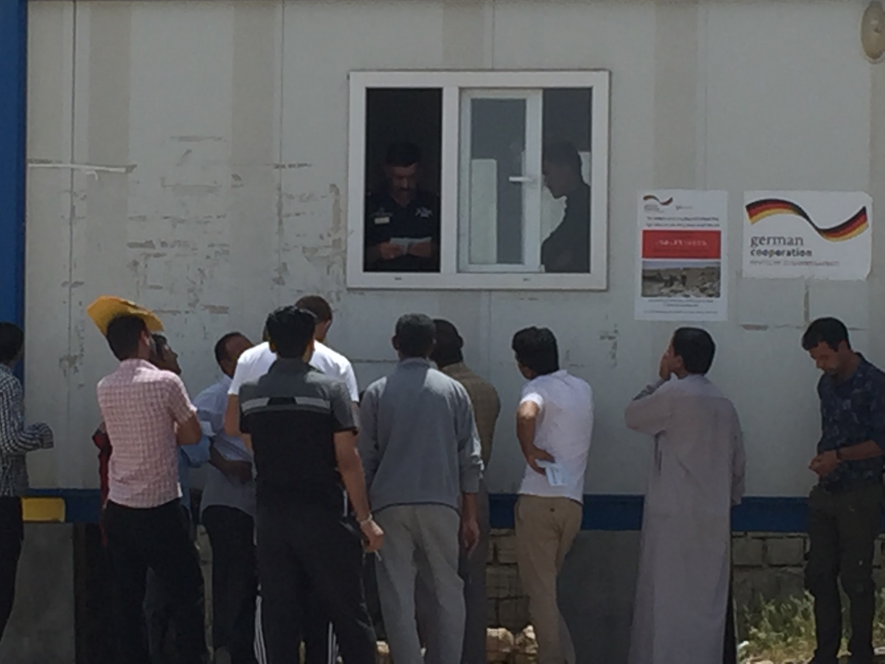
Navigating Power Hierarchies
Yazidis’ precarious existence and dependency on outsiders for survival (i.e., We refrained asking direct questions to displaced Yazidis residing in KRG controlled camps about the camp services and authorities)
Widespread mistrust of Sunni Muslims among Yezidis (i.e., It is more difficult to establish rapport with the community as a practicting Muslim).
Yezidi males waiting in front of an office in a camp

Slide 9
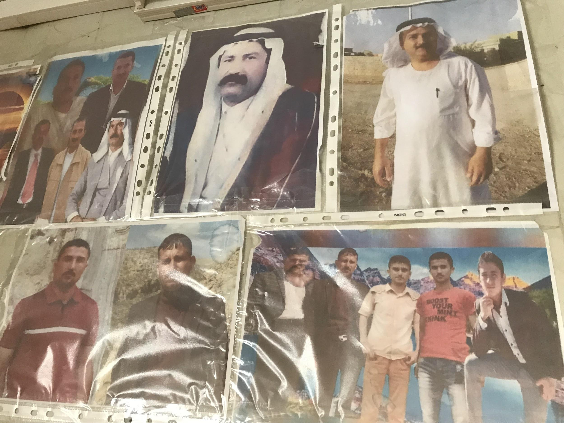
Reflective Thoughts on the Fieldwork
Making ethical decisions on-the-spot: There was an expectation of tangible benefit among some respondents. Yet paying individuals after interviewing them leads to unintended and undesirable consequences. Instead making a donation to a local NGO is a more sensible way to support the community.
Superficialness of ‘no-harm’ principle: The politics of victimhood generates incentives for the community to bring survivors to the forefront so that they can share their painful stories to receive international sympathy for the Yazidis. This dynamic may not only undermine the notion of individual informed consent, but also lead to retraumatization of survivors. Hence, it is essential to adopt a self-reflexive position that seeks constant empathy with the survivors.
How to develop a more engaged and responsible role as researchers? - We strive to give representation to the voices of the community so that “the world” knows and learns about their experiences.
Yezidis of Kocho -
murdered on August 15, 2014

Slide 10
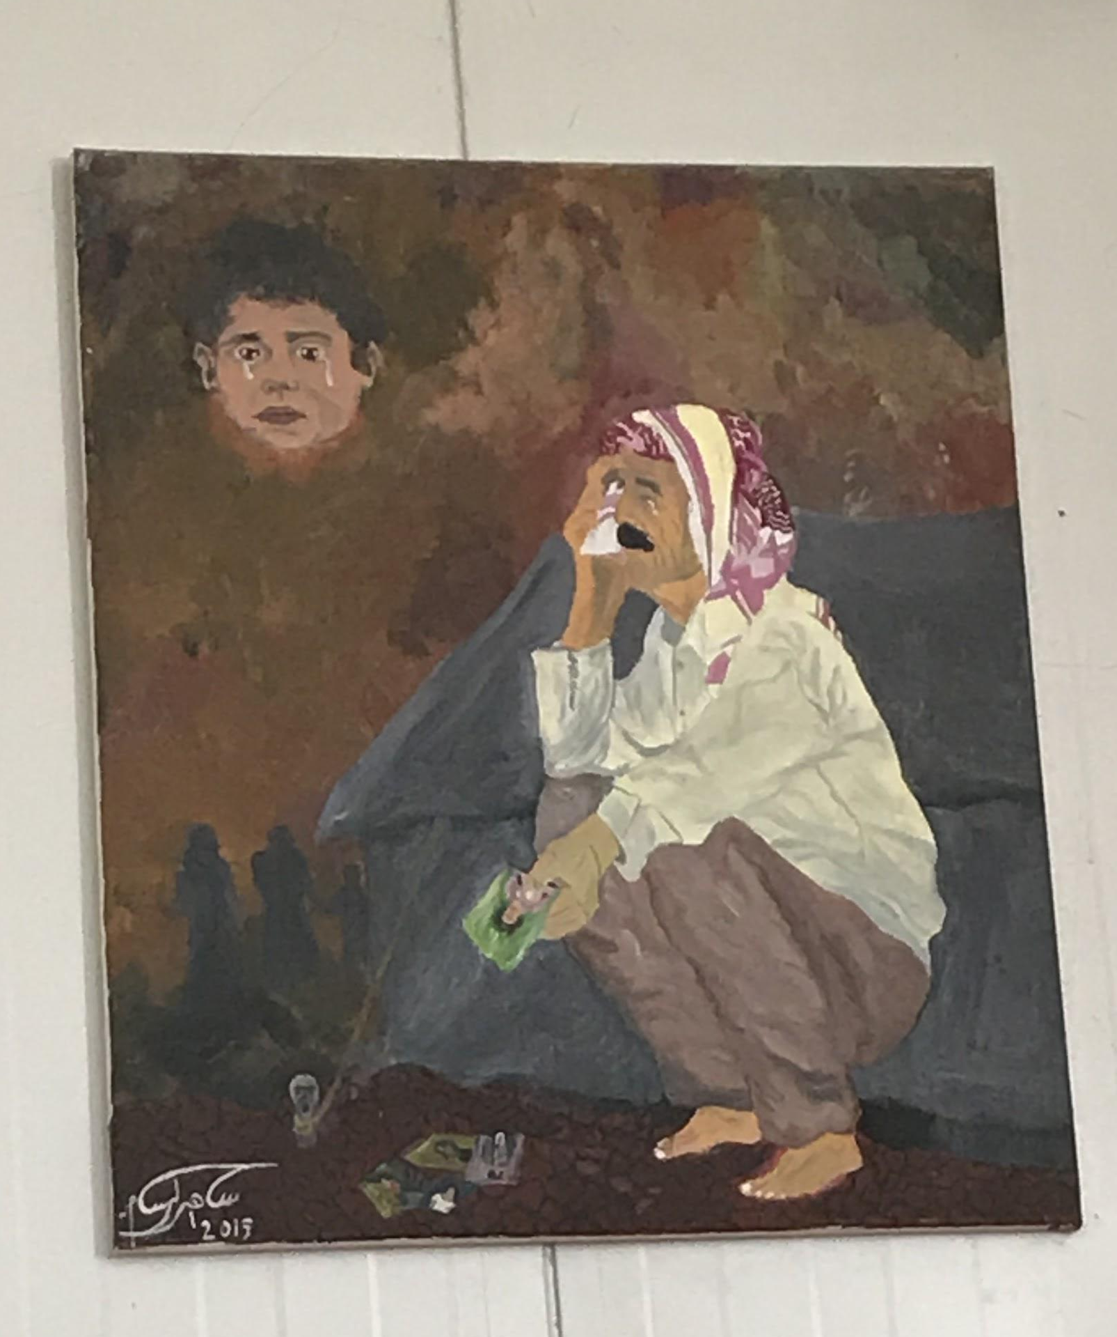
Findings - Transformation of Yezidi Identity
The general feeling of insecurity characterizing post-Saddam Iraq, the rise of Sunni extremism, the conflict between the KRG and Iraqi central government involving Yezidi lands, and the further fragmentation of the community via migrations and forced displacements have made it increasingly difficult, if not impossible, for Yezidis to seek political accommodation as a non-assertive minority group.
The genocidal attacks in 2014 has strongly reinforced this trend and contributed a proliferation of voices and platforms about distinctive Yezidi identity at local, national, and international levels. The Yezidi politics of recognition represents a major change in the community’s self-identification and representation given the long history of Yezidis as a liminal community lacking official recognition during the Ottoman times and widespread prejudices about their belief systems persisting until now.
At the same time, the rise of autonomous Yezidi politics is accompanied with an increasing fragmentation and dispersion within the community and an involvement of even greater number of external actors in Yezidi affairs. It is highly likely that the Yezidi diaspora, similar to the experiences of some other groups, such as Armenians and Alevis, would play an increasingly formative role in sustaining and shaping the collective identity.

Slide 11
Findings - Gender Relations among the Yezidis
The IS attacks led to the captivity of close to 7,000 Yezidi women and children. More than half of these captives were eventually liberated. This traumatic experience completely unsettled the community’s gender norms involving the embodiment of men’s and families’ ‘honor’ in women’s bodies. The Yezidi leadership made an unprecedented decision to welcome back liberated women to the community. This decision weakened the taboo about sexual violence and facilitated the rise of Yezidi women activist, including Nobel Laureate Nadya Murad.
At the same time, many of these women and girls continue to live with untreated trauma and in difficult conditions of displacement away from their homes. Some of these women have migrated to European countries and experiencing other difficulties such as being away from home and family, and adjusting to life in a different culture. Finally, the situation of children born to Yezidi women raped by their IS captors is a particularly delicate issue.
There are also indicators about the changing perceptions about women’s role and position in society among the Yezidi community. Some of the community members believe that empowering girls through enabling them to access education and jobs can provide them some form of protection. Moreover, displaced Yezidis gained access to new opportunities via the activities of women’s rights organizations and humanitarian organizations.

Slide 12
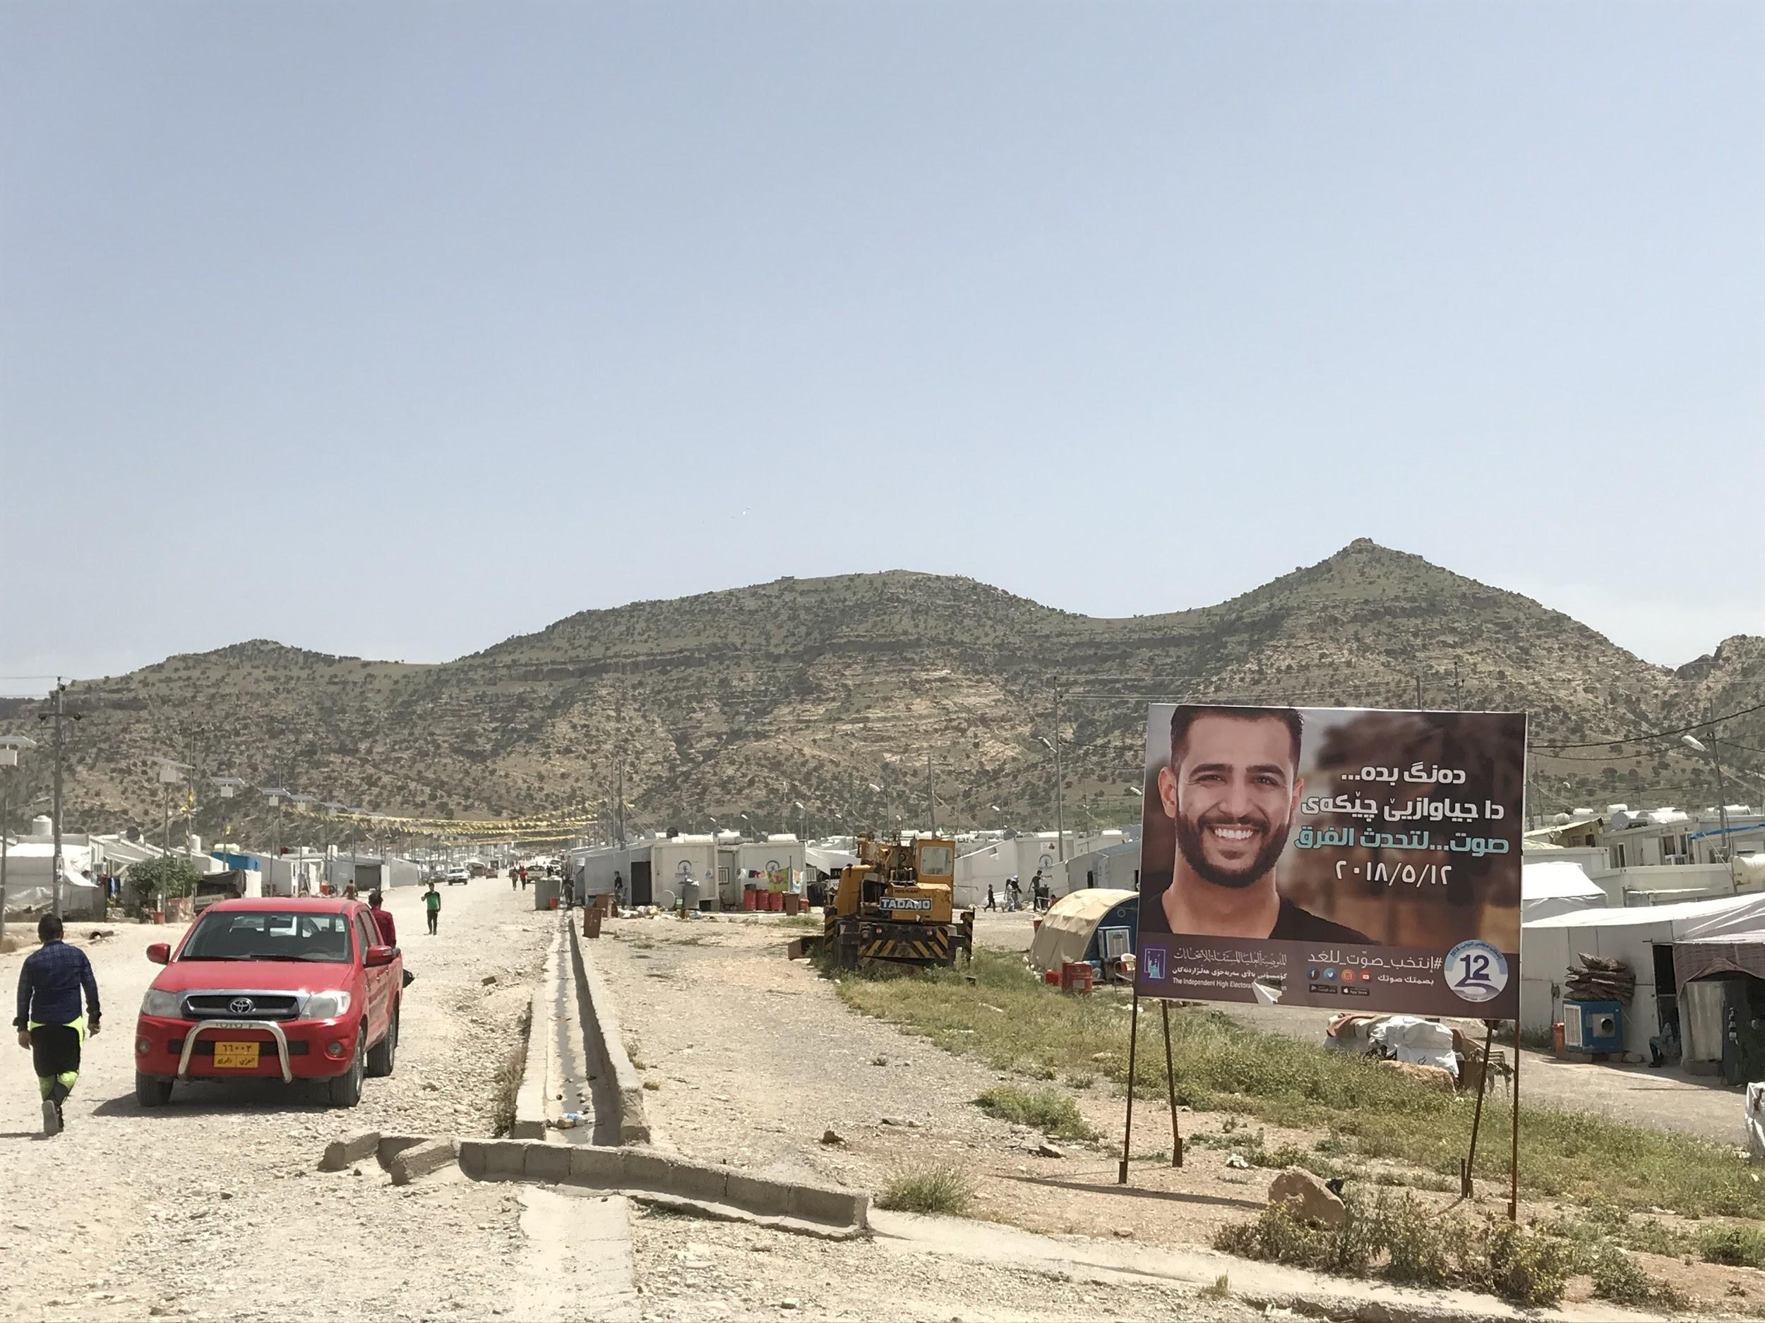
Findings - Gender Relations among the Yezidis (continued)
The tension between gender emancipation and group identity survival - gender hierarchies that demand young women to obey elder family members when making life choices (low levels of women’s educational attainment, labor participation and political representation; many women marrying before the age of 18 and remaining financially dependent on, and socially subordinate to, their husbands).
A significant number of Yezidi women gain access to unprecedented opportunities. Consequently, the ability of their families and community to control their choices diminishes, especially in the diaspora. Meanwhile, the lives of many Yazidi women, who lost not only their homes but also their fathers, husbands, and brothers, are more precarious than before.

Slide 13
Findings - Interreligious & Intimate Violence
The IS treatment of the Yezidis was vicious even by its own brutal standards. No other ethnic or religious group was as disproportionately affected from the IS waves of violence as the Yezidis.
A significant number of local people, many of whom were neighbors of Yezidis, actively took part in the atrocities. Attackers were no strangers to victims and continued to interact on a daily basis with them until the day of reckoning. Not only did they participate in lootings and shootings, but also enslaved Yezidi women and children for months and years.
The intimate nature of violence highly complicates inter-communal reconciliation in the long run. Even if IS was completely expelled from the Sinjar area by early 2017, local perpetrators continued to live in the area.
We aim to make sense of this intimate pattern of mass atrocities based on a code of religious difference.

Slide 14
Findings - Interreligious & Intimate Violence (continued)
The rise of Salafi-jihadism in northwestern Iraq since the 1990s was a catalyst that activated anti-Yezidi smears among large segments of the local Sunni population. When IS initiated its campaign of extermination against Yezidis in the summer of 2014, it capitalized on historical stereotypes about Yezidis that were widely available among the local people. Such stereotypes made mass execution, kidnapping, and conversion of the Yezidis justifiable in an environment of sectarian violence, which is post-2003 Iraq.
In northwestern Iraq, the 2003 invasion paved the way for the rise of Kurdish nationalism and provided some limited opportunities for Yezidis who were willing to join the Kurdish bandwagon. Yezidis became a crucial demographic bloc to the Kurdish claims over disputed territories in the Nineveh province, one of the most contested areas in the entire country. This political dynamic generated resentment among the Sunni Arabs and Turkomans who lost their privileged positions and increasingly perceived the Yezidis as the lackey of the Kurds
In this context, religious hatred (i.e., antagonism against a group by virtue of its purported core beliefs and innate characteristics) and political resentfulness become a combustible combination generating mass violence targeting the Yezidis.

Slide 15
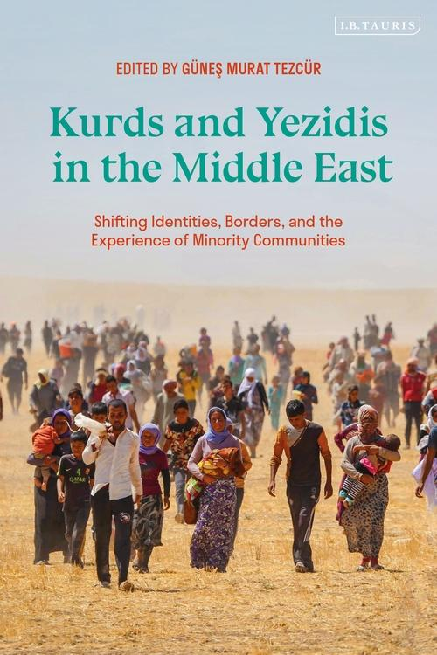
Scholarly Publications based on the Project -I
Güneş Murat Tezcür. Ed. (2021). Kurds and Yezidis in the Middle East: Shifting Identities, Borders, and the Experience of Minority Communities. London: I. B. Tauris.
This book diversifies the literature on Kurdish and Yezidi Studies by offering close analyses of subjects which have not been adequately researched, and in particular, by highlighting the Kurds' relationship to the Yazidis. Case studies include: the political ideas of Ehmede Xani; Yezidi and Kurdish refugees in camps in Iraq; the perception of the Kurds by Armenians in the late Ottoman Empire and the Turks in modern Western Turkey; and the important connections and shared heritage of the Kurds and the Yazidis, especially in the aftermath of the 2014 ISIS attacks.
The book includes two chapters based on the fieldwork conducted under this project:
Güneş Murat Tezcür, Zeynep Kaya, and Bayar Sevdeen. Survival, Coexistence, and Autonomy: Yezidi Political Identity after Genocide.
Tutku Ayhan, We are Yezidi, being otherwise never stopped our persecution': Yezidi Perceptions of Kurds and Kurdish Identity

Slide 16
Scholarly Publications based on the Project - II
Ayhan, Tutku, & Güneş Murat Tezcür. (2021). Overcoming “Intimate Hatreds:” Reflections on Violence against Yezidis. In Conceptualizing Mass Violence: Representations, Recollections, and Reinterpretations eds. Navras J. Aafreedi and Priya Singh. New York: Routledge.
Yezidis have a long history of persecution at the hands of local and imperial rulers fostering a strong sense of “victimhood.” Given this historical context, how could we make sense of the IS violence? This chapter addresses this question on the basis of original archival and field research involving documents in primary languages and dozens of in-depth interviews with a diverse group of Yezidis.
Zeynep Kaya. (2020). Sexual Violence, Identity and Gender: ISIS and the Yezidis. Conflict, Security & Development, 5, 631-52.
The article focuses on ISIS’s sexual and gender-based violence against the Yezidis and contextualises this case within wider long-term gender- and identity-based structural inequalities that facilitate sexual violence in conflict.
Zeynep Kaya. (2019, November). Iraq’s Yazidis and ISIS: The Causes and Consequences of Sexual Violence in Conflict. London School of Economics Middle East Centre Report.
Preventing sexual violence in conflict is not possible without tackling the underlying structural factors that foster this form of violence. ISIS’s attacks on the Yazidis showed again that gender (and gendered violence) is a key component of the politics of violence and cannot be reduced simply to an outcome of conflict.

Slide 17
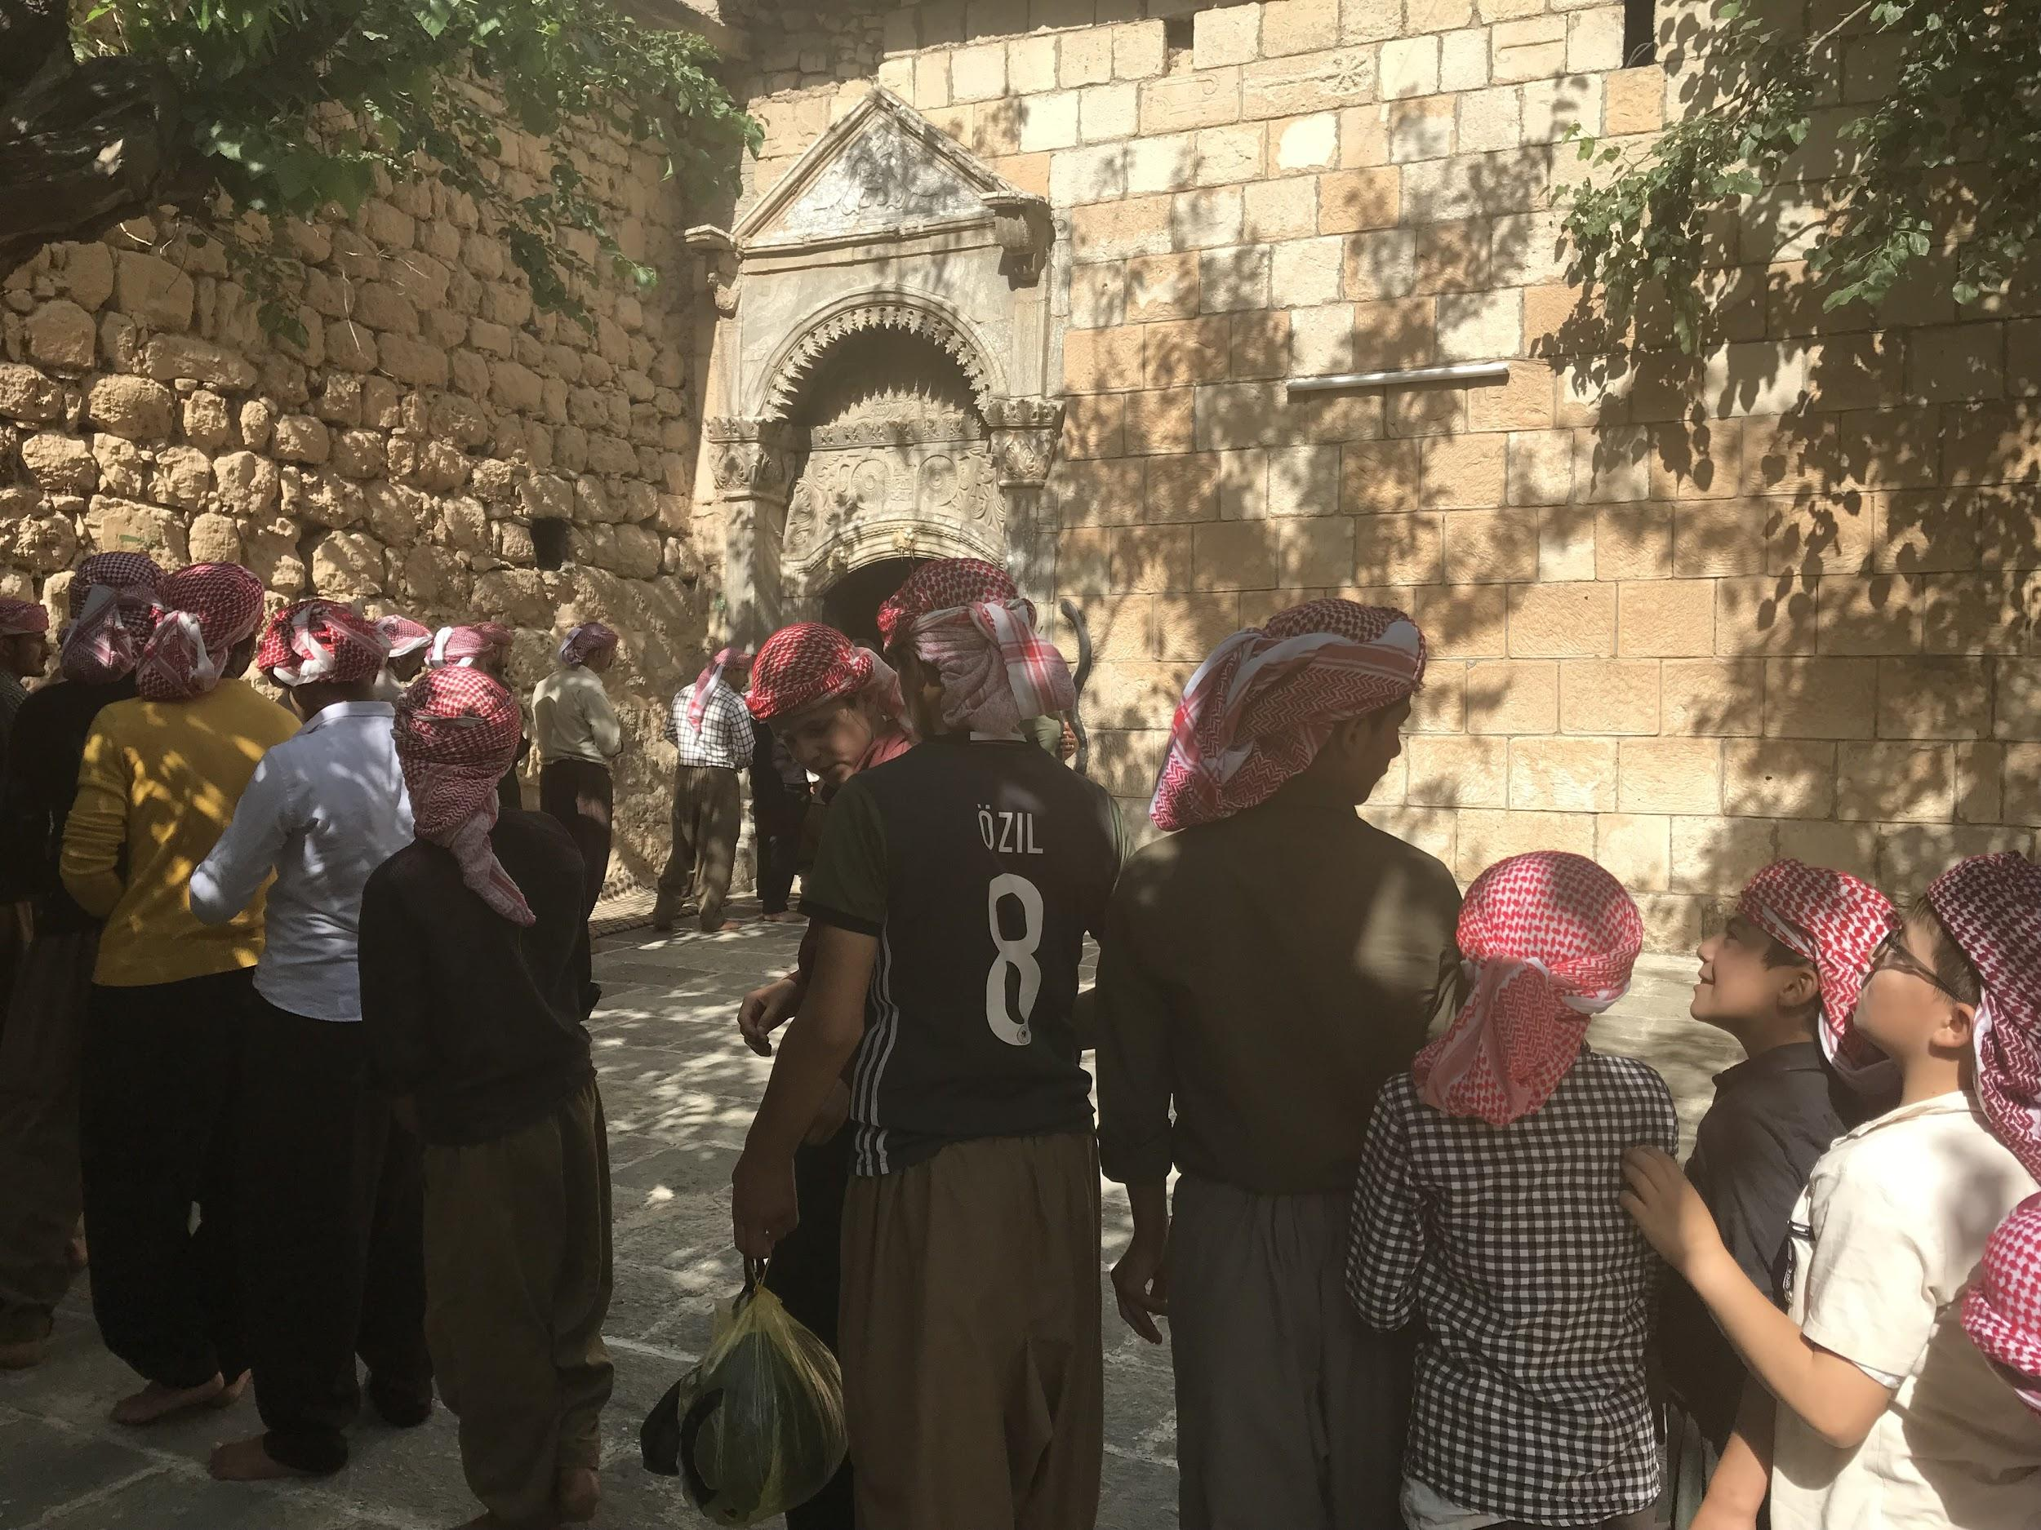
Scholarly Publications based on the Project - III (in progress)
A book manuscript titled Liminal Minorities: Religion and Violence completed by Tezcür
Liminal Minorities are groups whose core religious beliefs and practices remain ambivalent, ill-defined, and stigmatized in the eyes of elite and ordinary members of a dominant group. They tend to lack official and theological recognition from a dominant religious group. They are also subject of widespread stigmatization, which reflects social, political, or economic power asymmetries.
Religious beliefs demeaning members of liminal minorities contribute to their dehumanization. Consequently, these groups remain vulnerable to religiously sanctioned extreme forms of violence and certain repertoires of violence including sexual attacks.
Yezidis in Lalish

Slide 18
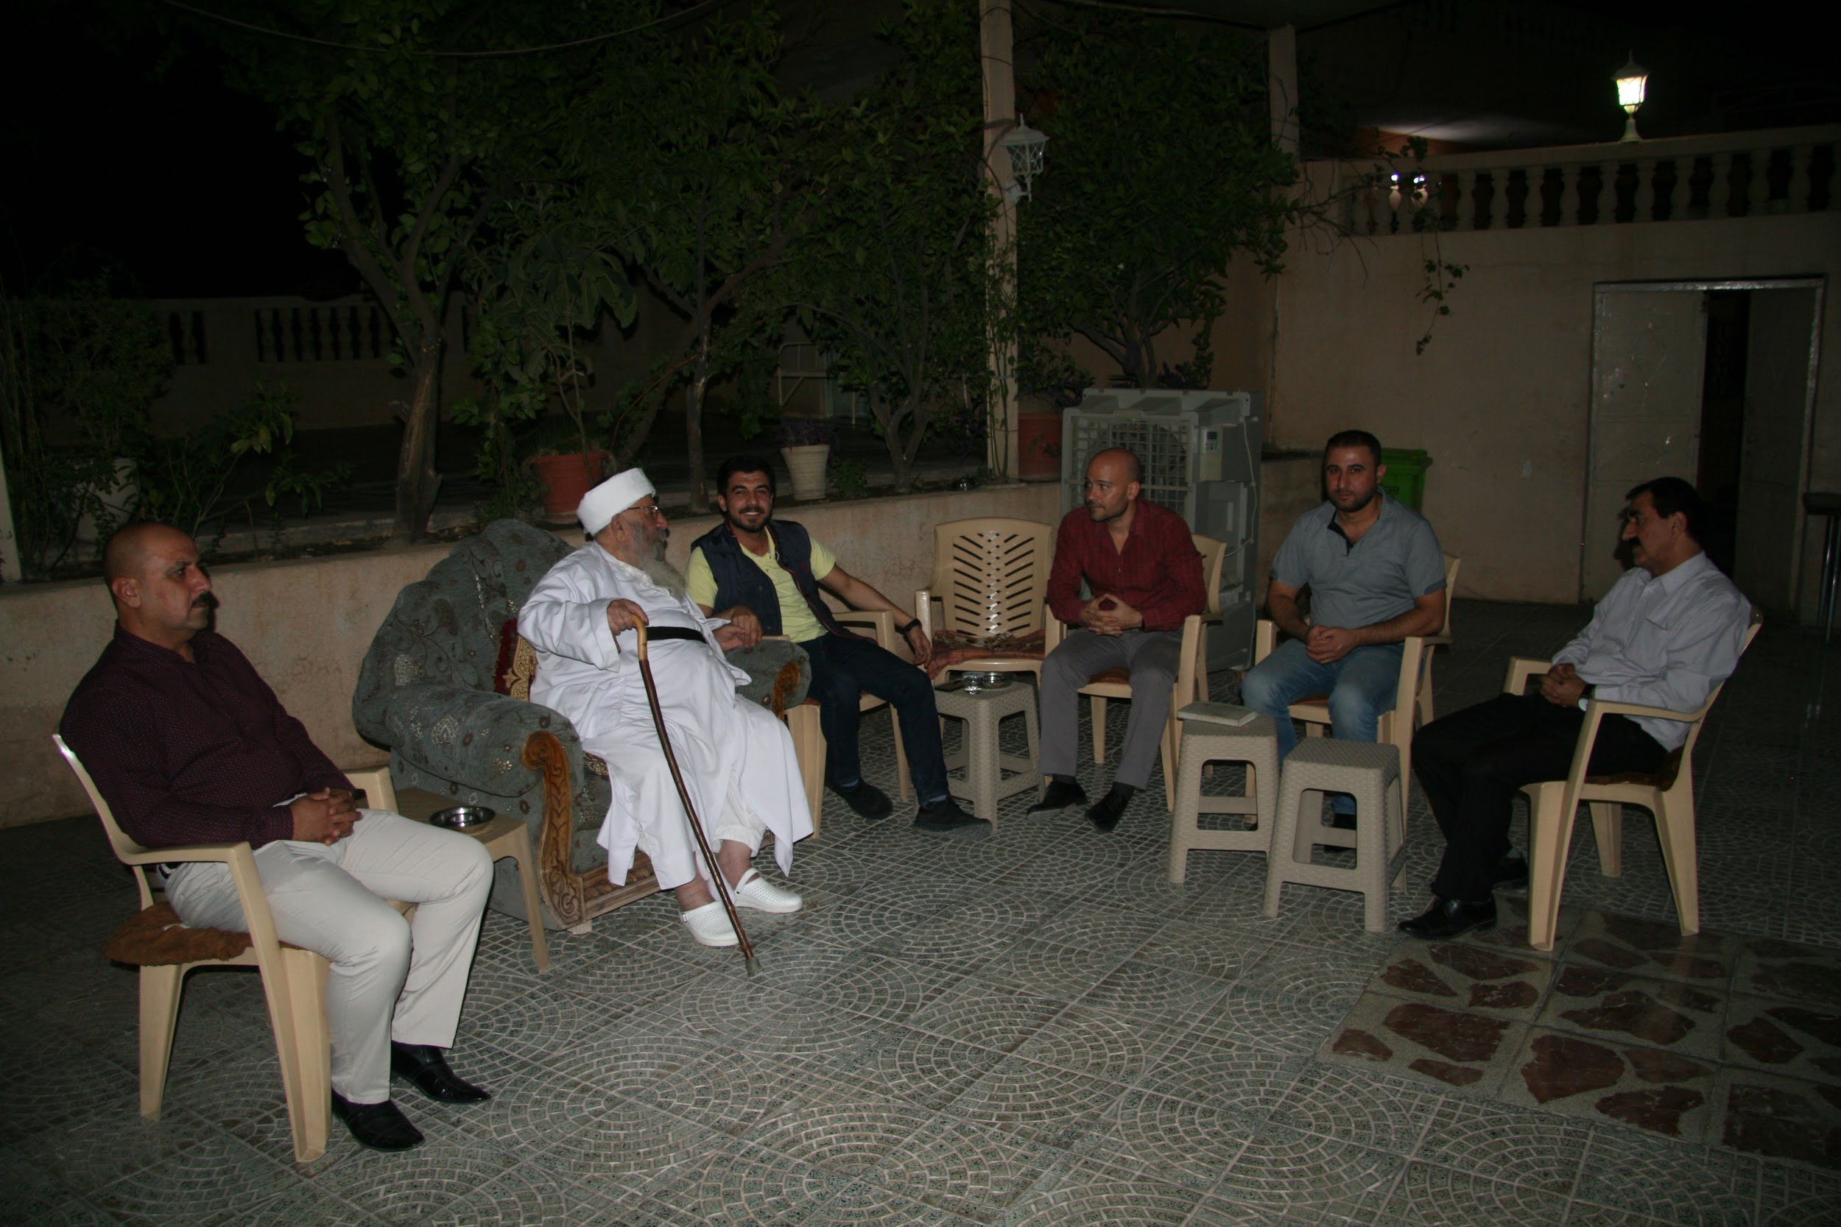
Yezidis as a Liminal Minority & Politics of Recognition
Religious liminality is primarily about how mainstream religious tradition, and not just niche and extremist interpretations, constructs a “deviant” group. Consequently, the antidote against violence targeting these groups is “less about pacifying ‘deviants’ and more about changing the central values” of a religious community.
Other liminal minorities include Alevis in Turkey, Baha’is in Iran, and Ahmadis in Indonesia and Pakistan.
A paradoxical and relatively positive consequence of IS’ genocidal campaign was the unprecedented international attention the Yezidis has attracted. The genocidal violence led to the global recognition of Yezidis as a persecuted religious minority par excellence deserving dignity and protection. It remains to be seen if this global recognition and widespread sympathy would mean a less precarious existence for Yezidis remaining in Iraq.
Tezcür having a meeting with Baba Sheikh, Yezidi religious leader, who passed away in 2020.

