Slide 1
What Stymies Action on Climate Change?
Religious Institutions, Marginalization, and Efficacy in Kenya
published in Perspectives on Politics (2021)
by
Lauren Honig Amy Erica Smith Jaimie Bleck
Boston College Iowa State University University of Notre Dame
Lauren.honig@bc.edu aesmith2@iastate.edu jbleck@nd.edu
This research was supported by the Project Launch Grant from the Global Religion Research Initiative of the University of Notre Dame
Project titled: “Keepers of the Garden: Abrahamic Religions and Support for Environmental Protection in Brazil and Kenya,” Amy Erica Smith and Lauren Honig

Slide 2
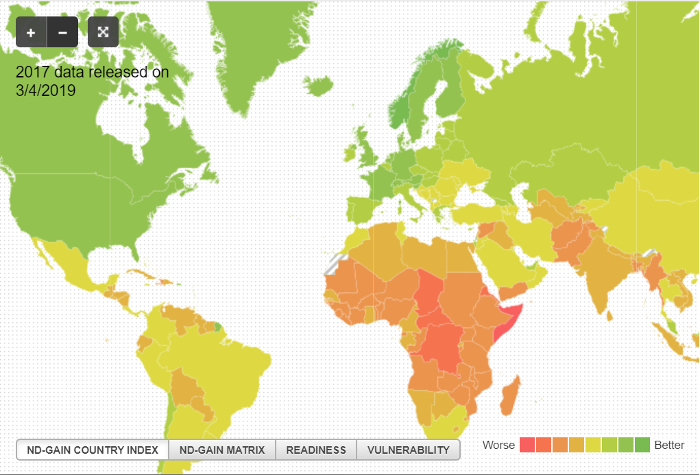
Motivation
Addressing climate change requires coordinated policy responses that incorporate the needs of the most impacted populations.
Globally, communities that had little role in creating climate change are bearing the brunt of its effects.
Even in a country with a long history of environmental activism and exposure to climate change, some communities may remain on the sidelines.
What stymies action on climate change?

Slide 3
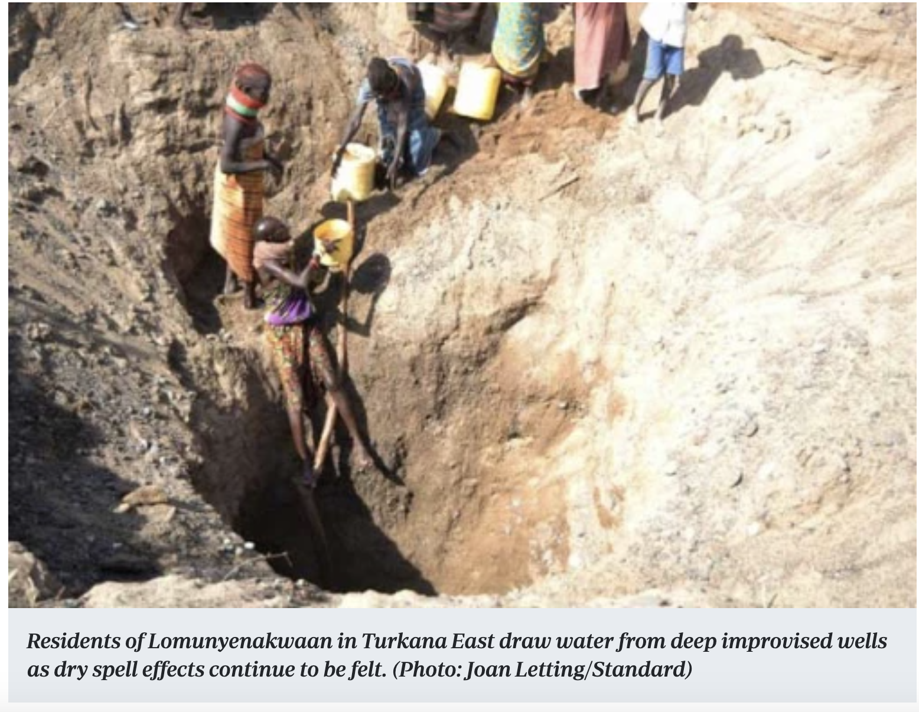
Kenya
Highly Impacted By Climate Change
Strong history of environmental activism
Kenyans have a high vulnerability to climate change; in recent years, the country has experienced many extreme weather events, from droughts to deadly floods.
Prof. Wangari Maathai,
founder of the Green Belt Movement in Kenya
Source: https://wangarimaathai.org/

Slide 4
Research Design
Qualitative Data Collection and Analysis (2018)
Catholic, Pentecostal, and Muslim congregations
Three field sites: Nairobi Center, Dandora, Coast (Kilifi)
16 clergy interviews
9 focus groups (79 congregants)
Coded transcripts
Questions focused on the connections between religious communities and climate change responses
Quantitative Data Analysis
Afrobarometer 2016
National public opinion poll of 1,599 Kenyans

Slide 5
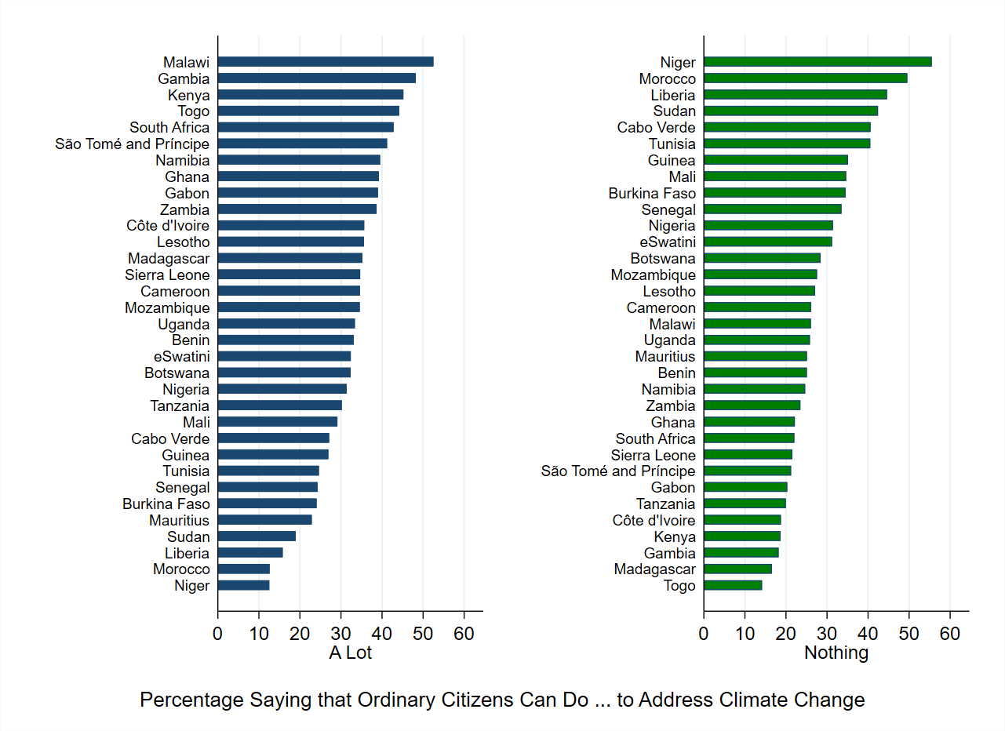
Kenyans have high beliefs in their ability to impact climate change
Source: Afrobarometer Round 7 (2016).

Slide 6
Scientific beliefs about climate change are similar across religious groups in Kenya
The question of whether climate change is anthropogenic or instead results from natural—or even supernatural—processes is a central divide in global public opinion on the environment. However, the qualitative and quantitative findings show that these beliefs do not differ among religious communities in Kenya.
In qualitative interviews, religious leaders unanimously agreed, as did participants in eight of nine focus groups, that the weather was changing, interpreted as part of a broader pattern
There was no evidence of differences among Catholic, Pentecostal, and Muslim religious groups in their causal attributions for these changes in weather. Across religious groups, clergy provided strikingly consistent explanations of climate change.
Every leader interviewed reported that changing weather resulted from human behavior, including phenomena such as charcoal burning, deforestation, and air pollution. All clergy, including imams, pastors, and priests, said they talked about climate change with congregants.

Slide 7
Scientific beliefs about climate change are similar across religious groups in Kenya
Afrobarometer (2016)
61% of respondents saw human behavior as the sole cause of climate change
14% attributed climate change to both human and natural causes
25% attributed it to natural processes or other factors
There are no statistically significant differences between Christians, Muslims, and the non-religious in such beliefs.

Slide 8
Adverse Climate Impacts Reported
The qualitative sample of religious communities included the urban localities of Dandora, Kileleshwa, and Westlands (Nairobi) as well as the rural county of Kilifi. Across different livelihoods and socio-economic levels at these research sites, there was universal agreement that the weather has been changing
In Dandora, respondents reported experiencing and observing climate change through: earlier cold seasons, colder cold seasons, extreme heat during dry seasons, less sunlight, stronger sunlight, early rains, heavy (or “too much”) rains, flooding, drought, dying wildlife, landscape changes, and uneven seasons. They connected these changes to: more illness, more malaria, air pollution/difficulty breathing, and less food.

Slide 9
Adverse Climate Impacts Reported
In Kilifi, respondents reported experiencing and observing climate change through: drought, flooding, insect pests, unpredictable amounts of rain, changes in the direction of rainfall, unusually high and low temperatures, less water access, changes in air quality, increased wind, poor agricultural harvests, increases in fish diseases and stocks, dying wildlife and livestock, and changes in the timing of planting seasons.
In the Nairobi estates of Westlands and Kileleshwa, respondents reported experiencing and observing climate change through: drought, extreme heat, flooding, heavy rain, abnormal rain patterns, dry lakes, unusual bird migrations, irregular sun, increased temperatures, decreases in fish stocks, changes in sunlight, extreme temperature decreases, unpredictable seasons, short growing seasons, wildlife dying, air pollution, mosquitos, water and food shortages, and less fruitful land.
In the quantitative analysis, pastoralists and those with lower levels of education expressed greater concern about a worsening climate and climate-related impacts. Residents of Eastern, Northeastern, and Coast provinces also reported more severe climate impacts.

Slide 10
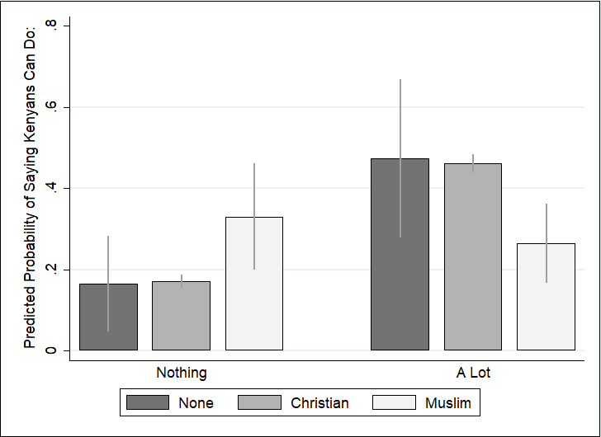
Beliefs about the ability to combat climate change differ across religious groups
Environmental Efficacy=
beliefs about the ability to combat climate change
Muslims express much lower belief in their ability to address climate change than other religious groups in Kenya
Environmental Efficacy, by Religious Affiliation
Notes: Estimates from Model 1 of the research article. 90% confidence intervals shown.
Source: Afrobarometer Round 7 (2016).

Slide 11
Beliefs about the ability to combat climate change differ across religious groups
In multivariate statistical analyses, non-religious and Christian respondents have identical levels of environmental efficacy: nearly half said that ordinary Kenyans could do a lot to impact climate change, and about a third thought they could do nothing.
Muslims, however, are twice as likely as other groups to say that they could do “nothing” about climate change, and half as likely to say that they could do “a lot,” even after controlling for a wide range of demographic factors including ethnicity, region, urban/rural, wealth, and education.

Slide 12
Why do Muslims Have Lower Environmental Efficacy?
Is it due to….
Difference in issue salience? No.
Difference in beliefs? No.
Difference in ethnicity? No.
Difference in relationship with the state? Yes.

Slide 13
Argument: Feelings of disempowerment and marginalization within the state discourage environmental activism

Slide 14
Evidence that Marginalization Stymies Efficacy
Qualitative Evidence:
Catholic and Pentecostal leaders expressed comparatively strong ties to politicians. They described the ease of contacting MCAs (Members of County Assemblies) and collaborative initiatives with the government. Congregants described the state being responsive to the Catholic Church. Others saw their churches as partners with the government on climate change issues.
Insights from members of Christian churches differed from Muslim communities. Every Muslim leader interviewed expressed alienation and distance from politicians; this was a constant across ethnic groups and locations in urban Nairobi or rural Kilifi. They described the challenges of contacting state leaders and having their voices heard.
Members of Muslim focus groups could not envisage collaborative or responsive state actors. Perceived oppression and state neglect seems to erode Kenyan Muslims’ sense of environmental efficacy, as individuals expect the state to stymie or be unresponsive to their activism.

Slide 15
Evidence that Marginalization Stymies Efficacy
As an imam said,
“The ways in which we are able to communicate to them becomes a problem..., because most of the time finding them is not easy and most of the time there is a very big gap between the political and religious leaders except for the time they need prayers only; when someone wants to be sworn in as president you are called to pray for them but other times you can’t find them....Politicians, we can use them only the time when they come to the church or mosque.”

Slide 16
Evidence that Marginalization Stymies Efficacy
As a Pentecostal pastor said,
“[Y]ou see the church as an organization is not just independent, it works in the nations and in the countries where the governments do also work. So the church has a percentage of contribution to help the community to have good life and the government is also concerned in the provision of good life of the community..., so what I think is that it’s good that they work hand in hand.”

Slide 17
Evidence that Marginalization Stymies Efficacy
The statistical analysis of survey data supports the claim that a group’s relationship with the state could impact their beliefs in their ability to combat climate change.
The analysis shows that moving from the minimum to the maximum level of trust in the state raises Muslims’ predicted probability of reporting high environmental efficacy from .12 to .45, and it is associated with a drop in the probability of reporting low efficacy from .54 to .17.
However, attitudes toward the state only matter for Muslims. A respondent’s relationship with the state does not impact beliefs in the ability to combat climate change for other religious groups.

Slide 18
Evidence that Marginalization Stymies Efficacy
Trust in State Leaders Boosts Environmental Efficacy Among Muslims
Notes: Estimates from Model 4 of the research article. 95% confidence intervals shown.
Source: Afrobarometer Round 7 (2016).

Slide 19
Conclusions
Policymakers, government, and NGOs should actively engage with marginalized communities in the design of climate change policy solutions, as they may be less likely to participate.
Our analysis suggests that groups that are highly concerned about climate change may remain on the sidelines due to experiences of marginalization.
In addition to members of Muslim religious communities, we also observe this result in the plight of pastoralists, who are highly impacted by drought and climate instability, but were significantly less likely to say that they could effect change.
If the most vulnerable populations are less likely to organize collective action, climate change policy is unlikely to respond to their specific needs. In designing climate change solutions, it is critical to identify citizens who may be systematically less likely to engage.

Slide 20
Acknowledgements
This research was funded by a Project Launch Grant from the Global Religion Research Initiative of the University of Notre Dame.
The authors are grateful for institutional support from the British Institute in Eastern Africa (BIEA) and the National Commission for Science, Technology & Innovation (NACOSTI).
This research was reviewed by NACOSTI as well as the IRBs of Iowa State University and Boston College.
Mercy Ngao and Melda Munyazi provided excellent translation support and research assistance. The authors are grateful to the religious clergy and congregants who shared their perspectives on climate change, their experiences, and their time for this research.

Slide 21
For further details, please see:
“What Stymies Action on Climate Change? Religious Institutions, Marginalization, and Efficacy in Kenya,” published in Perspectives on Politics (2021) by Lauren Honig, Amy Erica Smith, and Jaimie Bleck.

