Slide 1
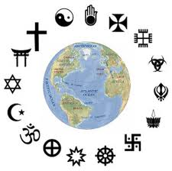
RELIGIOUS IDENTIFICATION IN GLOBAL PERSPECTIVE
BY K. Amber Curtis, PHD
Department of Political Science
Clemson University
2019-2020 GRRI BOOK LEAVE FELLOWSHIP

Slide 2
POINT OF DEPARTURE
Social psychology distinguishes between identity, an abstract category of potential group membership, and identification, which reflects how subjectively important an identity is to someone (Brubaker and Cooper 2000; Castano et al. 2002; Stets and Burke 2000; Tajfel 1982; Turner et al. 1987).
Identification, also known as centrality, is defined as:
“the centrality of a particular social group membership to the individual’s sense of self and the meaning that is derived from that identity” (Brewer 2001: 118)
“the importance or psychological attachment that individuals place on their identities” (Settles 2004: 487)
“the extent to which people consider their group identity to be an important part of their self-concept” (Kachanoff et al. 2016: 564)

Slide 3
PREVIOUS WORK
Curtis & Olson (2019b) outlined significant discrepancies in how “religious identity” has been operationalized across scholarly disciplines, noting a paucity of theoretical & empirical investigation into the social-psychological construct of identification with religion and a tendency to conflate the term “identification” with nominal religious affiliation (e.g., Djupe, Neiheisel, and Sokhey 2018; Hayes 1995; Jelen 1993; Leege and Kellstedt 1993; Margolis 2018).
Curtis & Olson (2019a) proposed a two-fold measure of psychological identification with religion, which they then assessed in three European countries [Germany, Poland, and the United Kingdom].
Curtis & Olson (forthcoming) probed identification with religion in a majority-Muslim context [Turkey], confirming its high variability and polarization.

Slide 4
OVERARCHING ARGUMENT
Extant studies conflate religious identity/identification; even those that do not predominantly use identification to explain other outcomes.
MY CONTRIBUTION = FLIPPING RELIGIOUS IDENTIFICATION TO A DEPENDENT VARIALBE WORTHY OF EXPLANATION IN ITS OWN RIGHT!
Religion’s relevance for how one chooses to define him/herself is conceptually and empirically distinct from whether and how they self-categorize, and from how generally important they report religion to be in their everyday lives.

Slide 5
OVERARCHING ARGUMENT, CONT’D
Religious identification is also inherently subjective, meaning that one may identify strongly with “religion” even if they do not affiliate with an organized tradition.
Studying identification with religion in cross-national and cross-cultural context is especially important, not only to gain generalizable insights but also because of the strong U.S.- and Western-focused bias in much of the extant literature on religious identity and religiosity (Smith et al. 2013).

Slide 6
UNDERLYING AGENDA
Why is religion a more salient social identity for some people than others?
What explains why some individuals highly prioritize being “a religious person” while others do not identify with religion at all?
Where does religion rank in comparison to other identity alternatives?
Are the roots of religious identification shaped primarily by individual characteristics, social network influence, or contextual circumstances?

Slide 7
CONCEPTUALIZING RELIGIOUS IDENTIFICATION
I investigate two dimensions of identification (per Curtis & Olson 2019a):
1) Independent importance: independent strength of religious identification (i.e., how strongly one identifies with their religion in general)
2) Relative prominence: the degree to which religious identity is valued or prioritized above other identity alternatives (i.e., the extent to which religious identity is—or is not—the most important identity one holds)
These are critical to know for two reasons:
Nominal religious affiliation isn’t necessarily indicative of having internalized a religious identity (Hackett 2014)
In an era of “fuzzy fidelity” (Voas 2009), psychologically identifying with religion isn’t contingent on affiliating with any specific religious group or organization

Slide 8
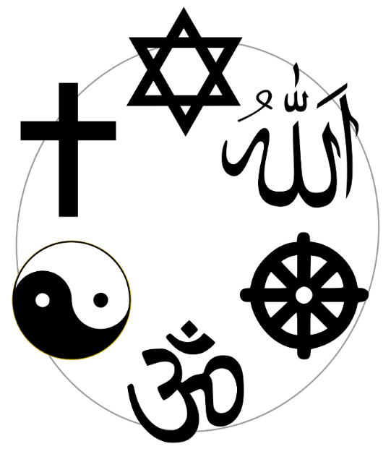
RESEARCH DESIGN
I adopted a comparative, quantitative approach compiling original, nationally representative public opinion surveys in 9 countries across 6 world regions administered online by the polling firm Opinium LLP:
Argentina (February 2016; n=2,004)
Germany (May 2015; 2,002 adults)
India 2019 (January 2020; 2,001 adults)
Japan 2019 (January 2020; 1,500 adults)
Nigeria 2019 (December 2019; 1,007 adults)
Poland 2015 (May 2015; 2,002 adults)
Turkey 2018 (August 2018; 2,007 adults)
United Kingdom (May 2015; 1,020 adults)
United States (June 2019; 1,002 adults)

Slide 9
CASE SELECTION
These nine country cases were strategically selected for multiple reasons:
They maximize variation in aggregate religiosity (see Figure 1).
They exhibit varying levels of religious diversity while together encompassing all major world religions.
They span a wide variety of cultural, historical, and political relationships with religion.
They enable me to directly compare non-Western to Western contexts.

Slide 10
FIGURE 1: AGGREGATE RELIGIOSITY
Figure 1. Cross-National Variation in Aggregate Religiosity
Note: Data from http://www.pewglobal.org/2008/09/17/chapter-2-religiosity/ (accessed 10/7/18)

Slide 11
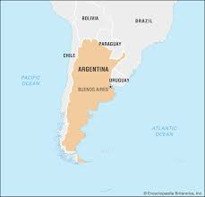
ARGENTINA
Located in Latin America
Chiefly Roman Catholic country yet home to many Protestants as well
Its array of economic, political, and social struggles over the past several decades have led some to question whether Argentinians’ high levels of religiosity hinder the adoption of the democratic values arguably necessary for prosperity and regime stability (Patterson 2004)

Slide 12
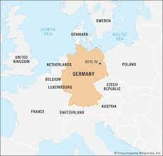
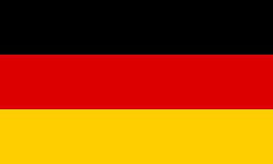
GERMANY
Located in Europe
Birthplace of the Protestant Reformation
Internal division: Many West German citizens proclaim themselves to be of a Judeo-Christian denomination (Pew Research Center 2012), while citizens in East Germany—where secularism was heavily enforced until reunification in the early 1990s—exhibit far lower religiosity (Pollack and Pickel 2007)

Slide 13
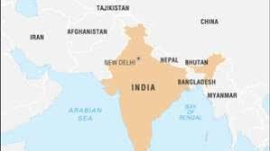
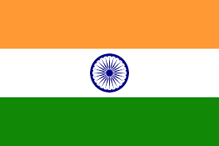
INDIA
Located in Asia
One of the most religiously diverse countries in the world, although its predominant religion is Hinduism (CIA 2016)
State-imposed restrictions on religious practice and social hostilities based on religious affiliation are both high in India (Lipka 2017)
Religious identity is related to caste status in complicated ways (Thorat 2010; Waughray 2010)

Slide 14
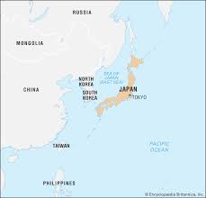
JAPAN
Located in Asia
Has a deeply religious history with the indigenous Shinto and Buddhist traditions at its core, but is largely secular today (Coslett 2015)
According to a recent WIN/Gallup poll, Japan is the second-least religious country in the world (Smith 2017b)

Slide 15
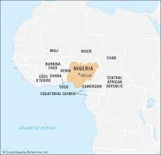
NIGERIA
Located in Africa
Nearly evenly split between Muslims and Christians, plus 1.4% “folk religions” and a handful of others (Pew: “Religion in Nigeria”); religiosity is extremely high
It is deemed “a volatile religious fault line” (Pew: “Tolerance and Tension”) and has received significant attention for religiously-motivated violence by the extremist group Boko Haram (Wilson 2018)

Slide 16
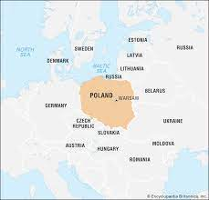
POLAND
Located in Eastern Europe
Despite official suppression of religion during the Cold War, Poland’s Catholic identity has survived well into the post-communist era
Most citizens today report being highly religious (Byrnes 2001)

Slide 17
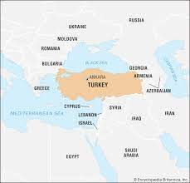
TURKEY
Located in the Middle East
Nearly 100 percent of citizens are nominally Muslim, with a mix of Sunni, Shi’a, and Alevi adherents (CIA World Factbook 2016), yet strict secularism was enacted starting in1928
While Turkish laïcité has typically been incredibly strict, Turkey is undergoing a complex and rapidly changing relationship with religion—especially since since Recep Tayyip Erdoğan came to power (Azak 2010; Dressler 2010; Kaya 2013; Keyman 2010; Kuru and Stepan 2012; Warhola and Bezci 2010)

Slide 18
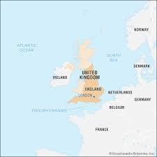
UNITED KINGDOM
Located in Western Europe
Features the established Church of England yet has a sizeable Muslim minority thanks to post-colonial migration (Davie 1994; Norris and Inglehart 2011)
UK citizens are increasingly nonreligious, causing debates over removing religion from public life to rage (Bingham and Swinford 2015)

Slide 19
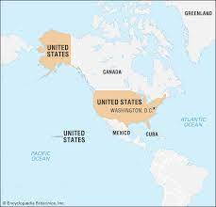
UNITED STATES
Located in North America
Religion remains much more prominent than most other Western countries but is still an escalating source of division, especially with the rise of the “nones” (Djupe et al. 2018; Layman 2001; Lim et al. 2010; Putnam and Campbell 2010; Smidt et al. 2009, 2010)

Slide 20
MEASURING RELIGIOUS IDENTIFICATION: 2 WAYS
“We are all part of different groups. Some groups are more important to us than others when we think of ourselves. How important are each of the following in describing how you personally see yourself?” [your religion]
Importance: 1 (do not identify with it at all) to 7 (identify with it very strongly)
Prominence: subtracts Importance from one’s mean level of 14 other identity alternatives (e.g., gender, age, race/ethnicity, occupation, nationality, etc.)

Slide 21
MULTIVARIATE ANALYSIS TO EXPLAIN EACH ASPECT OF IDENTIFICATION
I conduct pooled cross-national regression with country fixed effects to assess the extent to which Importance and Prominence are determined by three categories of explanatory factors:
Level 1: Individual level attitudes & characteristics (e.g., existential insecurity, risk aversion, religious affiliation, Big Five personality traits, sociodemographics)
Level 2: Social network composition & influence
Level 3: Contextual factors (e.g., state support of religion, national economic insecurity, ethnolinguistic & religious diversity, etc.)
This not only enables me to test which level holds the most explanatory power, but also to examine whether and how macro-level environments condition individual-level effects

Slide 22
BOOK MANUSCRIPT STATUS
All data collection is finished
Statistical analysis is complete for 6/9 countries
Severe disruptions caused by the Covid-19 pandemic delayed data coding and analysis for the remaining 3 countries
Final manuscript on target for completion by December, 2021
I plan to submit the book manuscript for publication at Oxford or Cambridge University Press

Slide 23
SUMMARY OF MAIN FINDINGS SO FAR
In all places, religious identification is the most highly variable of 15 different identity options. In other words, people tend to either identify with it extremely strongly or not at all (underscoring why that religion is particularly controversial and polarizing).
Regardless of the religious tradition with which one identifies, this variance is best explained by certain personal characteristics coupled with social network influence.
I confirm that religious identity becomes more salient under conditions of perceived threat (Jetten et al. 2001; Peek 2005) and is prioritized when it is achieved rather than ascribed (Ammerman 2003; Cadge and Davidman 2006; Hammond 1988; Parsons 1982).

Slide 24
SUMMARY OF MAIN FINDINGS SO FAR, CONT’D
Crucially, I show that cultural and national differences are much less important than typically assumed; strong religious identifiers share far more in common with one another worldwide than they do with weak- or non-identifiers within their same country or religious group—which is counterintuitive given that the practices, motivations, and expressions of religiosity as social identity vary across different religions (Cohen et al. 2005).
Altogether, my book brings a new perspective to the study of belonging—one of the four dimensions that comprise people’s overall orientations to religion (Saroglou 2011)—while heeding the call to bring a more global focus to systematic studies of religion (Smith et al. 2013).

Slide 25
OVERARCHING CONTRIBUTIONS
At the theoretical level, my book illuminates the predictors of strength and salience of religious identification in comparative perspective while highlighting ways in which individual identification with religion is similar to or distinct from that associated with other types of identities.
At the practical level, it offers a guide to policymakers grappling with publics that are divided over religious differences. By better comprehending the drivers of religious identification, politicians and lawmakers will be able to predict how different individuals will think and act politically based on the intensity of their (non)identification with religion. Ideally, this will help them find ways to bridge the ever-growing gap between those who are religious and those who are not.

Slide 26
QUESTIONS?
acurti2@Clemson.edu

