Slide 1
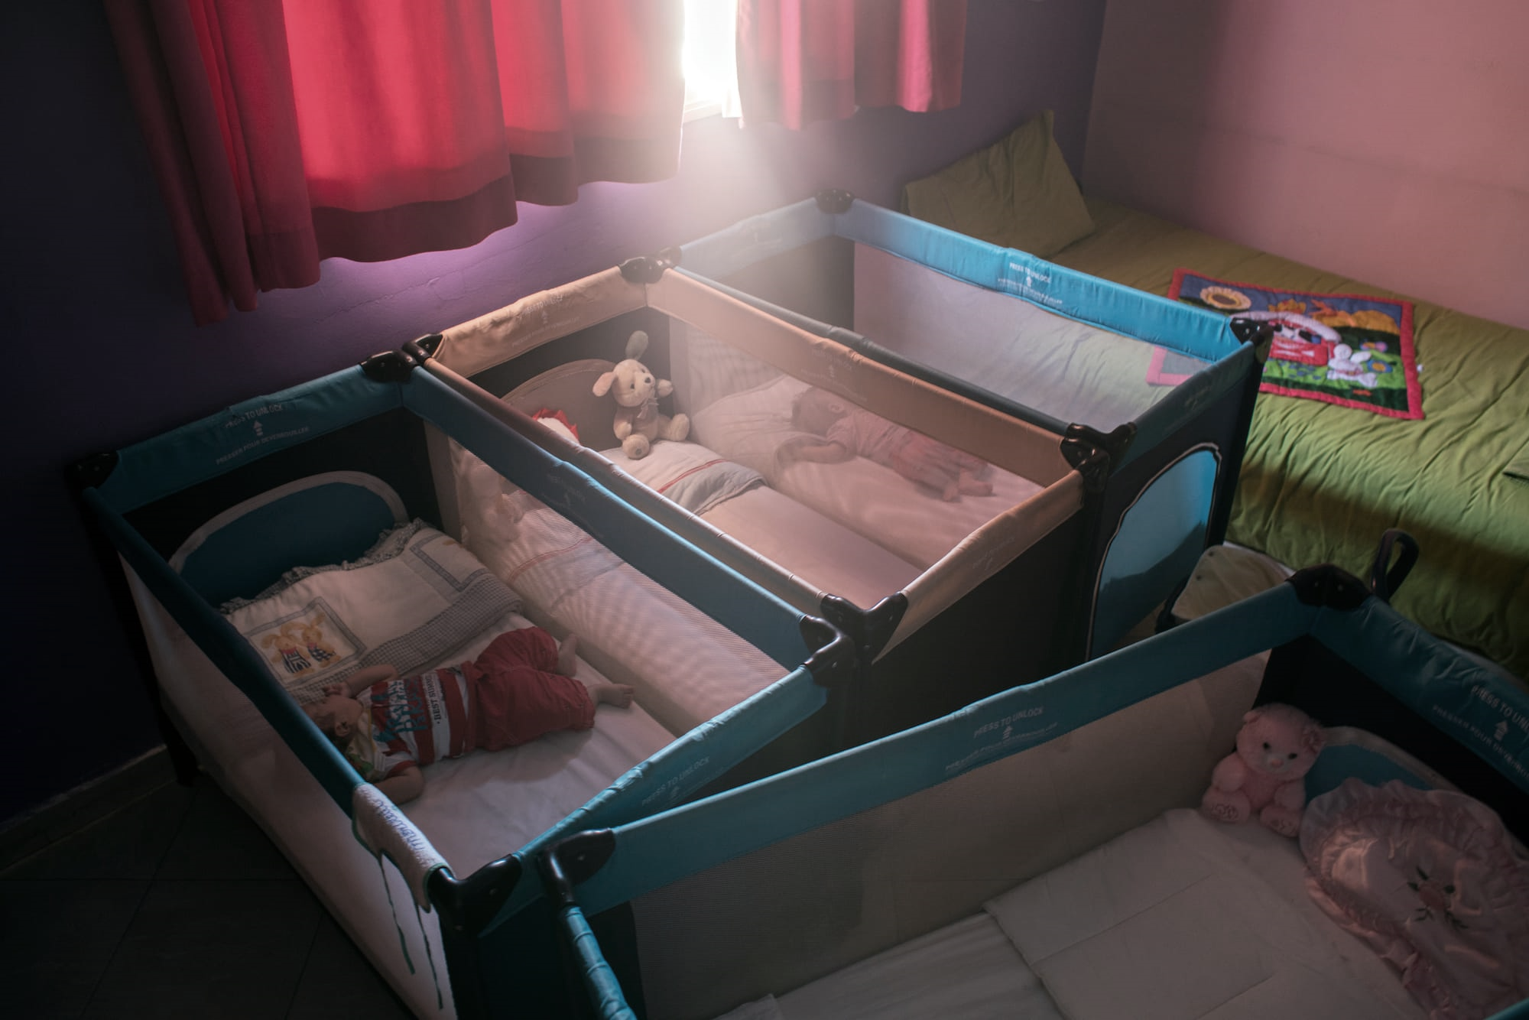
Guardians of Faith: Global Contestations Over the Care of Muslim Orphans
Nermeen Mouftah,
Assistant Professor of Religion
Butler University
April 2021

Slide 2
The Global Religions Research Initiative Project Launch grant supported preliminary ethnographic fieldwork in Morocco and Pakistan (April, June-August 2019). This presentation depicts a work-in-progress, including my research questions, methodological and theoretical approach, the scholarship in which this work is in conversation, as well as preliminary findings and directions for further research.

Slide 3
The Muslim Orphan Paradox
The Muslim orphan lives a paradox: at once the intense focus of alms because of an Islamic tradition that takes the orphan as the paradigmatic figure in need, and yet scorned because of their perceived rootlessness. While the care of the orphan is highly laudable across Muslim societies, precisely what care should look like is deeply contested. In large part, this is due to two major factors: the stigmatization of children born outside of marriage, and a consensus among the Islamic legal schools that adoption (tabannī) is prohibited. Chief among the legal concepts deployed to regulate their care is kafāla, or guardianship. My research investigates how Muslims grapple with enacting an ethics of care for orphans as they negotiate twenty-first century meanings of guardianship.

Slide 4
How do Muslims negotiate the legal, biological, and affective realms of the care and abandonment of vulnerable children?

Slide 5
This article marks a first stage in responding to a research question that frames religion as a central category for understanding the care of vulnerable and unparented children. The paper examines the orphan paradox as it is structured, experienced, and debated among contemporary Muslim Americans. Research for this article shaped my conceptualization of global debates and driving concerns for notions of orphanhood, stigma, and relatedness that shaped fieldwork in Morocco and Pakistan.

Slide 6
American Muslim Adoption Agency, New Star Kafala, promotional and educational media
Kafāla
guardianship or sponsorship, similar to but not collapsible into adoption (tabannī). Used in Morocco and other North African countries, (and not a key concept in conversations in Pakistan).

Slide 7
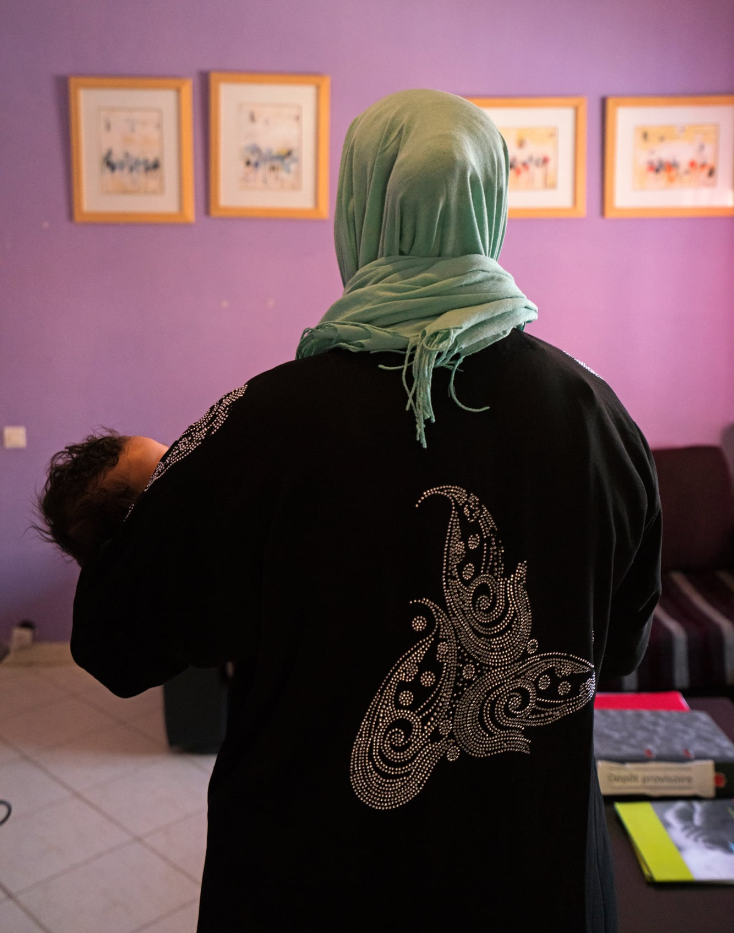
An Ethnographic Approach to probe the complex convergence of the interpretation of Islamic jurisprudence (fiqh), and evolving conceptions of family and care.
The 2019 summer fieldwork traced prominent global networks and institutions of Muslim orphan care through the flows and frictions of North American Muslims to vulnerable children in Morocco and Pakistan, the two Muslim-majority countries with high documented rates of child relinquishment that also uniquely facilitate intercountry adoptions as a way to decrease the number of children in institutionalized care.
Interlocutors included children and teenagers raised in orphanages, social workers, nurses and other orphanage staff, and guardians, to better understand twenty-first century meanings of kafāla as they intersect and depart from the universalizing vernacular of “the best interests of the child.”
Photo by Ali Berrada for La Ligue Marocaine Pour la Protection de l’Enfance (LMPE)

Slide 8
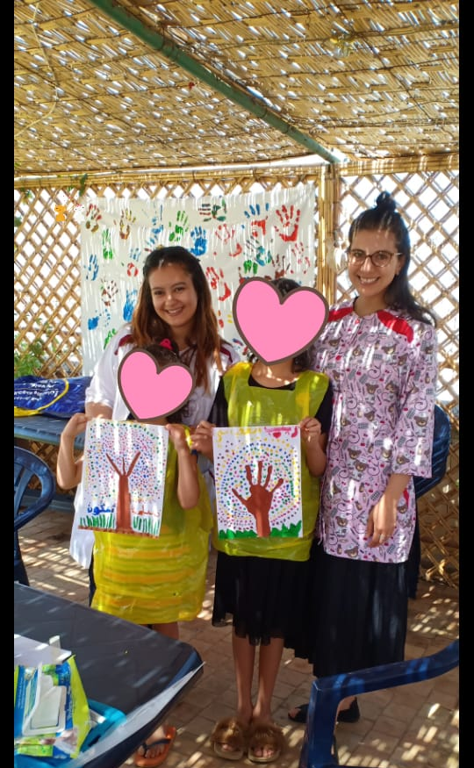
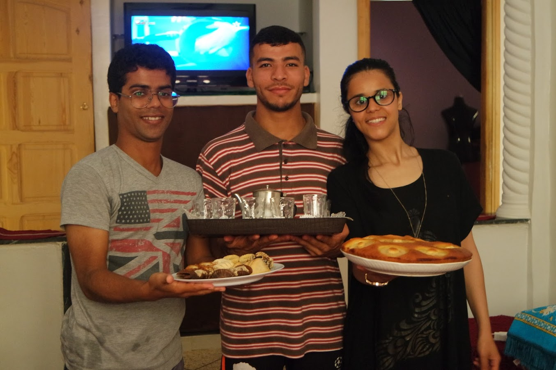
Fieldwork
Fieldwork included participant-observation fieldwork (Morocco), interviews, and focus group discussions (Morocco and Pakistan). I conducted approximately 50 hours of French, Arabic, English, and Urdu-language structured and semi-structured interviews. (For Urdu interviews, I had a translator). My fieldwork was based primarily in orphanages and orphanage-like institutions (“hostels,” “villages,” and “homes”) where I met my primary interlocutors.
Former residents of L’Annexe du Nid host lunch in new home
Author at Le Nid. Photo by Le Nid staff

Slide 9
Literature and Interventions
Muslim orphans largely considered by scholars of Islamic law (Chaumont, 2012; Fekry, 2018; Madelung, 2013; Pesle, 1919; Powers, 2015), yet major disjuncture between the fiqh and how Muslim societies have coped with orphans.
Twentieth century social histories of orphan care in the Middle East highlight debates surrounding who is responsible for orphans, as well as the related shift from private religious institutions to state-sponsored ones (Baron 2014; Ibrahim 2018; Maksudyan 2008, 2009, 2014; Sonbol 1996; Yazbak 2001).
As a result of the gap between law and practice, and the large number of extralegal accommodations for orphans, ethnographic work on global and domestic everyday enactments of raising orphans and bureaucratic processes is essential.
This research contributes to work on gender and Islamic law (see Eltantawi 2017; Hirsch 1998; Mahmood 2012; Mir-Hosseini 1997; Mir-Hosseini et al. 2015).
Anthropology has largely approached the orphan through processes and problems of (transnational) adoption (Howell, 2007, 2009; Leinaweaver, 2008; Modell, 2002; Wang, 2016). This work privileges the analysis of race and ethnicity as the primary analytical lens for understanding issues of identity, to the exclusion of religion.
To date, Jamila Bargach’s ethnographic work in Morocco (2002) is the single full-length monograph to address the gap between relevant Islamic laws and contemporary practices of adoption and fostering in a Muslim-majority context.

Slide 10
Questioning Institutionalized Care
“Children should not grow up in institutions. Kafala is the best thing for children.”
-former resident of L’Annexe, male, 22 years of age
“This place will either be my heaven, or it will be my hell.”
-employee reflecting on his work at Karachi boys hostel, Anjuman Hayat-ul-Islam

Slide 11
Questioning Institutionalized Care
National and transnational debates over how to care for orphans and what care should look like is in some places transforming conventional orphanages. Emergent forms of communal living (villages and homes), as well as the use of particular techniques to modernize institutional care, including play, touch, and opportunities for eye contact.
Emphasis on education (primary and secondary, Islamic, vocational).
Efforts to decrease the number of infants and children in institutional care through national and international kafāla/adoption, and child and family sponsorships. Simultaneously new orphanages being built.

Slide 12
National Context 1: Morocco
Participant-observation fieldwork focused around a pair of orphanages run by a foundation in Meknes: Le Nid, and L’Annexe du Nid. I also visited orphanages in Rabat and Tangier that allowed for comparative insights. Interviews included:
15 orphanage directors and office staff, as well as community-based organization leaders
24 orphan youth
15 adoptive parents
14 orphanage caregivers/nurses

Slide 13
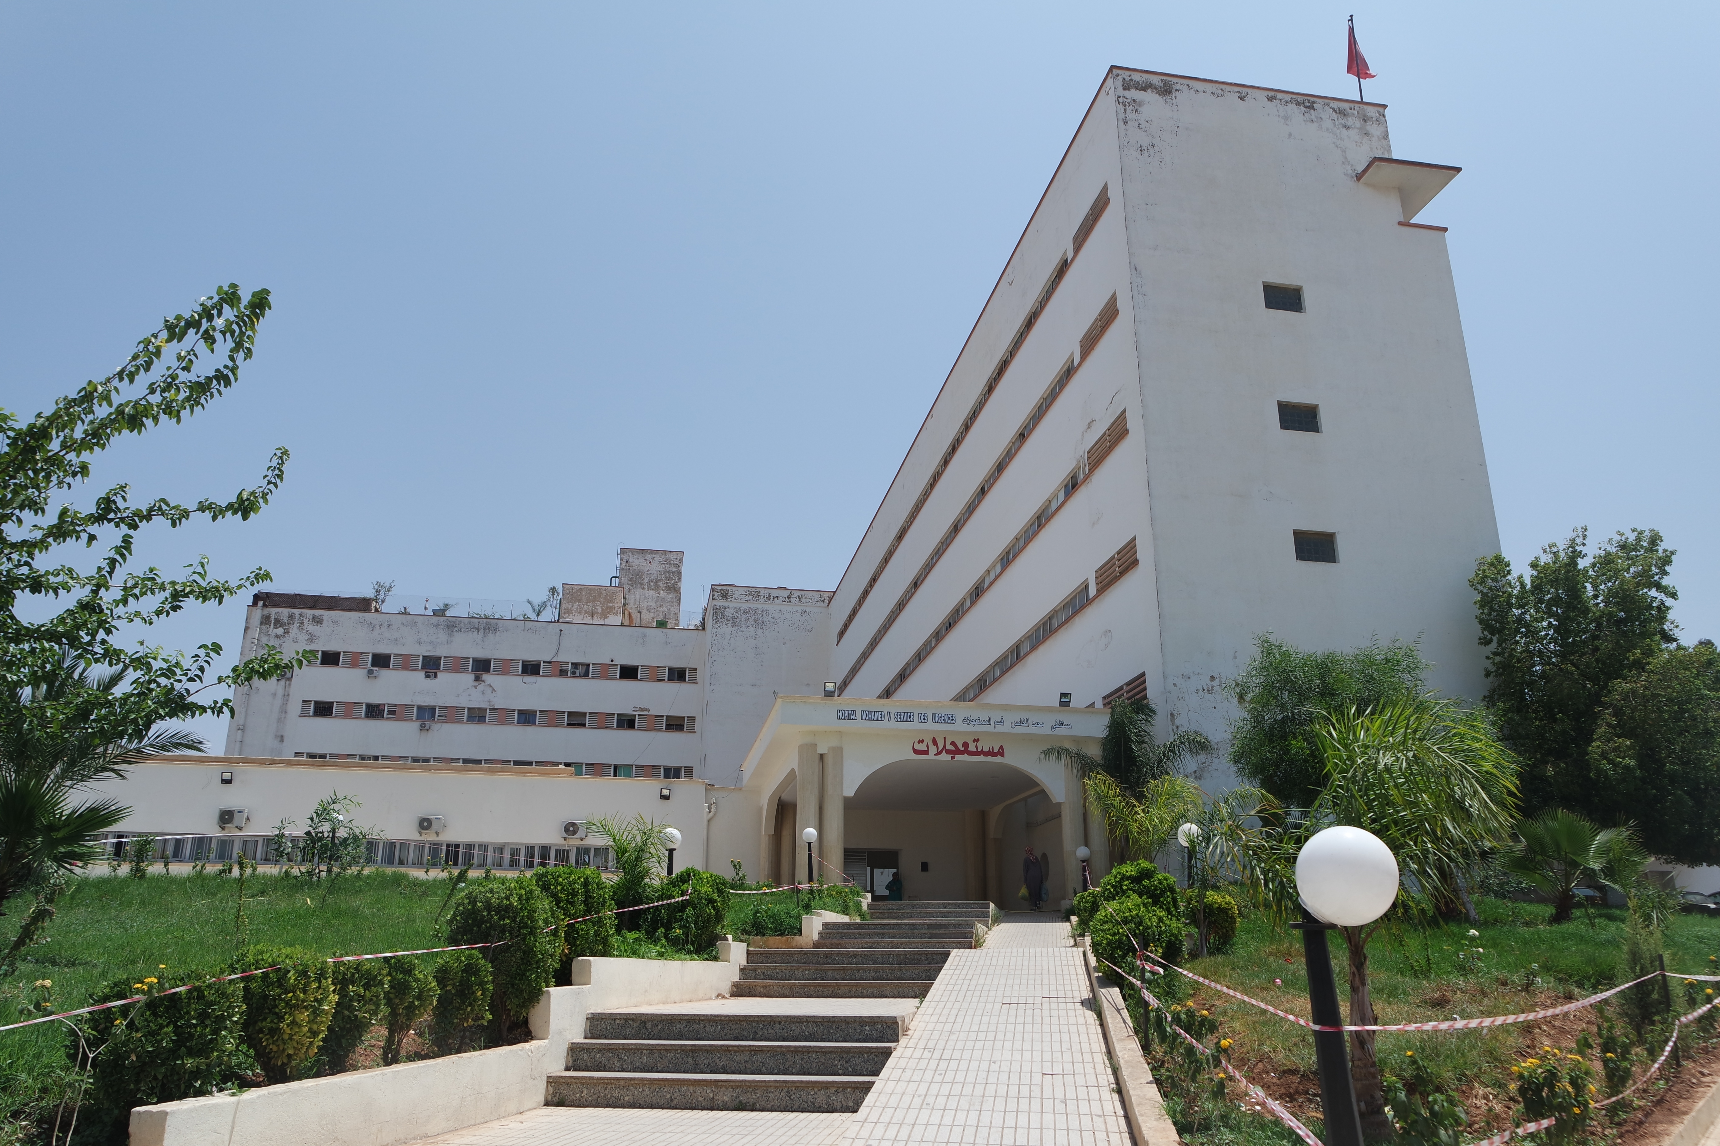
Le Nid (est. 1988), located on the top floor of the Hôpital Mohammed V, Meknes, Morocco Infants and children 0-7 years of age

Slide 14
Muslim Authenticity in Debates about Care
“Competition over the souls of children”: Christian missionary works providing care for orphans (through homes and communal arrangements like Village de l’Espérance) and their regulation by Moroccan law.
Efforts to stem child relinquishment: women’s and children’s rights activists advocating for social reform and amendments to Moroccan laws, including: the use of DNA in court, women’s custodial rights, social stigma around single-motherhood (and motherhood outside of marriage), and women’s reproductive rights.
An Islamic and national conception of care for non-biological children: Tabanni (“adoption”) VS kafala (guardianship) in public discourse, as well as Moroccan, and international law.

Slide 15
Regulating Religious Identity of Guardians
Morocco requires that guardians are practicing Sunni Muslims. Interviews with social workers, and imams emphasize religious practice in child rearing. All potential guardians are tested to establish their Muslimness. Officials explain the importance of the procedures to protect the child from being raised as non-Muslims. They warned of their experiences with guardians who planned to raise children as Christians, and others who planned to raise children without any religious formation.
Many of those going through the guardianship process found the questions and test to be an invitation to perform basic religious knowledge and a “fake” religious identity palatable to state authorities.
“These children are much higher than religion.” -prospective guardian mother from France
“Even God can’t make you do what your children can.” - prospective guardian from Belgium

Slide 16
L’Annexe du Nid (est. 2007), Meknes, Morocco
Youth 8 years of age and older

Slide 17
Growing Up
The life histories of young men and women becoming adults offers a view on the life-course as experienced by those transitioning out of institutional life. Youths on the verge of and beginning to live independently critique the impact of orphanages and a social world that stigmatizes them. Their lives and stories shed light on relationships with sponsors, cohort-siblings, and the possibilities for work and marriage prospects at a moment when they are keen to define their identities and carve out an independent future for themselves.

Slide 18
Village de l’Espérance (2000-2010), Ain Leuh, Morocco
First established Emmagene Coates and Ellen Doran in1951. Reestablished in 2000 by Christian families who acted as foster care providers to 33 children. In 2010 the Moroccan government accused the families of proselytizing and expelled the parents from Morocco in a case that gained international attention. The children were eventually brought to live in L’Annexe in Meknes while their foster parents continue to appeal the court decision.

Slide 19
Family as God’s Work
The Christian parents at the commune were accused of proselytization (illegal in Morocco) and deported to their home countries (in the United States, United Kingdom, South Africa, New Zealand, and a number of European countries). While the expelled parents made a case for religious freedom, and Morocco tried a case against outsiders infringing on the respect of Moroccan and Islamic traditions, the case helps probe modern and contemporary forms of missionary work centered on orphans, including practices of religious formation, and notions of the “natural spiritual state” of newborns and children.
Boonstra family at Village de l’Espérance.
Photo on Village of Hope website: http://www.voh-ainleuh.org/

Slide 20
National Context 2: Pakistan
In Pakistan my fieldwork focused on institutionalized care in Karachi and Lahore where I visited approximately a dozen child-care institutions (“hostels,” “village” alternatives to institutionalized care, and orphanages). I also interviewed related community organization leaders as well as lawyers involved in adoption cases. Interviews included:
12 orphanage directors and office staff, as well as community-based organization leaders
12 orphan youth
10 adoptive parents
6 orphanage caregivers/nurses
3 lawyers
Archival research at Dawn, one of the country’s predominant English-language newspapers

Slide 21
Relinquished Babies and Social Orphans
Edhi Foundation is arguably Pakistan’s most famous charitable organization providing care to relinquished babies throughout the country. Child relinquishment is widely believed to be associated with babies born outside of marriage, preference for boys, and parents who struggle to economically provide for their families. While difficult to estimate, Edhi Foundation approximates that 15-20 babies are abandoned each month.
While relinquished infants are a part of public conversation and fit a classic idea of “the orphan,” Pakistan’s various institutions and programs for orphan care indicate much larger numbers of social orphans, a child with one or both parents who do not provide their primary care. Institutionalized care of school-aged orphans focuses intensely on education. Children and youth at “hostels,” “homes,” and “villages” access improved living conditions and educational opportunities visiting nuclear and extended families on weekends and holidays.
Bilquis Edhi,
Edhi Foundation, Karachi

Slide 22
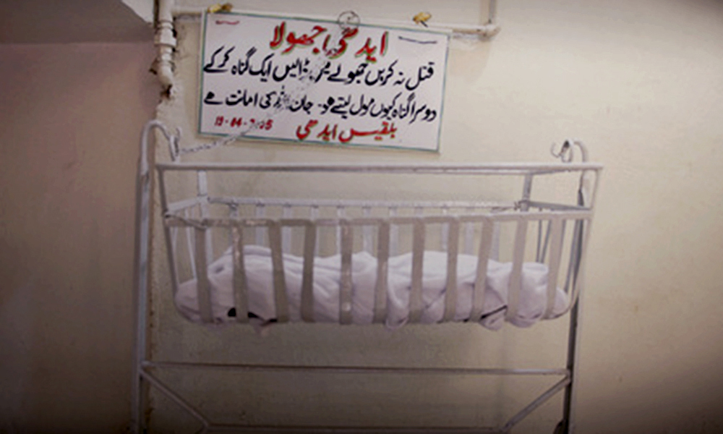
Edhi cradle (jhula)
“Do not kill [the child]. Put it in the cradle. Why do you purchase another sin after having already committed one? Life is a trust from God.
Bilquis Edhi”
Photo from Dawn

Slide 23
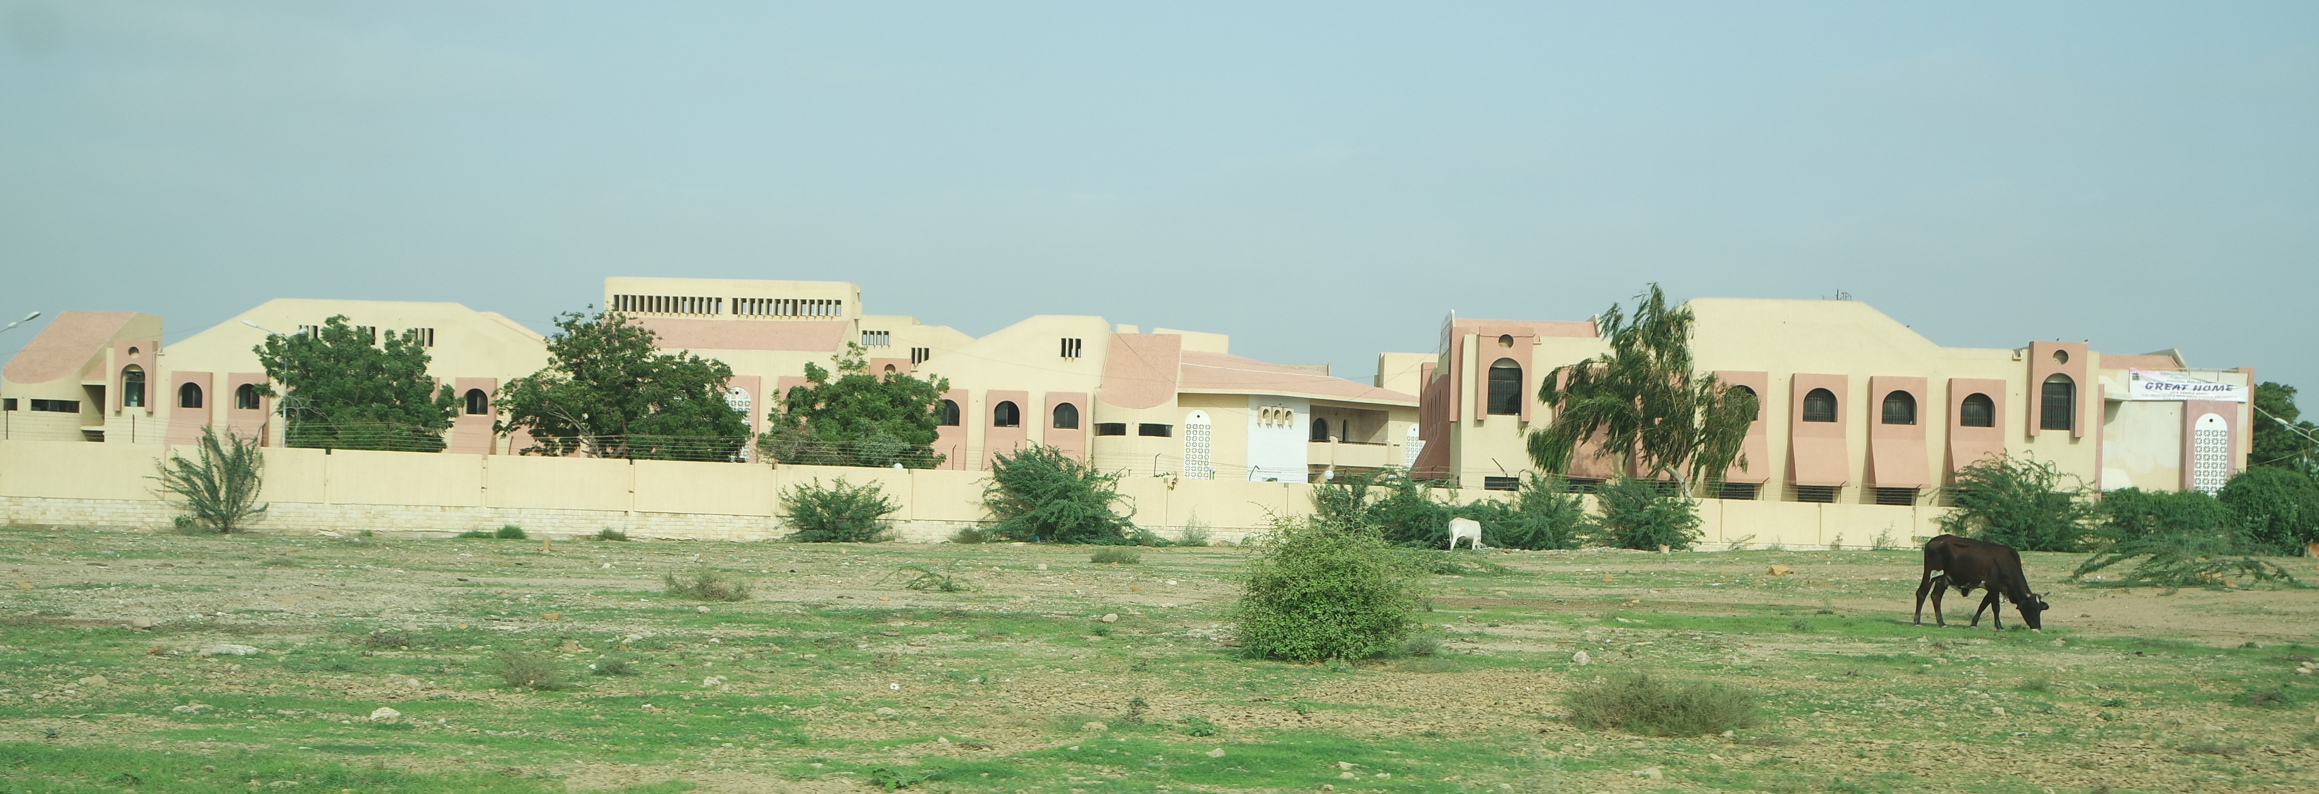
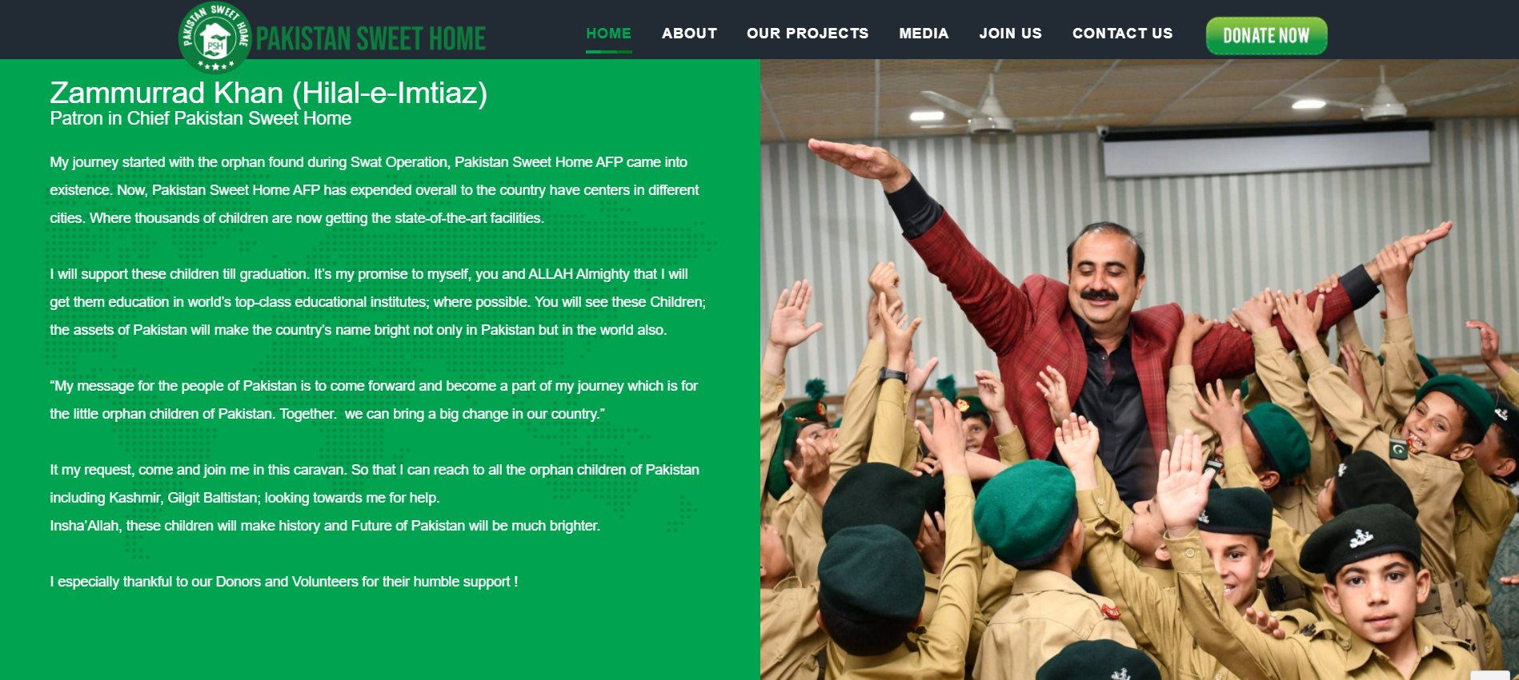
Pakistan Sweet Homes, Outskirts of Karachi, Pakistan
Better lives? Social Orphans in Pakistani Institutional Care
To date, my research has focused on institutional structures and practices of care for youth who are primarily considered social orphans. The case suggests a counter-point to global trends away from institutionalized care, while at the same time the arrangements re often spoke of by youth, social workers with ambivalence.

Slide 24
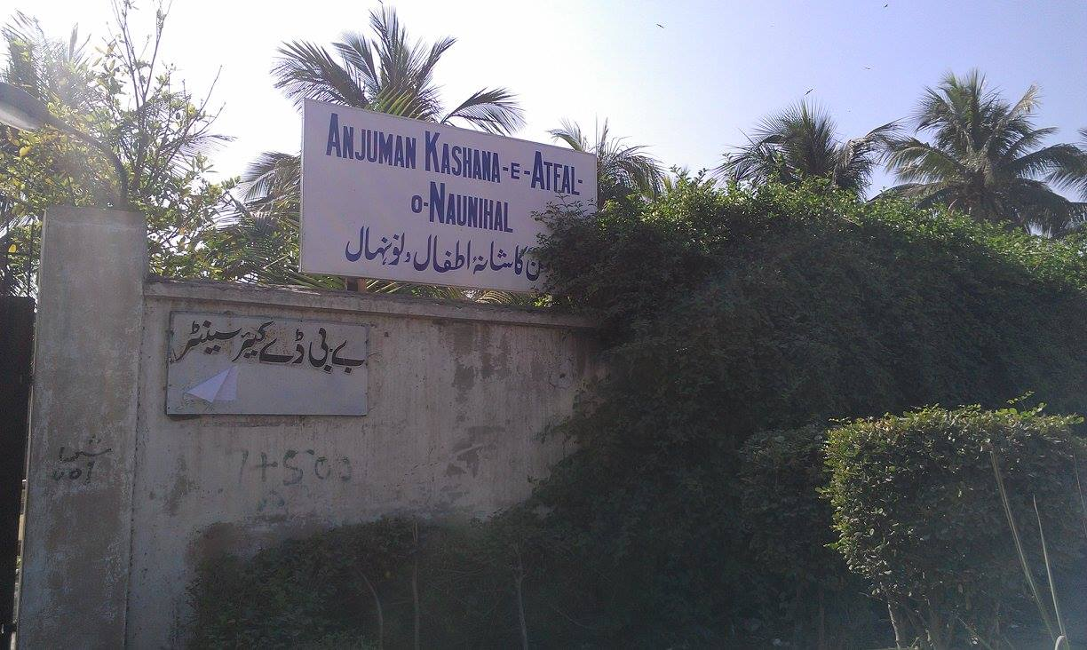
Anjuman Kashana-e-Atfal-o-Naunihal, Karachi, Pakistan Girls Hostel

Slide 25
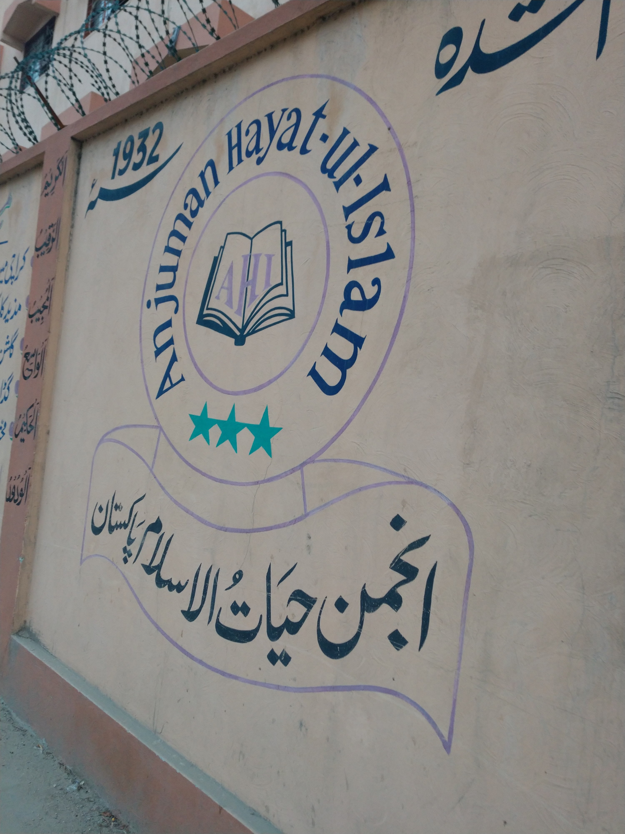
Anjuman Hayat-ul-Islam Orphanage, Karachi, Pakistan Boys Hostel

Slide 26
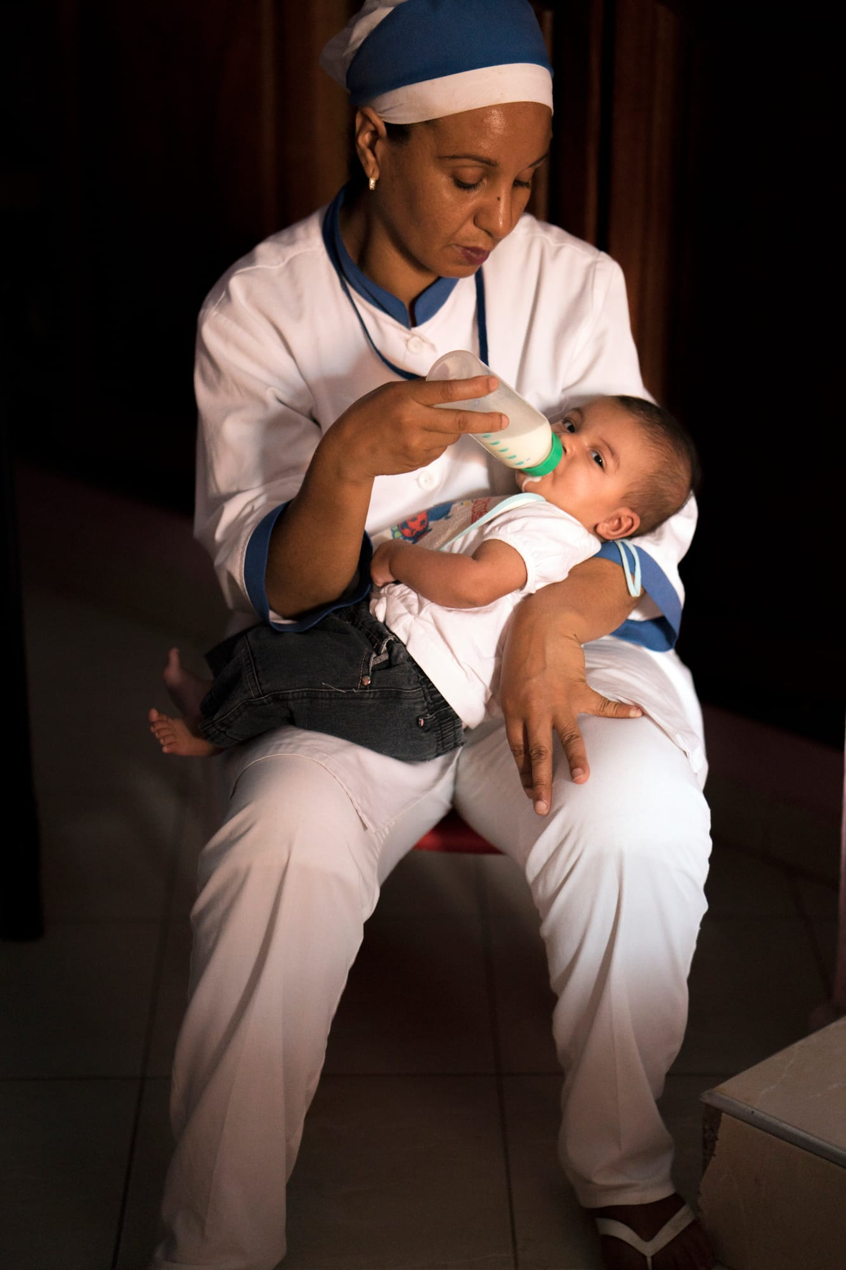
Stakes: The Negotiation of Care and Sovereignty
Religion deeply shapes debates over and practices of orphan care. As the Euro-American concept of the “best interests of the child” enshrined in the Convention on the Rights of the Child continues to be ratified and implemented, the Muslim orphan paradox is not simply indicative of a peculiar resistance to established norms. Instead, the ongoing contestations around how to best care for Muslim orphans calls our attention to evolving developments in the law, activism, and social work, among communities—Muslim, Christian, and secular—as they evaluate the historical legacies, ongoing inequalities, and exclusions that continue to impact the care of the orphan.

Slide 27
Future Directions
Funded Fieldwork
“Morocco’s Abandoned Children: Islam, Law, and the Regulation of Care and Kinship”
Funded by the American Academy of Religion’s Collaborative International Research Grant
Collaborator: Dr. Zaynab El-Bernoussi (Sciences Po Rabat)
We will examine increased activism to shift public opinion on the stigmatization of children born outside of marriage, including children conceived from rape and incest. Frequently relinquished at birth, these children are a focal point for contentions between women’s and children’s rights activists and Islamist politicians, in debates around sexual ethics and custodial rights. Understanding institutionalized care and its alternatives in light of recent debates to revise Morocco’s personal status code (Mudawwana) centers vulnerable children to intervene in anthropological understandings of care, filiation, and family law.

Slide 28
Thank you
I am grateful to the GRRI for the opportunity to conduct this preliminary research to get a transnational ethnographic project off the ground. Many generous people in the United States, Morocco, and Pakistan made the research possible. Thank you to Sarah Haider and Wafa Bennani for the essential introductions that allowed me to begin this research. In Morocco, Adil Bennis, Mohammed and Khadija Belkhayat facilitated essential introductions that made possible my extended time with Rita Zniber Foundation. In Pakistan, I am tremendously grateful to Syed Muaz Shah and Ziauddin University’s Faculty of Law, as well as Nur Sobers Khan, and Bilal Sami as generous guides and hosts.
I am tremendously grateful to those who shared their stories and introduced me to their work, their homes, and their lives.

