Slide 1
Between Shanghai and Mecca: Diaspora and Diplomacy of Chinese Muslims in the Twentieth Century
Janice Hyeju Jeong

Slide 2
Topic Introduction
Emergence of a new social group of Chinese Muslims across dispersed places in early-twentieth century, post-imperial China — merchants, scholars, politicians, warlords, public writers — who strengthened patronage and political ties with one another, formulated connections with leaders of Muslim societies across the Indian Ocean and the Arabian Peninsula, and partook in religious and cultural diplomacy on the side of Republican China against imperial Japan during World War II by utilizing the pilgrimage route to Mecca.
The Chinese Civil War (1946-1949) and the victory of the Communist Party created more than 20 million international refugees; among them were Chinese Muslim escapees, elites and commoners, who formed diaspora communities in dispersed places including Taiwan, Burma and northern Thailand, and Malaysia and Singapore.
Remarkably, streams of Chinese Muslim exiles flowed into Mecca throughout the 1940s and 1950s and formed a little-known Sino-Muslim diaspora community in the Hejaz (western coasts of the Arabian Peninsula). With connections to mainland China severed during the Cold War, they maintained relations with co-religionists in Taiwan, while becoming Saudi citizens and residents.

Slide 3
Research questions
What has Mecca as a place and an imagination represented to Chinese Muslim communities dispersed across mainland China, Taiwan, and Saudi Arabia?
What are the mechanisms through which Chinese Muslims forged and reshaped transnational networks at the face of global transformations of the twentieth century?
How have Sino-Islamic networks been entangled with the spheres of domestic and international politics?

Slide 4
Argument
From the turn of the twentieth century to the present, Chinese Muslims have interweaved vibrant ties of pilgrimage, religious charities, and kinship that transcended national and regional borders
Mecca has mediated Chinese Muslims' circulatory network formations and diasporic understandings of the past by figuring as an imagined home place, and as a hub for pilgrims and exiles
Such networks between China and the Arabian Peninsula have flexibly changed shape and re-routed themselves in response to historical events, and provided conduits for informal diplomacy at opportune moments

Slide 5
Objectives
To widen the social worlds of Chinese Muslims who have been classified into different 'ethnic minorities' within the confines of the territorial Chinese nation-state
To bring into light historic partnerships between Chinese states and transnational Islam that tend to be forgotten or erased
To diversify understandings on Islamic networks that have revolved around the Hejaz (western coasts of the Arabian Peninsula), beyond the focus on imperial governance and the so-called radical Islamist groups

Slide 6
Methodology and Data
History and Anthropology
Combination of textual materials and oral interviews/ethnography
Textual sources: pilgrimage travelogues published or reported to the government between the 1840s and the 1970s; memoirs; archival records (located primarily in Taipei); Islamic periodicals
Interviews with the living community of Chinese Muslims in Jeddah, Ta'if, Riyadh, and their acquaintances in Gansu/Qinghai, Yunnan, and Taiwan
Tracing of individual actors over time and generations

Slide 7
The Growing field of Islam in China (selection)
Social and intellectual histories
Jonathan Lipman, Familiar Strangers: A History of Muslims in Northwest China (1997) Zvi Bendor Benite, The Dao of Muhammad: A Cultural History of Muslims in Late Imperial China (2005)
Sachiko Murata and William Chittick, Chinese Gleams of Sufi Light: Wang Tai-yu’s Great Learning of the Pure and the Real and Liu Chih’s Displaying of the Concealment of the Real Realm (2000)
David Atwill, The Chinese Sultanate: Islam, Ethnicity, and the Panthay Rebellion in Southwest China, 1856-1873 (2005)
Zvi Bendor Benite, The Dao of Muhammad: A cultural History of Muslims in Late Imperial China (2005)
Kelly Hammond, China’s Muslims and Japan’s Empire: Centering Islam in World War II (2020)
Ethnographies
Dru Gladney, Muslim Chinese: Ethnic Nationalism in the People’s Republic (1996)
Maris Bloyd Gillette, Between Mecca and Beijing: Modernization and Consumption among Urban Chinese Muslims (2000)
(volume edited by Rachel Harris, Guangtian Ha and Maria Jaschok) Ethnographies of Islam in China (2020)
Legal history/anthropology
Matthew Erie, China and Islam: The Prophet, the Party, and Law (2016)
Roberta Tontini, Muslim Sanzijing: Shifts and Continuities in the Definition of Islam in China (2016)
Rich literature on present-day Xinjiang Autonomous Prefecture, including works by Ildiko Beller-Hann, Rian Thum, Joan Smith Finley, Kwangmin Kim, David Brophy, Justin Jacobs, Jay Dautcher, and Tom Cliff, among others

Slide 8
Transnational approaches to the Hejaz
Eric Tagliacozzo, The Longest Journey: Southeast Asians and the Pilgrimage to Mecca (2013)
Lale Can, Spiritual Subjects: Central Asian Pilgrims and the Ottoman Hajj at the end of Empire (2020)
Michael Christopher Low, Imperial Mecca: Ottoman Arabia and the Indian Ocean Hajj (2020)
Muhammad Arafat, “Be-longing: Fatanis in Makkah and Jawi” (Ph.D. dissertation, Harvard University 2013)

Slide 9
Bridging the two regions: Inter-Asian Connections
Tracing the ebbs and flows of transnational Sino-Islamic networks bridges the divides between conventional regional units of analysis in area studies (the Middle East and East Asia); shows relations and connections between the two seemingly separate regions over long periods of history
Examples of pioneering works in trans-regional studies of Asia
Engseng Ho, Graves of Tarim: Genealogy and Mobility across the Indian Ocean (2006); Conceptual overview on inter-Asian connections and related scholarship: “Inter-Asian Concepts for Mobile Societies.” The Journal of Asian Studies 76, no. 4 (November 2017)
Cemil Aydin, The Politics of Anti-Westernism in Asia: Visions of World Order in Pan-Islamic and Pan Asian Thought (2007)

Slide 10
Findings

Slide 11
Mecca and Medina as figurative homelands in pre-twentieth century imperial China
“Majia (麻嘉)”
Zhou Qufei’s Lingwai Daida 嶺外代答 (Notes from the Land beyond the Passes, 1178) and Zhao Rugua’s Zhufan zhi 諸蕃志 (Description of the Foreign Lands, 1225)
Birthplace of the Buddha Ma-xia-wu; Ka’ba as the Buddha’s House that attracts all countries of Dashi (Arabia) every year
“Tiantang (天堂)”
Wang Dayuan’s Daoyi zhilue 島夷誌略(Shortened Account of the Non-Chinese Island Peoples, travels claimed to be undertaken during the 1330s)
Reachable from Yunnan through land within one year or through the sea, with a warm climate and fertile soil, where people’s customs are hospitable and Islamic calendar (Huihili) is used. Dress codes of men and women (long coats made of fine cloth), food habits, and available commodities such as cloves, nutmeg, musk, pepper, silver, blue-and-white porcelain and iron ding (cauldron) noted
“Tianfang (天方)”
Da Ming yi tong zhi 大明一統志 (Records of the Unity of the Great Ming, 1461)
“Country of Medina” (默德那國 Modenaguo) in Records of the Unity of the Great Ming
Excerpts taken from Wu Jian’s inscription on Qingjing mosque reconstruction stele in Quanzhou (1350)
Medina: attributed as the ‘homeland' (zuguo) of Muslims (Huihui) governed by 'payambar’ (prophet) Muhammad, from which Sa'd ibn Abi Waqqas had come and began to spread the teachings in China; Adjacent to 'Tianfang’, or Mecca

Slide 12
Mecca and Medina as figurative homelands in pre-twentieth century imperial China
Fuzhou mosque reconstruction stele (1549)
“the construction of the mosque was to worship the teachings of the Heavenly Square (Tianfang)…”
Sa’d Waqqās having sailed through the seas and reached Fujian
“…the teachings spread out and permeated China, and mosques/temples (si) were constructed everywhere”
Hebei Dingzhou mosque stele (proclaimed date 1348, more likely 15th or 16th c.)
Description “Country of Mecca” (Tianfang guo) in the “western regions” (xiyu) as the origin place (zu) of Huihui teachings, where lies an abode of worship surrounded by four sides. As China was situated east to the “western regions,” believers of the teachings turned westward
“Country of Medina”: Homeland (zuguo) of Muslims (Huihui)
“Sahāba Sa‘d Waqqās …started to transmit the teachings into China,” and instructed “forefathers to regard ten thousand countries as homes (yiwanguo wei jia 以萬國為家), worship the heavens as the roots, and not construct any images.”
Source: 中国回族金石录 (2001)

Slide 13
Constructing mosques as a substitute to the hajj
Hebei’s Zhangjiakou mosque stele (1523)
The duty of “paying homage to (zhanli) the five-colored jadeite square in the west” could be substituted by establishing mosques.
Shanxi’s Datong mosque reconstruction stele (1622)
since China could not “pay homage (zhanli)” in multitude to the west, mosques would be constructed instead.
Source: 中国回族金石录 (2001)

Slide 14
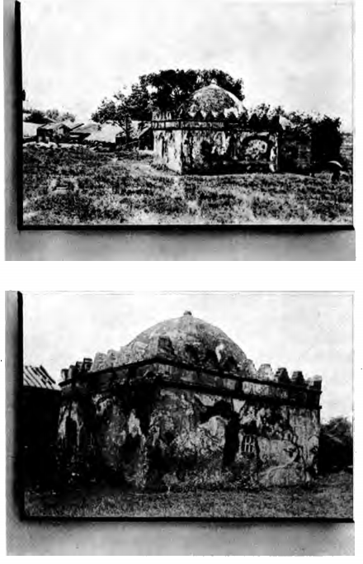
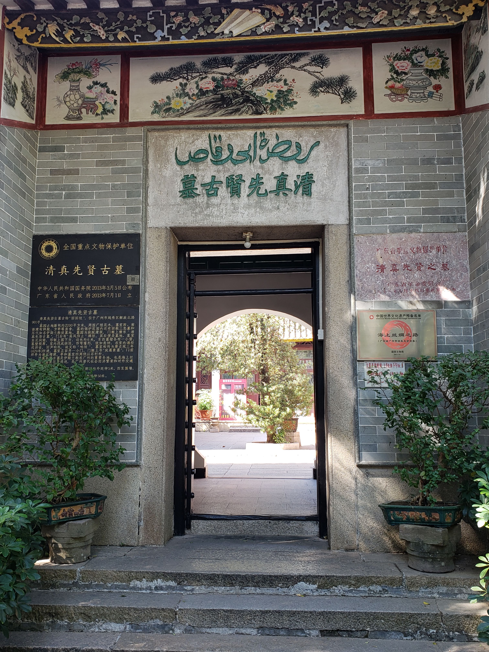
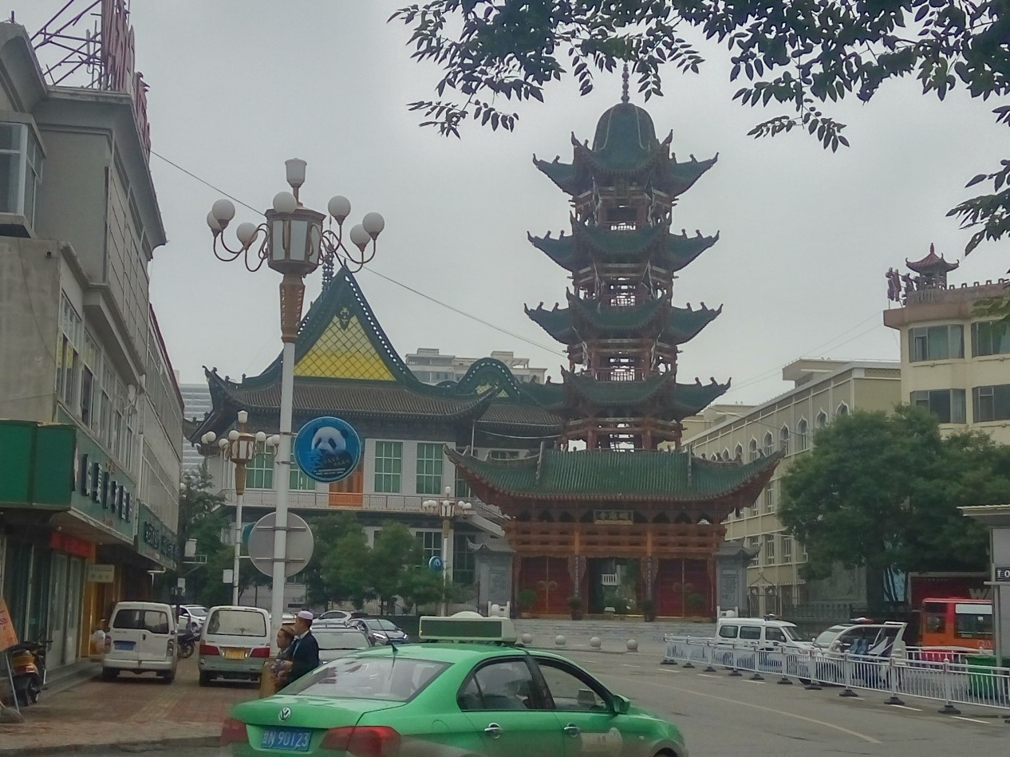
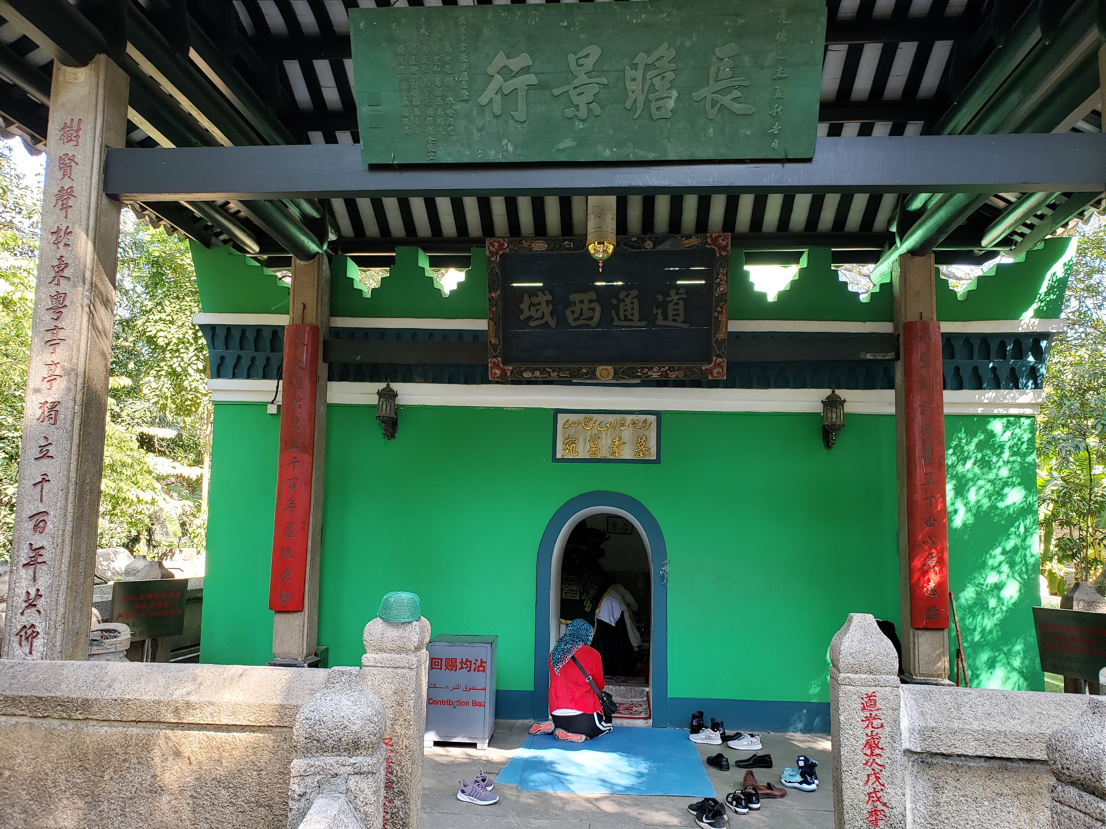
‘Little’ Meccas of Linxia and Guangzhou (Canton)
The grave and death anniversary of of Sa’d Waqqās (سعد بن أبي وقاص) from Mecca, mythically buried in Guangzhou, have been commemorated since at least the mid-18th century
Linxia in southern Gansu – concentration of shrine-tomb complexes belonging to different Sufi orders, many of them initiated since the 17th century by returnees from the pilgrimage to Mecca
Grave of Abi Waqqās, early 20th century
Grave of Abi Waqqās (Dec 2019)
Linxia in southern Gansu (June 2016)
Grave of Abi Waqqās (Dec 2019)

Slide 15
Popularization of pilgrimage routes – hajj paths undertaken by Ma Dexin from Yunnan, 1841-1846

Slide 16
Contrast to Ma Lü’an’s pilgrimage route from Chengdu; travels primarily on steamships, shortened time and transit points ( 天方纪程, January-August 1924)

Slide 17
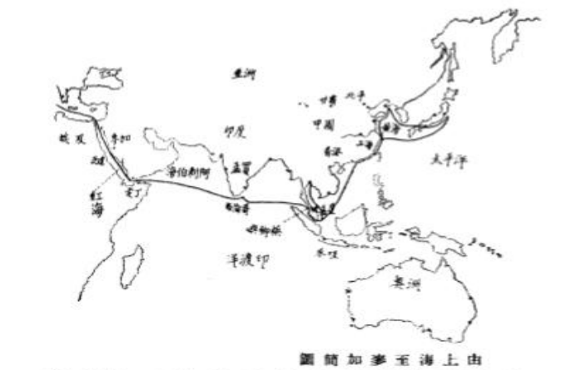
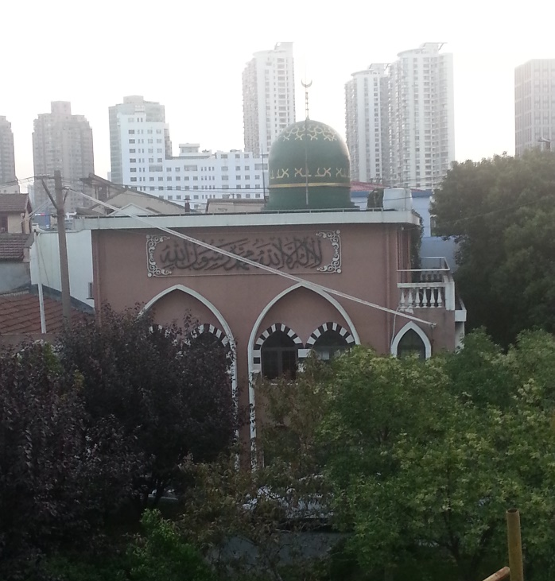
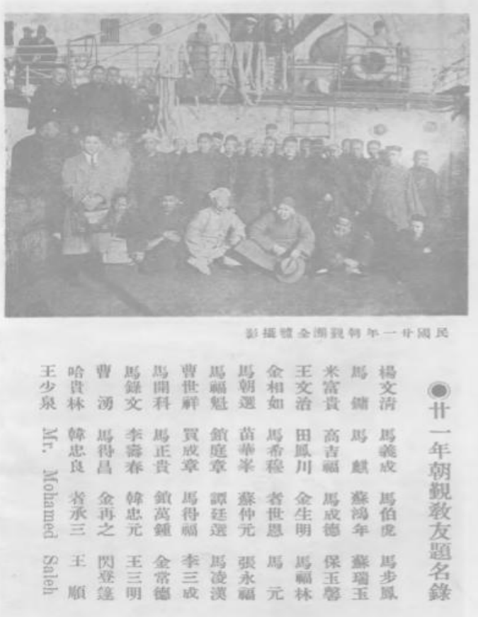
Creation of Islamic enclaves in the new intermediary space of Shanghai
Popularization of railway and steamship travels
Shanghai: new transport and logistics hub for pilgrims flocking from different parts of China
Ex. Xiao Taoyuan mosque (constructed in 1917 and expanded in 1924, with donations from across southern parts of China, to accommodate the increasing number of pilgrims transitioning in the city)
Excerpt from the guidebook “From Shanghai to Mecca”(1932)
Xiao Taoyuan mosque
(2016)
List of names of pilgrims departing from Shanghai in 1932

Slide 18
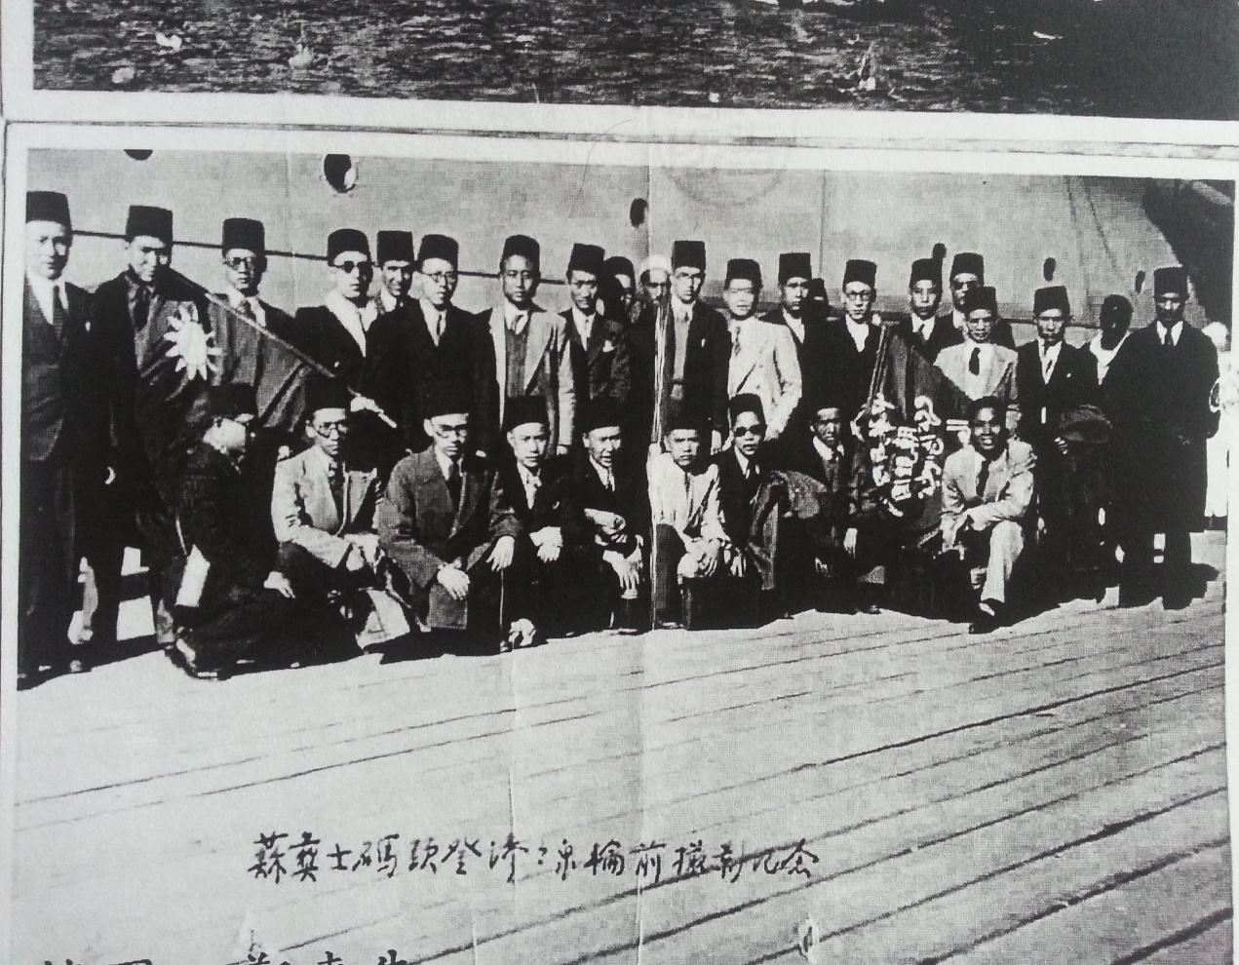
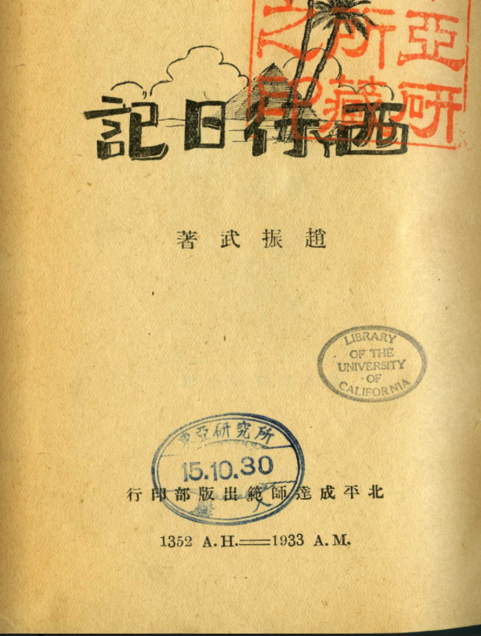
Mecca as a magnet for pilgrims, diplomats, and refugees in the inter-war period and onto World War II
1930s accounts of pilgrimage and diplomatic missions
Encounters with pilgrims and refugees from across China, the Indian Ocean rim, and Russia
Lax regulations on political membership
Descriptions of four waqf institutions in Mecca used by pilgrims from China and Xinjiang
Zhao Zhenwu, Diaries of Journey Westwards (1933)
Chinese Muslim students from al-Azhar University heading to Mecca. On the headboard at Suez (1939).
Source: Ministry of Foreign Affairs Archives (Taipei)

Slide 19
Endowment institutions for pilgrims from “China”
Ma Mingdao’s observation in Mecca (1936):
Four “Chinese” pilgrim lodge houses in Mecca. One for “Dungan” people, one for Kashgar (for those coming through the southern route of Xinjiang), one for Yili (for travelers taking the northern route of Xinjiang), one for Hami.
Although the housings were divided in this way, the boundaries were not clear on the ground.
The “Dungan” housing had been built through the assistance of Ma Fuxiang and was managed by “Hassan.” Present in the housing: Ma De (馬德), the brigade commander for the general Ma Zhongying; Qinghai’s minister of transportation Ma Chaoru (馬朝儒); Ma Zhongliang (馬忠良) from Ningxia; Li Xiangfu (李相甫) from Henan; and Xi Jingxian (希敬賢), who had stayed in Mecca for two years.
While staying in Mecca during the hajj season, Ma Mingdao met pilgrims from China who had come through different routes, some through Shanghai and others via India.
Source: Ma Mingdao, “Cong Yisidanbu Dao Maijia (從伊斯擔堡到麥加）,” Chenxi (晨熹) 2, no. 9, 10, 12 (1936)

Slide 20
Exiles and Escapees from ‘Xinjiang’ in the Hejaz – descriptions by the Chinese Islamic pilgrimage missions during World War II
Report by the anti-Japanese Chinese Islamic delegation from Cairo to the Nationalist government (1939):
Overseas Chinese (Huaqiao 華僑) population numbering around 2,000 were residing in the Hejaz Kingdom (Hanzhi Wangguo 漢志王國). Most of them were Turkic Muslims (chanhui 纏回) from Xinjiang who “could not bear the regional government’s oppression and were getting by with difficulty in the sacred lands.” There were also a small number of people from Yunnan, Gansu, Ningxia, and Sichuan Provinces who had come to the region for commerce and pursuit of knowledge. The pilgrim settlers were not receiving treatment equal to that towards diaspora subjects (qiaomin 僑民) from other countries, due to the absence of a Chinese diplomatic body in the Hejaz. Problems such as passport issues were making them become citizens of the Hejaz (ru hanzhi guoji 入漢志國籍) without a choice.
Those who had occupied relatively high positions back in Xinjiang fell to the status of “petty peddlers and carriers,” or were making a living as teachers. If the government does not provide relief for those wandering (liuli 流離), it would be difficult to “prevent them from being utilized as propaganda tools for the enemy.”
A merchant from Xinjiang named “Habib Allah” had initially opened a store in Mecca and was selling “national products” (guohuo 國貨). Following the Japanese occupation of Shanghai, Habib Allah had no choice but to turn to selling the Japanese products.

Slide 21
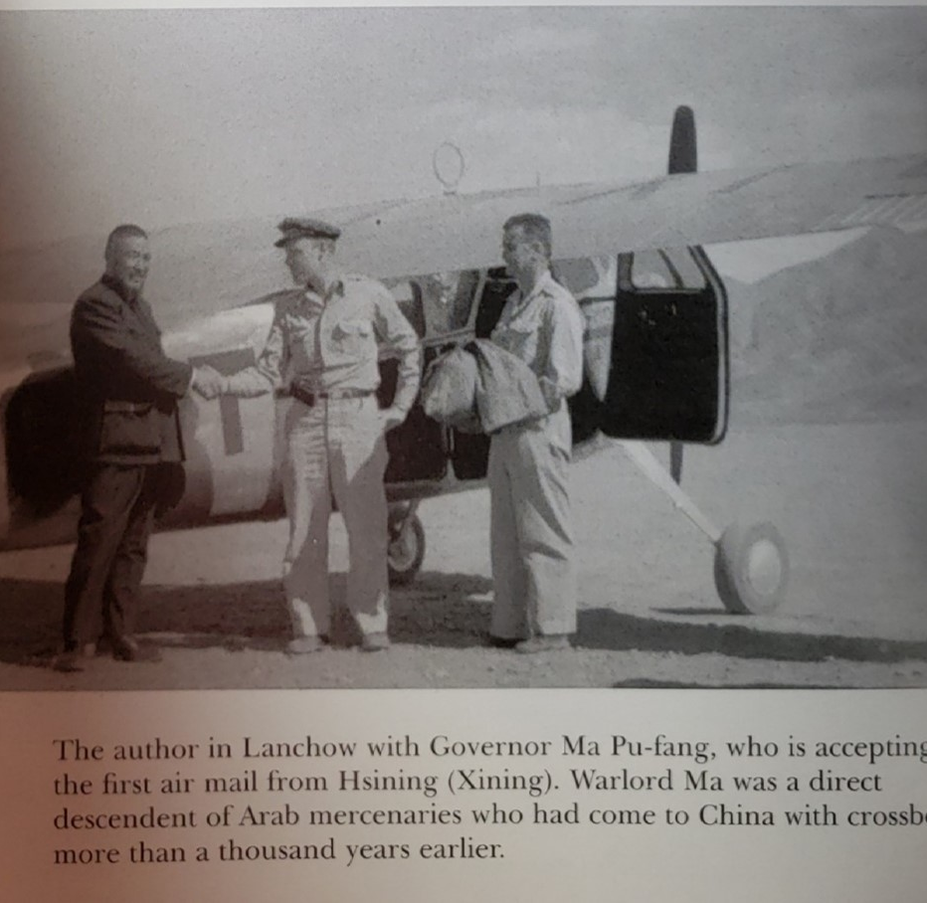
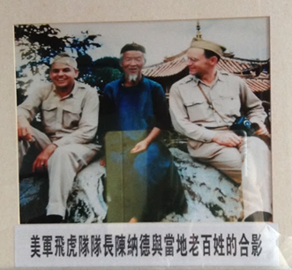
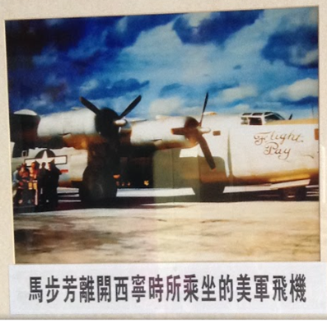
Waves of post-World War II Escapees
May 9, 1949
Source: Felix Smith, China Pilot: Flying for Chennault (1995), p.144)
Source: Ma Bufang residence
(Xining, Qinghai)
“American military Flying Tigers leader
Chennault with the locals”
“American military airplane boarded by Ma Bufang when he left Xining”
Relocation of Hussein Ma Bufang, former warlord and governor of Qinghai Province, to Mecca with two to three hundred of his close familial and political associates; airlifted by Civil Air Transport (CAT), founded by a retired U.S. military aviator Claire Chennault
Sojourn of Ma Bufang clan in Cairo for seven years (1949-1956); their return to Mecca following the rise of Jamal Abdul Nasser in Egypt and its recognition of the People’s Republic of China. Dispersal of the extended family to Ta’if and Jeddah
Streams of refugees from Gansu and Qinghai to Mecca through the 1950s escaping from anti-rightist collectivization campaigns; utilizing the old overland routes via Tibet, Kalimpong, and Calcutta, onward to Bombay (Mumbai) and Jeddah

Slide 22
Estimates of the ‘overseas Chinese’ community in Saudi Arabia (1961)
Survey by the Embassy of the Republic of China on “overseas Chinese” populations in Saudi Arabia (1961)
Compilation of information on places of origin (jiguan 籍貫), age and citizenship status
271 persons surveyed: 243 from Gansu; 77 from Qinghai; 35 from Tibet; 12 from Ningxia; 9 from Yunnan; 5 from Sichuan; 2 from Xinjiang; 1 from Hong Kong
Inclusion of 10 women from “Arabia” (A-la-bo)
109 had acquired Saudi citizenship; 173 with permanent resident status; 110 had neither citizenship nor residency (most of whom were from Tibet, Sichuan, and Gansu)
Names: combination of Chinese surnames (such as Ma, Sha, Hai, Han, Min, Na, and Lin) and Arabic first names (i.e. Ma Maria, Ma ‘Abdullah), whereas elderly persons who had spent some time back in China often had their full Chinese names written down.

Slide 23
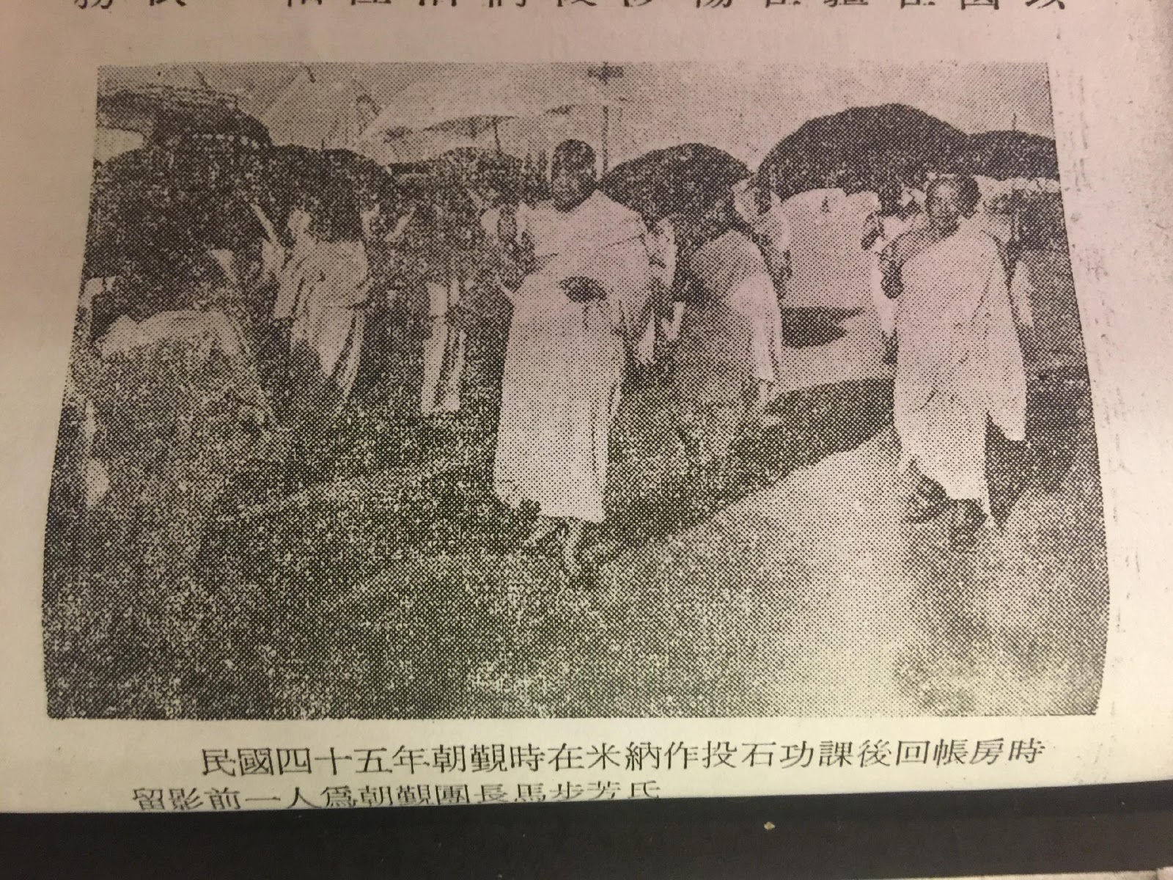
Re-Routings during the Cold War: Pilgrimage and diplomacy
Annual pilgrimage delegations from Taipei to Mecca starting from 1954
Tight economic and political relations between the Kingdom of Saudi Arabia and the Republic of China (Taiwan) during the Cold War
Strong anti-communist overtones of the hajj delegations up to the early 1970s
Portions of the Chinese diaspora community in the Hejaz drawn into the anti-communist Islamic diplomacy espoused by Taipei
1956 hajj delegation led by Hussein Ma Bufang
Ma Bufang during the hajj of 1956
Source: Ma Huanwen, Xixing Sanji 西行散记 (1966)

Slide 24
Re-routings during the Cold War: Endowment institutions
Endowment institutions (waqf; awqāf): sites of convergence, mediation, and re-directions
Relative lack of English-language scholarship on waqf institutions in Mecca
Russian consulate in Jeddah (1895):
126 Russian and Bukharan subjects in Mecca, and 24 tekkes (including five for the Kazan Tatars). “’‘Sarts’ from Central Asia organized the tekkes according to their regional background: Bukhara, Samarkand, Margelan, Andijan, Tashkent, and Namangan.”(Norihiro Naganawa, “The Hajj Making Geopolitics, Empire, and Local Politics: A View from the Volga-Ural Region at the Turn of the Nineteenth and Twentieth Centuries” in Central Asian Pilgrims: Hajj Routes and Pious Visits between Central Asia and the Hejaz)
Dutch Orientalist Snouck Hurgronje (Hajj 1884-5)
“…there are many waqf-houses in Mekkah for neighbors of Allah, each belonging to a special branch of the Jawah peoples. Among those best known are some commodious ones for Aceh, a few for people from Banten, and some for Malays from Pontianak (Borneo). Such foundations are partly founded by a great gentleman whilst making the Hajj and later supported at his cost and managed by some one whom he has appointed…Other waqf-houses are built from sums collected by a Sheikh from the pilgrims ‘led’ by him and their countryfolk, with the secondary object of, as manager of the waqf, being able to dispose of the best rooms for himself and his friends…” C. Snouck Hurgronje, Mekka in the Latter Part of the 19th Century
Two ‘Chinese’ lodging in Mecca
1924 – Endowment by the Gansu warlord Ma Fuxiang, allegedly carried by a Sufi scholar (father of Long Ahong of the Qadiriyya order based in Linxia)
Late 1950s – Endowment from Ma Bufang in the Ajiyad region after his return from Cairo

Slide 25
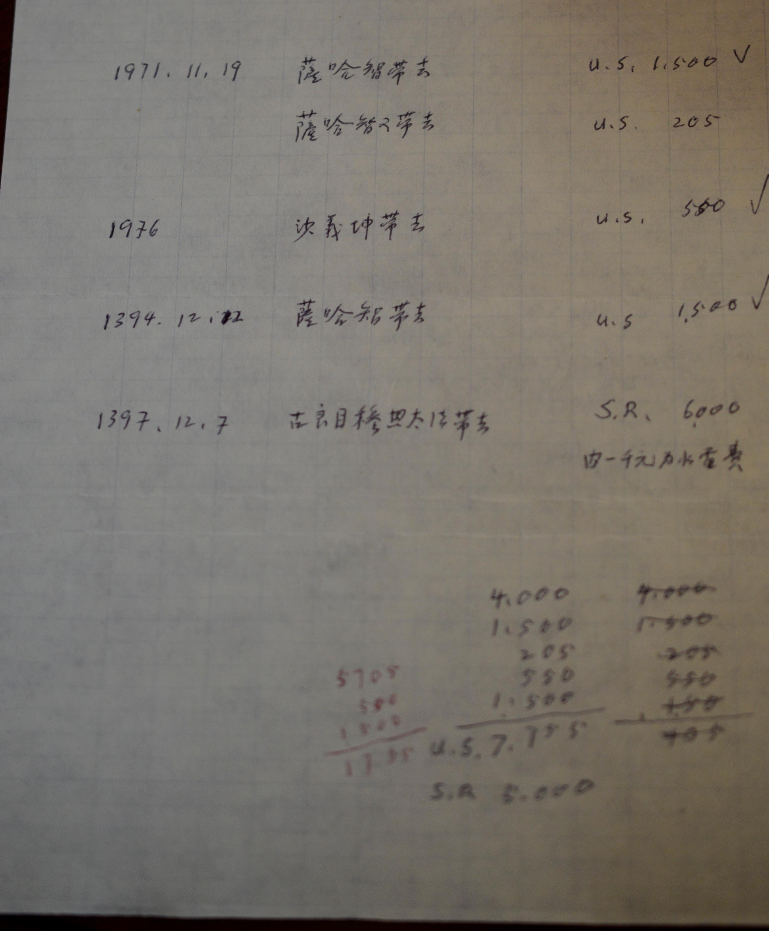
Re-routings during the Cold War: Endowment institutions
The waqf from 1924: microcosm of the re-routings of Sino-Islamic trans-regional networks during the Cold War and their durability
Destruction of the waqf resulting from the expansion of the Haram (1955~) ; reconstruction process appears in the memoirs and diaries of Gao Wenyuan (Shams al-Din al-‘Ali, 1910-2010)
First reconstruction : re-direction of donations, including from communities in Hong Kong, carried by “Sha Yikun (沙義坤)” and “Sa Haji 萨哈智” (likely Sa Zhaoxi萨兆熙); and from Thailand

Slide 26
Post-Cold War Reconnections: Endowment institutions
Second reconstruction: revival since 2013
“Now in Mecca, there are two waqfs. The big waqf has six stories and thirty rooms. Two floors are for families, about three to four. They live throughout the year. They have iqama (residence permit), and work, too. They were born here. There are two Tibetan families who are poor and live there for free. There are also Chinese women, old in their age, and they have lived with us for five to six years in the waqf. The rest of the rooms are for pilgrims, during Ramadan for example, who number twenty, thirty, or forty. They make the pilgrimage, live for three to four months, and go back… The official pilgrims come in groups, of 10,000 or 12,000 and rent places. [But] there are pilgrims who use other ways to come for the pilgrimage, out of their own pockets. They come, maybe five, ten or fifteen of them, in the name of traders, etc., and stay in waqf for free. These are unofficial ways. We take from them fees for electricity.”
(interview with the “watcher” of the waqf, Hussein Suleiman ‘Omar, 2017)

Slide 27
Post-Cold War Reconnections: New relations
Reunions in Mecca through the 1980s through unofficial visits framed in religious terms, prior to the establishment of official diplomatic relations between the KSA and the PRC
Reconnections signified rediscoveries of old homes and families. This represented new sources of social capital, especially for those in Saudi Arabia without the rights and benefits of citizenship. Resumed travels brought the possibility of initiating peddle trade between the industrial ports of China and major cities in Saudi Arabia
Alternative places of belonging and identification
Example of Zaynab and Hassan
Hassan, born and raised in Ta’if, reunites in Mecca with his half-siblings from Gansu who came to Saudi Arabia to visit their father in 1984 through the relatives invitation visa
The return of Hassan to Tibet and Gansu in 1990 in search of his parents’ ancestral homes
Hassan’s marriage with Zaynab, who belonged to a branch of Hassan’s extended family in Gansu. Relocation of Zaynab to Ta’if in 1990. Hassan starts conducting peddle trade between China and Jeddah/Riyadh/Mecca. Zaynab’s brothers and brothers-in-law in Gansu/Sichuan sojourn in Saudi Arabia for multiple years to support the business.
Mecca is a source of solace for Zaynab, who has lived in Ta’if for almost three decades: “…I am living in Saudi Arabia because of Mecca and Medina, and nothing else. As for other matters, nothing holds importance. I have no way of telling whether I would be returning to China in twenty or thirty years. But when I grow older, I want to live in Mecca and be close to the Haram.” (Zaynab, 2017)
Continuous forging of new relations of kinship between the Saudi-Chinese diaspora community and their extended family/acquaintances in mainland China

Slide 28
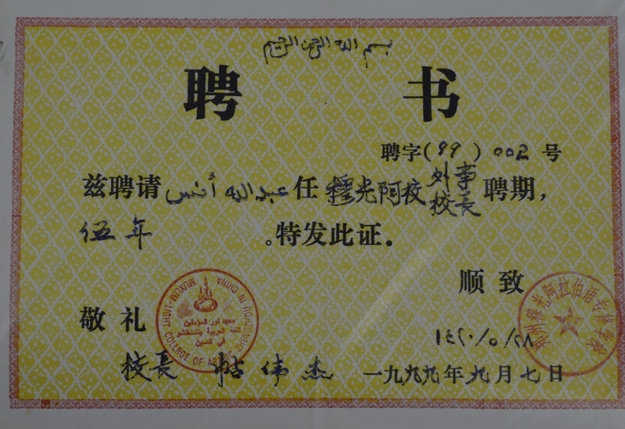
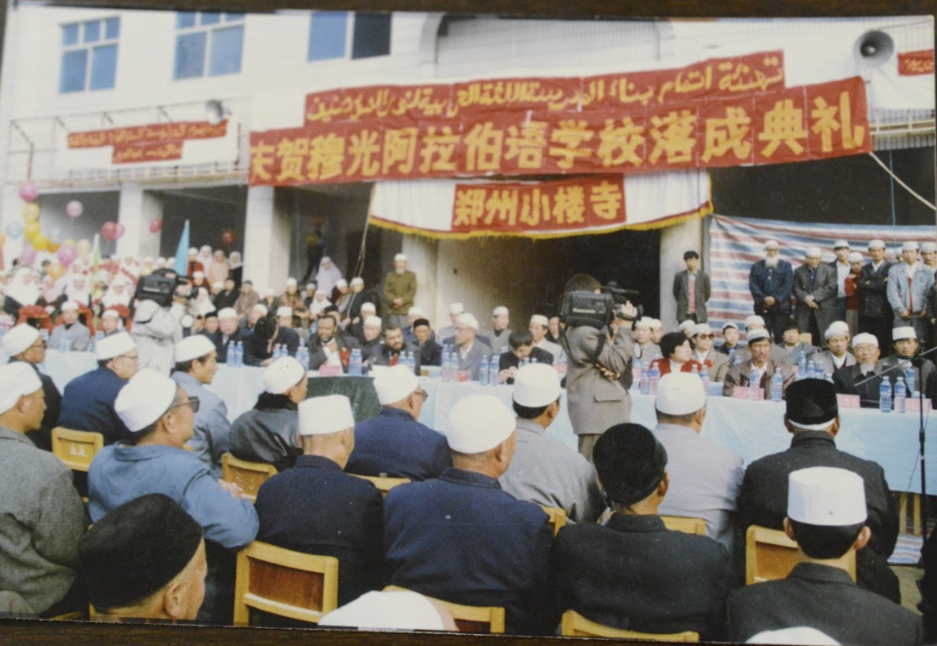
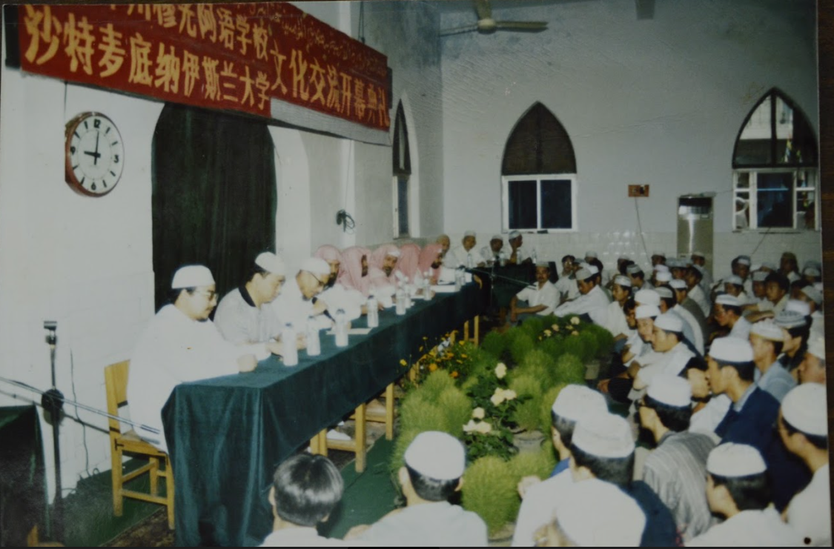
Post Cold-War Reconnections: New relations
The case of Abdullah Anas (Ma Jinkly):
Return to China (Zhengzhou, Henan) in the mid-1980s as a religious missionary, in affiliation with the World Muslim League in Mecca
Second marriage with a Chinese Muslim woman from Qinghai
Import of wholesale clothing from Guangzhou to Jeddah and Ta’if on the side
Networks of religion, kinship, and trade intermixed with one another

Slide 29
Contingences and Divergences
Newcomers through the 1990s and 2000s, forging of relations with the older diaspora community
Chinese graduates of the Islamic University in Medina
Divergent choices
“I graduated from the Islamic University in Medina in the mid-1990s and decided to do business. I stayed in Dubai for nine years…We got to know Ya’qoub because we are from the same region [Xunhua in Qinghai]. Our company sponsored his trip to China two years ago, so that he could visit his home. His daughter who has Saudi citizenship acts as a sponsor for our company’s operations…You would think that people in Saudi Arabia are rich, but this is confined to a small group of people; the ordinary people’s conditions are quite bad. I had many conversations when I was in Medina. Ya’qoub’s conditions were poor, too. The livelihoods of some people in Saudi Arabia don’t reach the standards of Chinese people. Saudi Arabia on the outset values religion and its equality, but in truth these are empty words. Look at Ya’qoub, he lived in the country for almost 60 years but doesn’t even have citizenship…We are preparing to close our business in Saudi Arabia, the economic conditions have not been so good for the past few year.” – Faisal (2017)
“I met my granduncle (who had escaped from Gansu in the 1950s) when I was studying at the Islamic University in Medina. He would tell me all the hardships he went through with his wife, sewing skullcaps everyday. They had no child who could help. Although they managed to open a small shop in Ta’if, their lives never really recovered. When he passed away, I stayed on to take care of my grandaunt. My job provides residency permit, and it is not too arduous. I work in the morning and afternoon and the location is close to home. The salary is reasonable. And you know, a prayer in Medina is equivalent to 1,000 prayers elsewhere, and one prayer in Mecca worth 100,000 times.” – Suleiman (2017)

Slide 30
Home: Everywhere or Nowhere?
Perpetual foreigners
“Our generation…knows nothing. My grandfather had taught near the Haram after coming from China, and my father could speak classical and colloquial Chinese, as well as Arabic. I know that I have relatives in China, but I’m clueless about who and where they are. My father passed away several years ago, too….We are in between Saudi Arabia and China, and we are neither Saudi nor Chinese. When we go to China, they would say we are not Chinese, that we don’t look like Chinese. In Saudi Arabia, people would say we are not Saudi, even if we have Saudi documents and citizenship. So, we wonder if we are Saudi, or Chinese, Saudi Chinese, or I don’t know what (ma adri ish).” – Mariam (2017)

Slide 31
Conclusions
Mecca has served as a consistent magnet for pilgrims and diasporas from Muslim parts of China, and a mediator of transnational connections. Travels to the city created new Islamic hubs at central points of transport (i.e. Shanghai)
Mecca as an abstract metaphor has inspired dual sense of belonging and the making of ‘little Meccas’ in China
Religious travels, inter-state diplomacy, exiles, ties of kinship, and small-scale commerce have been intermeshed with one another in constituting trans-regional ties between China and the Arabian Peninsula
Chinese Muslim communities need to be understood as dynamic mobile societies whose channels of circulations across the geographies of China, the Indian Ocean, Central Asia and the Arabian Peninsula preceded the Belt and the Road formations
Chinese states have periodically capitalized on their domestic Muslim populations as a means of cultural diplomacy
Further conceptualizing Mecca as a convergence point for diverse strands of diasporas, and a reference point for historical narratives and regional pilgrimage sites (little Meccas) would reveal rich histories of inter-Asian connections. This approach would also diversify scholarship on Islamic networks and the Arabian Peninsula

