Slide 1
Theories in the sociology of religion

Slide 2
Religion
Short writing exercise:
In a few sentences, answer this question:
What is religion?

Slide 3
Religion
What is religion?
According to Emile Durkheim: “a unified system of beliefs and practices which unite into a single moral community called a Church, all those who adhere to them”
According to Milton Yinger, this is how religion functions: “a system of beliefs and practices by means of which a group of people struggles with the ultimate problems of human life” (like death, suffering, evil, etc.)
This definition is broader, and can include things like science and technology
Which one makes more sense to you? Is there anything missing in these definitions?
Is the “supernatural” necessary for the definition?
How does the definition that you wrote compare? Get into small groups to discuss.

Slide 4
Religion
Religion is a social institution—what are its functions?
Characteristics of religion
Social phenomenon involving grouping people around a faith with shared beliefs, rituals, morals, symbols, worldviews, giving them a sense of belonging
Provides a shared system of meaning and expectations
It promotes social order and serves as a mechanism of social control (how?)
Some important differences:
Sacred: something that has a quality greater than humankind, is related to the supernatural
Secular: everything else not related to the supernatural
Spirituality: a personal connection with something greater than oneself (a higher power/force)
Spirituality may or may not include involvement in organized religion
So what’s the difference between religion and spirituality?
Fill in the blank: religion is more ______, while spirituality is more _________

Slide 5
Theory on Religion
Classical understandings and approaches to the sociology of religion
Emile Durkheim’s Elementary Forms of Religious Life
Karl Marx’s Opiate of the Masses
Max Weber’s Protestant Ethic and the Spirit of Capitalism
Contemporary approaches to the sociology of religion
Peter Berger’s Sacred Canopy
Robert Bellah’s Civil Religion
Steve Bruce’s Secularization Theory

Slide 6
Suggested Class Activity
Group juggling
Form a circle with everyone standing up facing the inside of the circle. The leader of the group will begin with one object in hand (i.e. a small ball). The leader will ask one group member to repeat their name, and then the leader will gently toss the object to that group member. The group member will reply "Thank you, (the leader's name)!" The leader will reply by saying, "Your welcome, (the individual's name)!? The object will continue around the circle in the same manner, making sure everyone has received the object, until the object ends up in the hands of the original leader. NOTE: During the first round, once a group member has tossed the object, have them cross their arms to prevent repetition. The same pattern will start again with the leader adding more objects. Once an object has been dropped, the pattern starts all over with the first object. NOTE: the leader should mix up sizes and shapes of objects (i.e. a rubber chicken, toilet paper, etc.)

Slide 7
Durkheim on Religion
Collective Effervescence
The intense and electric feelings and
experiences of a social gathering
Gives people extraordinary feelings, often euphoric
Reaffirms social bonds and moral unity
Did you feel any of this, to a lesser degree, when juggling as a group? Have you felt collective effervescence in other situations?
For Emile Durkheim, this collective effervescence plays a big role in the development of a religion
Durkheim attempted to study the most primitive form for religion (its elementary form)
He studied the origins of religious life in aboriginal tribes in Australia. His question: “how does religious life emerge?”

Slide 8
Durkheim on Religion
Basic process of the formation of religion
In clan life, each clan is represented by a “totem” (A sacred object (that represents a plant or animal) which represents the whole clan, a symbol; did not start out as sacred)
The clan comes together regularly at social gatherings
At these social gatherings, the totem is important and prominent
The totem transforms into a churinga; the collective effervescence of the gathering is attributed to the totem—it is given greater, spiritual significance
The meaning of the totem/churinga is not intrinsic, it is socially ascribed

Slide 9
Durkheim on Religion
This provided proof to Durkheim that religion is social
And not necessarily based on the supernatural but involves moral practices and beliefs
Religion sustains the rest of our existence (in the profane/secular sphere)
Durkheim’s definition is widely accepted
Are there any totems in our own lives that have a more sacred meaning? Try to come up with at least two and share with your group
What function does it serve? Is it based on the supernatural? If not, what does it represent? How unifying is this totem?

Slide 10
Marx on religion
Marx, like Durkheim, understood religion as created by humans
He takes it further than the elementary forms and has a different focus
Marx considers that religion reflects humans’ self-consciousness and self-esteem…how?
Religion is understood as a general theory of the world
The legitimated/justified world
Marx was writing at a time when capitalism was just emerging
Marx’s idea of religion
Our religion is not “The Truth”
It is a socially fabricated truth, an ideology only with no actual basis
If it’s not truth, what is the truth?

Slide 11
Marx on Religion
Let’s talk about drugs
What effects do drugs (specifically opiates or “downers”) have on people?
Marx saw religion as a drug, specifically an opiate
It is a “sign of the
oppressed creature”
Short writing
exercise
Take 5 minutes and
write about why Marx
framed it that way

Slide 12
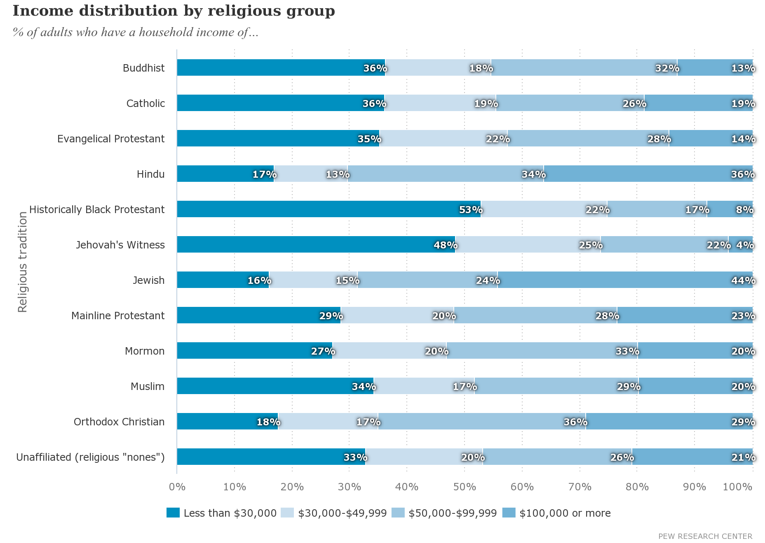
Marx on Religion

Slide 13
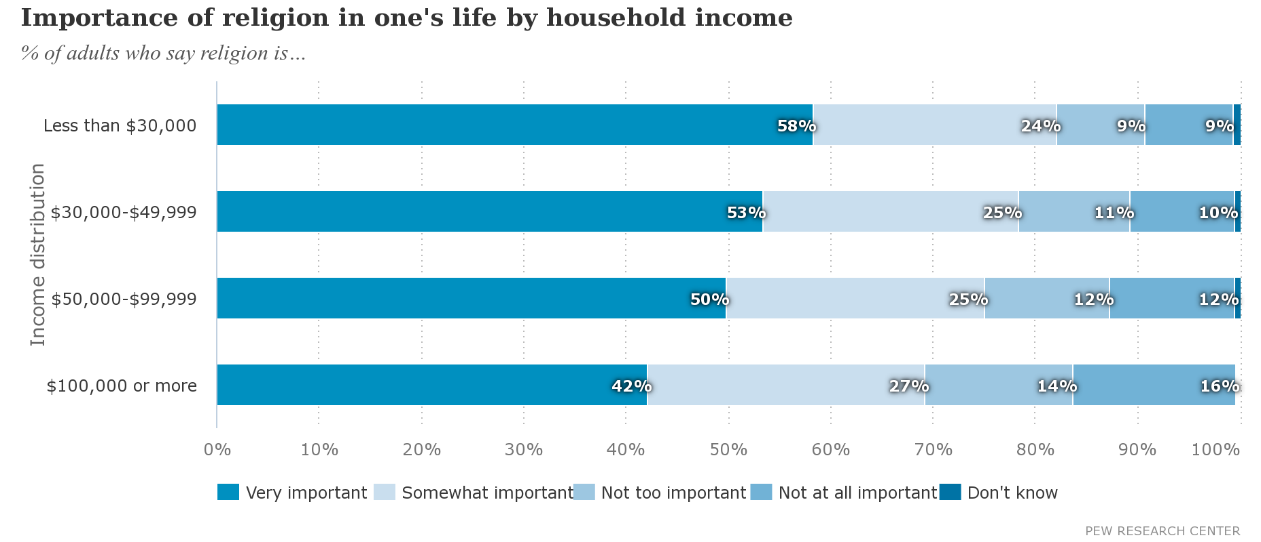
Marx on Religion
How might race, gender, and socioeconomic status impact religious affiliation and belief?

Slide 14
Marx on religion
Trends
People of lower SES are more likely to seek out, feel greater connections with, and have more belief in the divine control of a higher power
Lower SES get more psychological and physical health benefits from being religious
Religion is an illusion
Serves to distract the oppressed from realizing their exploitation and serves to maintain the status quo
Who gives us this drug?

Slide 15
Marx on Religion
Here’s how it works
Society, according to Marx, is founded upon the economy
which shapes other social institutions like education, family, politics, media, religion, etc. These other institutions serve to keep the economy, and its exploitative nature, functioning. These institutions—including religion—have that opiate effect of distracting the people and keeping them oppressed
how things are produced (called the means of production) and the relationships between socioeconomic classes (called the relations of production, between the bourgeoisie and proletariat)

Slide 16
Marx on Religion
Get into small groups and compare and contrast Marx and Durkheim’s view of religion
What stood out most to you about each?
Which one do you gravitate toward?
How are they similar? How are they different?

Slide 17
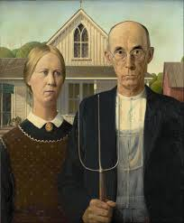
Weber on Religion
The Protestant Ethic and the Spirit of Capitalism
In the early history of the US, Protestant immigrants, specifically Calvinists, dominated the landscape
This Protestant immigrant has been characterized by having strong values of hard work, delayed gratification, and investment
Calvinists believed in predestination—specifically, that it has already been determined whether or not you are saved. However, they saw success in worldly activities as looked upon favorably by God.

Slide 18
Weber on Religion
Max Weber argued that without those Protestant immigrants, capitalism would NOT have emerged in the US when it did and in the form that it did. They, in effect, created the capitalist spirit
He argued that religion was a cause of our current system of capitalism (not the only cause)
Capitalism is characterized by profit maximization being a goal in and of itself which correlated with the Protestant ethic of success in order to be rewarded in the afterlife

Slide 19
Contemporary ideas
The Sacred Canopy
Peter Berger’s idea of how humans place meaning on reality
This meaning can be otherworldly in nature—trying to understand the world as a whole as significant, having greater meaning
This greater meaning legitimates society; what does this mean? what does this look like?
This “canopy” (like a tent or umbrella) protects us and was/is constructed by us
The sacred canopy is religion
How does this view of religion differ from the classical understandings of religion?

Slide 20
Contemporary ideas
Civil Religion
Robert Bellah’s idea of how religion
manifests in everyday sociopolitical life
Civil religion includes practices in which citizenship takes on religious aspects
It is a “public” religion, as religious is typically seen in the private sphere due to the separation of church and state
Civil religion takes what is political further—justifies, mobilizes, honors it through religion
In the US, Protestant Christianity is the foundation of much of mainstream society
Why?

Slide 21
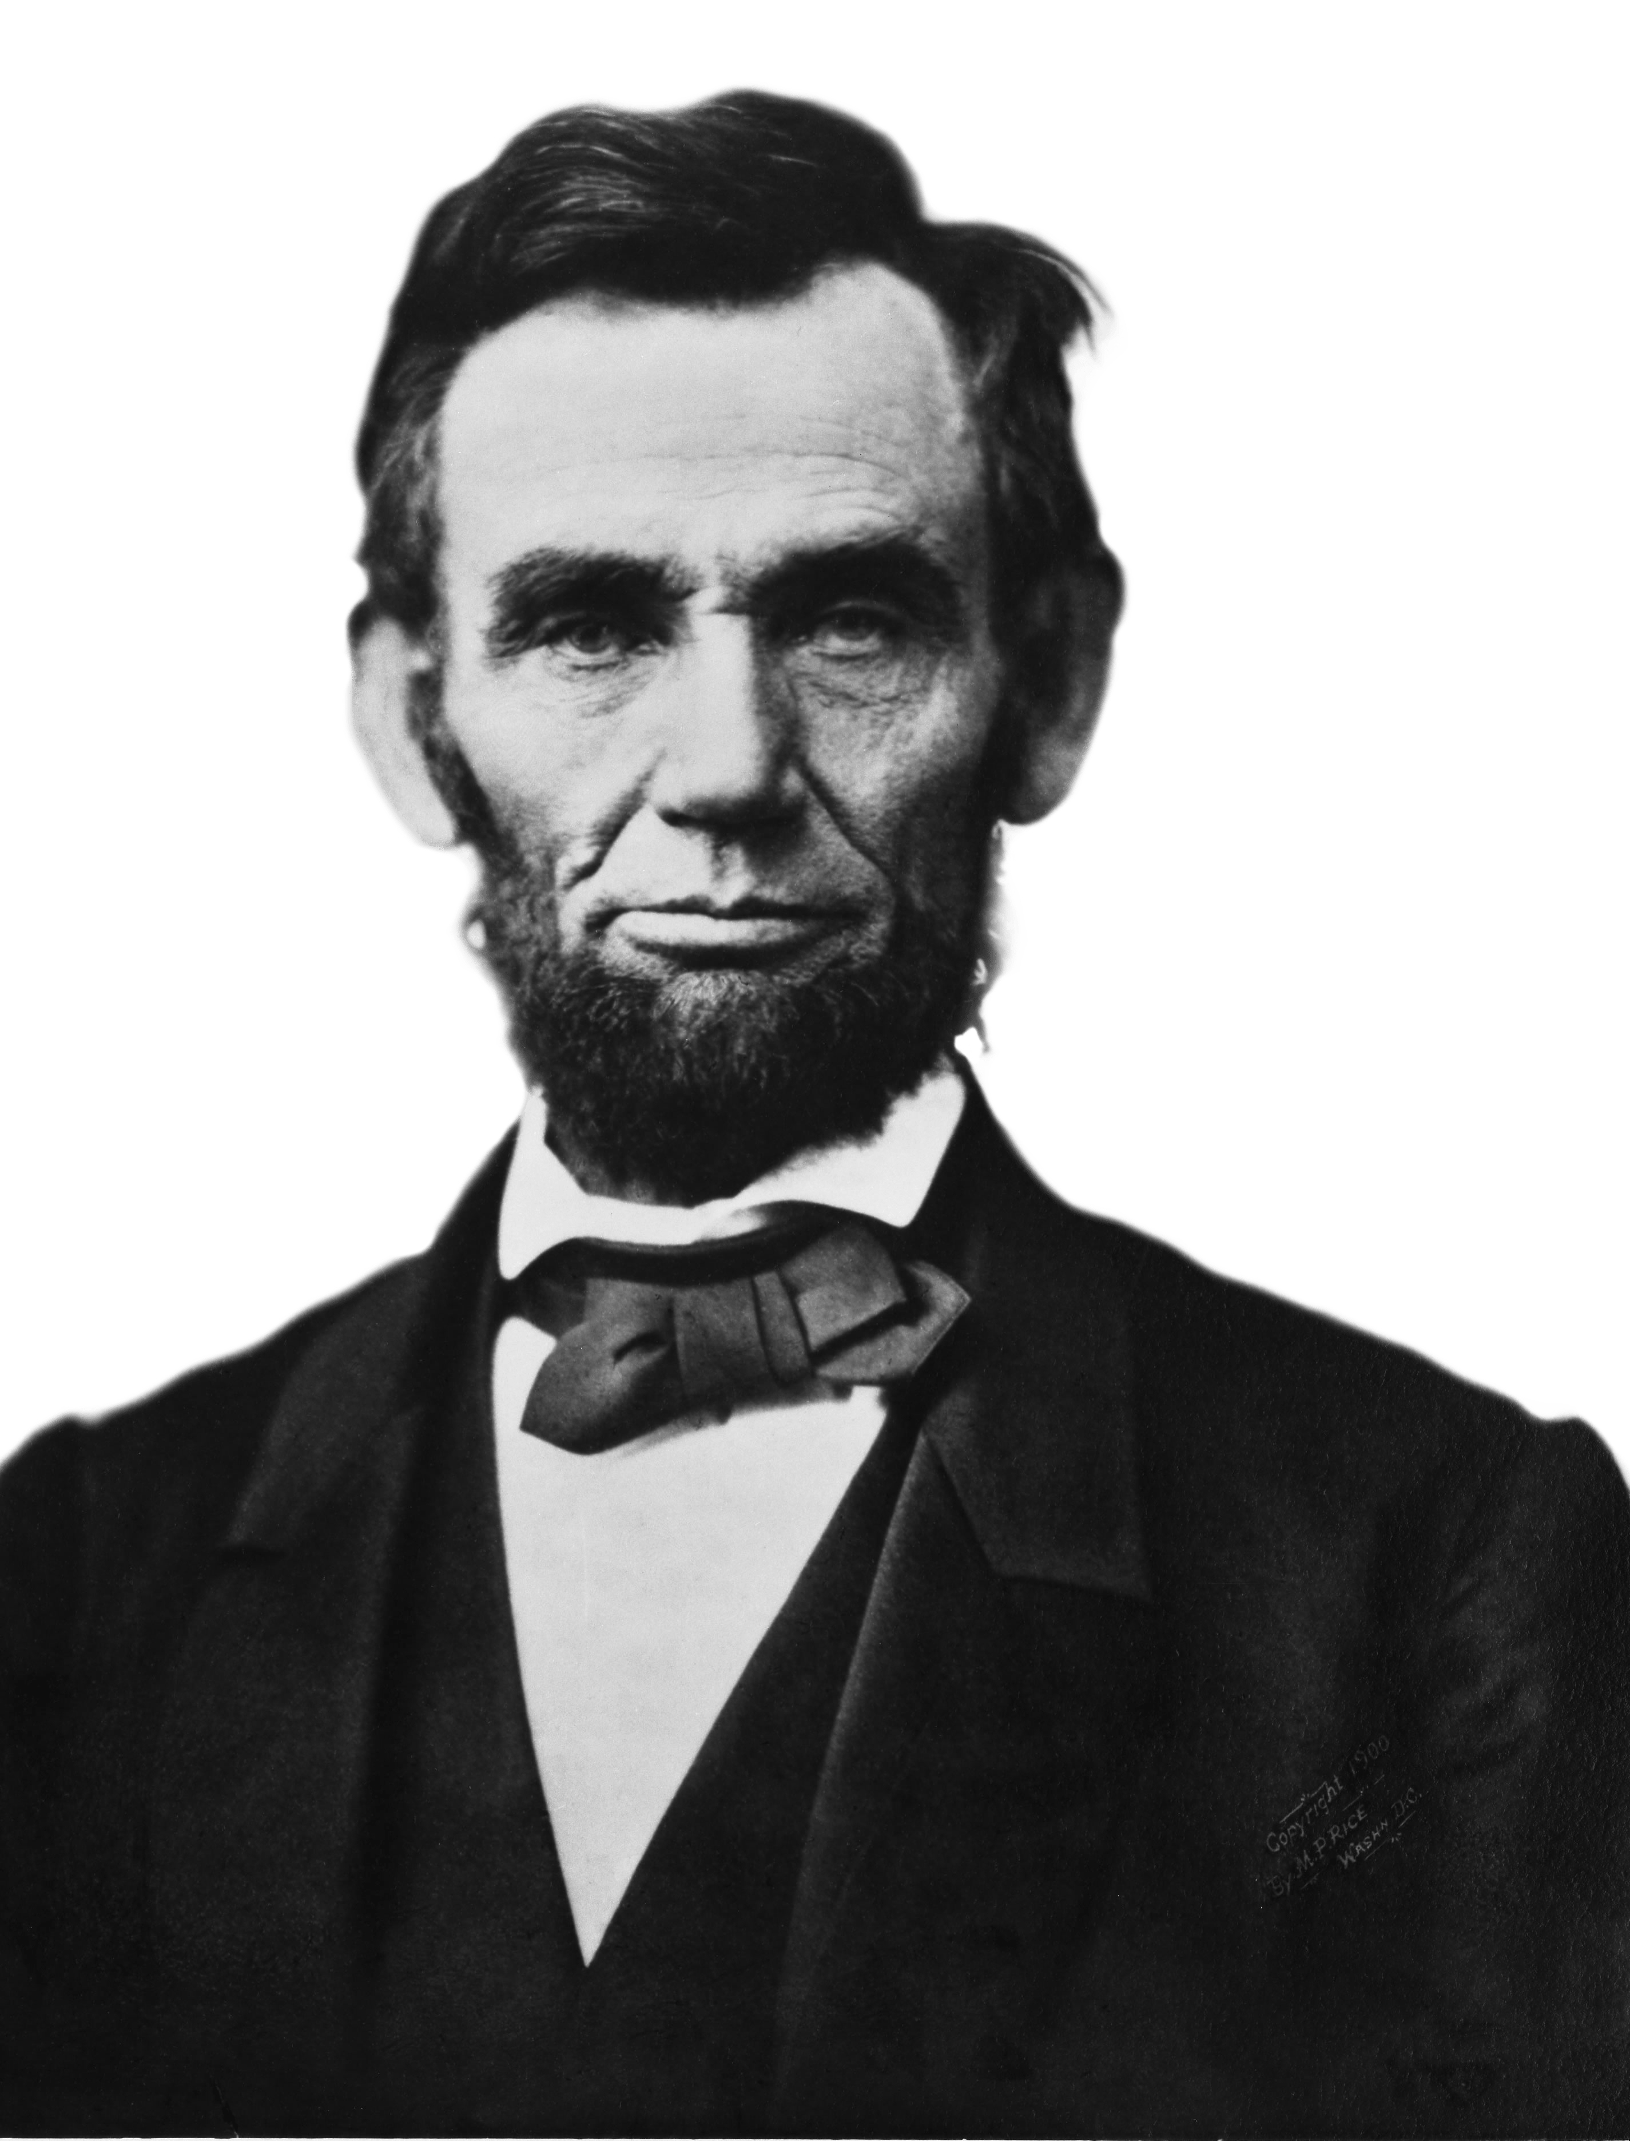
Contemporary ideas
Example in US history: The Gettysburg Address
Audio: https://www.youtube.com/watch?v=BvA0J_2ZpIQIs
Text:
"Four score and seven years ago our fathers brought forth on this continent, a new nation, conceived in Liberty, and dedicated to the proposition that all men are created equal.
Now we are engaged in a great civil war, testing whether that nation, or any nation so conceived and dedicated, can long endure. We are met on a great battle-field of that war. We have come to dedicate a portion of that field, as a final resting place for those who here gave their lives that that nation might live. It is altogether fitting and proper that we should do this.
But, in a larger sense, we can not dedicate — we can not consecrate — we can not hallow — this ground. The brave men, living and dead, who struggled here, have consecrated it, far above our poor power to add or detract. The world will little note, nor long remember what we say here, but it can never forget what they did here. It is for us the living, rather, to be dedicated here to the unfinished work which they who fought here have thus far so nobly advanced. It is rather for us to be here dedicated to the great task remaining before us — that from these honored dead we take increased devotion to that cause for which they gave the last full measure of devotion — that we here highly resolve that these dead shall not have died in vain — that this nation, under God, shall have a new birth of freedom — and that government of the people, by the people, for the people, shall not perish from the earth.”
Is there anything religious in this speech?
Hidden or obvious?

Slide 22
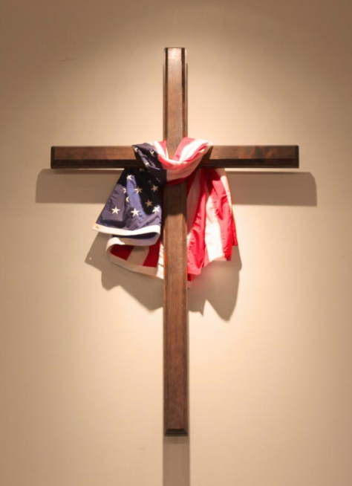
Contemporary ideas
Are there other examples of civil religion in American history or folklore? Get in groups and come up with examples of these concepts in the American context
Exodus
Chosen People
Promised Land
New Jerusalem
Sacrificial death
Rebirth
Prophets, martyrs, saints
Sacred events, days, places
Sacred rituals, symbols, songs, prayers, scripture
Do other countries or cultures have a civil religion?

Slide 23
Contemporary ideas
Secularization
A process of removing institutions, such as education and government, from the dominance or influence of religion
Why might social institutions do this? What benefits are there? Are there any disadvantages?
Secularization theorists, including Steve Bruce, have argued that as society modernizes, there will be less of a need for religion
The argument is that the institution of religion will not have as strong of a role in society, culture, institutions, and families as it once did
Take 5 minutes and write your thoughts about this idea. Does it have merit? Does it have flaws? Will it come true? Has it begun already?

Slide 24
Contemporary ideas
The Starbucks Red Cup Case Study
There was a significant controversy about the 2015 cup and the so-called “War on Christmas”
How do these debates relate to secularization, religion, politics, the economy, and culture?
Is secularization happening?

Slide 25
Suggested Assessments
Short paper assignment
Have students watch a 3 minute clip of Charlie Chaplin’s Modern Times:
(https://www.youtube.com/watch?v=DfGs2Y5WJ14)
Prompt: For Marx, the economic structure is of utmost importance to understand social life. Now, imagine a factory during the Industrial Revolution. Each worker had specialized tasks to increase efficiency and maximize profit. In the clip, the workers were alienated from one another, pit against each other. They worked under circumstances of constant supervision. The supervisor that appears on the screens represent the bourgeoisie while the line workers represent the proletariat. The workers have false consciousness, they are distracted from their exploitation (did you see the horrible working conditions and treatment?). They fight against one another as a result. They do not have class consciousness, or the realization that they are ALL being exploited and oppressed. If they banded together, they could change their circumstances or even overthrow the bourgeoisie! In 1-2 pages, explain how this clip and discussion of the economic structure relates to religion, highlighting Marx’s perspective on religion. Also, discuss how this very old clip (1936) relates to societies today.

Slide 26
Suggested Assessment
Essay exam question
Compare and contrast the classical understandings of religion (Marx, Durkheim, Weber). How do they map onto the classical sociological theories of structural functionalism and conflict theory?
Short Paper Exercise
Research other countries and cultures and find one wherein the practices of citizenship take on religious aspects—where a civil religion exists. What does it look like? What are some of the major aspects of this civil religion? How does it compare to that in the US? Write a 2 page paper in response and provide citations for your research.

Slide 27
Suggested Readings
Abad-Santos, Alex. 2016. “Starbucks’s Red Cup Controversy, Explained.” Vox https://www.vox.com/2015/11/10/9707034/starbucks-red-cup-controversy
Bellah, Robert. 1967. “America’s Civil Religion.” Daedalus (Winter).
Berger, Peter. 1967. The Sacred Canopy. Garden City, NY: Random House.
Bruce, Steve. 2002. God is Dead: Secularization in the West. Malden, MA: Blackwell Publishing.
Chaplin, Charlie. 1936. Modern Times. https://www.youtube.com/watch?v=DfGs2Y5WJ14
Durkheim, Emile. 1912. The Elementary Forms of Religious Life.

Slide 28
Suggested Readings
Marx, Karl. 1843. Critique of Hegel’s Philosophy of Right.
Pew Research. 2019. Religious Landscape Study. Income Distribution. https://www.pewforum.org/religious-landscape-study/income-distribution/
Weber, Max. 1930. The Protestant Ethic and the Spirit of Capitalism. Allen and Unwin.

