Slide 1
Introduction to the sociology of religion

Slide 2
Religion
Short writing exercise:
In a few sentences, answer this question:
What is religion?

Slide 3
Religion
So, what is religion?
According to Emile Durkheim: “a unified system of beliefs and practices which unite into a single moral community called a Church, all those who adhere to them”
According to Milton Yinger, this is how religion functions: “a system of beliefs and practices by means of which a group of people struggles with the ultimate problems of human life” (like death, suffering, evil, etc.)
This definition is broader, and can include things like science and technology
Which one makes more sense to you? Is there anything missing in these definitions?
Is the “supernatural” necessary for the definition?
How does the definition that you wrote compare? Get into small groups to discuss.
Social scientists and people who study religion often cannot come to a consensus on the definition of religion, which highlights the fact of how personal religion, and therefore its definition, can be

Slide 4
Religion
Religion is a social institution—what are its functions?
Characteristics of religion
Social phenomenon involving grouping people around a faith with shared beliefs, rituals, morals, symbols, worldviews, giving them a sense of belonging
Provides a shared system of meaning and expectations
It promotes social order and serves as a mechanism of social control (how?)
Some important differences:
Sacred: something that has a quality greater than humankind, is related to the supernatural
Secular: everything else not related to the supernatural
Spirituality: a personal connection with something greater than oneself (a higher power/force)
Spirituality may or may not include involvement in organized religion
So what’s the difference between religion and spirituality?
Fill in the blank: religion is more ______, while spirituality is more _________

Slide 5
Discussion Questions
Get into small groups and discuss the following questions. Make sure to come up with examples and/or explanations for each.
Can you be both religious and spiritual?
Can you be religious without being spiritual?
Can you be spiritual without being religious?

Slide 6
Religion
The Sacred Canopy
Peter Berger’s idea of how humans place meaning on reality
This meaning can be otherworldly in nature—trying to understand the world as a whole as significant, having greater meaning
This greater meaning legitimates society; what does this mean? what does this look like?
This “canopy” (like a tent or umbrella) protects us and was/is constructed by us
The sacred canopy is religion
What are the major religions in the world? The US?
What does religious affiliation look like in the US?

Slide 7
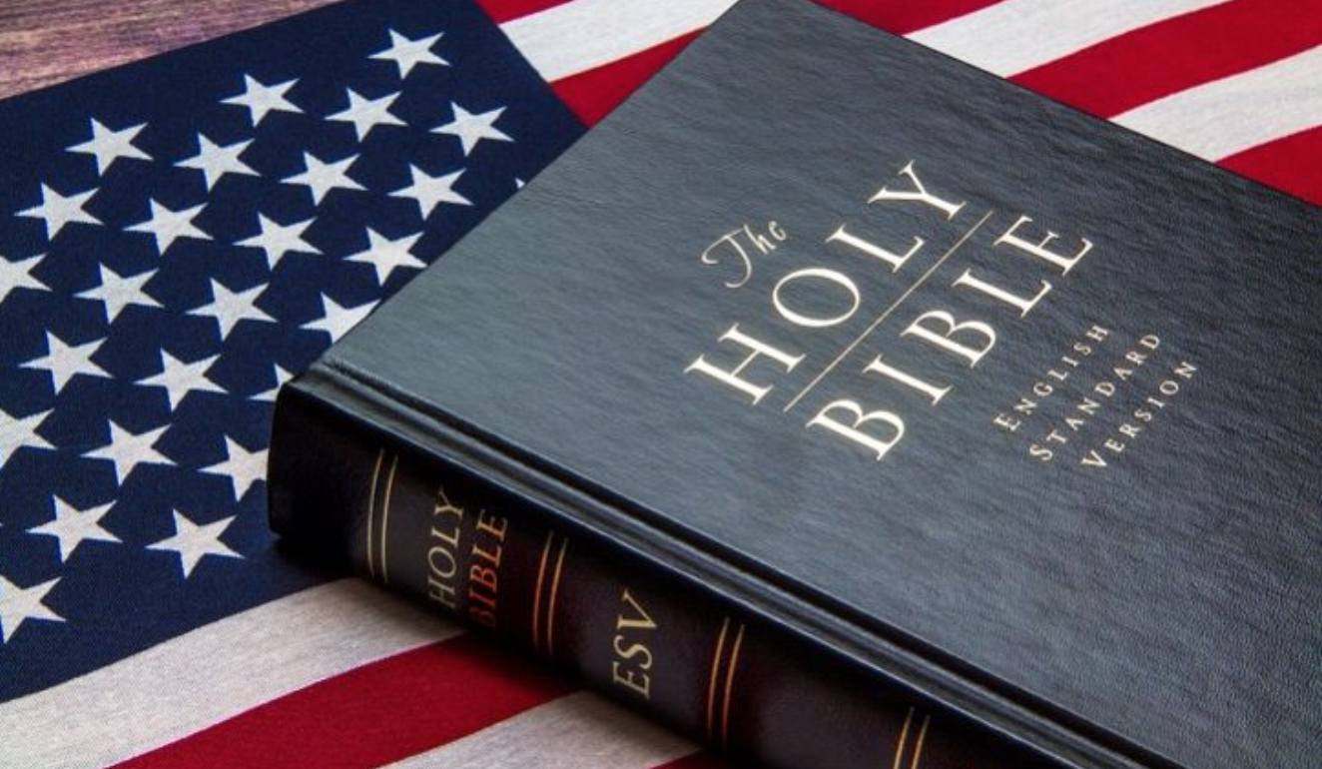
Religion in the US
Religion | %
Christian | 70.6%
Evangelical Protestant | 25.4
Catholic | 20.8
Mainline Protestant | 14.7
Historically Black Prot. | 6.5
Other Christian | 3.3
Non-Christian Faiths | 5.9%
Jewish | 1.9
Muslim | 0.9
Buddhist | 0.7
Hindu | 0.7
Other | 0.3
Other Faiths | 1.5%
Unaffiliated | 22.8%
Nothing in particular | 15.8
Agnostic | 4
Atheist | 3.1
Source: Pew Research

Slide 8
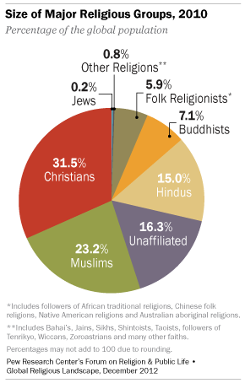
Global Religion

Slide 9
Discussion
Religion | %
Christian | 70.6%
Evangelical Protestant | 25.4
Catholic | 20.8
Mainline Protestant | 14.7
Historically Black Prot. | 6.5
Other Christian | 3.3
Non-Christian Faiths | 5.9%
Jewish | 1.9
Muslim | 0.9
Buddhist | 0.7
Hindu | 0.7
Other | 0.3
Other Faiths | 1.5%
Unaffiliated | 22.8%
Nothing in particular | 15.8
Agnostic | 4
Atheist | 3.1
Source: Pew Research
Take 5 minutes to write down some of your initial thoughts on this data
Get into small groups and discuss. Be prepared to share what you talked about

Slide 10
Immigration and religion
Immigration and religion—why is it important?
Emigration, voluntary or involuntary, can be very stressful
Religion gives strength, meaning, helps with coping, makes sense of the world and afterlife, connects to others
Religion may be the only constant in their lives
How does immigration impact US religious affiliation?
The 1965 Immigration and Nationality Act was a turning point in migration as it ended immigration-admissions policies based on race and ethnicity
Previous policies included the 1882 Chinese Exclusion Act and other quota-based systems for immigration in place since the 1920s that restricted intake of non-European immigrants
1965 and beyond included immigrants from all over the world

Slide 11
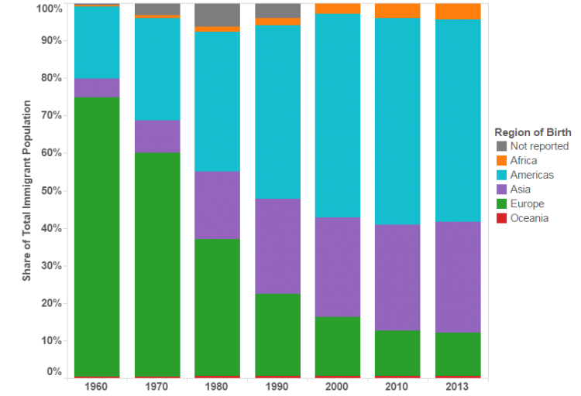
Immigration and religion
US Immigrant Population by World Region of Birth, 1960-2013
How do you
think the religious
landscape of
the US changed
as the
demographics
changed
through
immigration?

Slide 12
Immigration and religion
Changes to the US religious landscape
Post-1965, there was an increase in religious diversity
Islam, Buddhism, Hinduism, Sikhism, other forms of Christianity and Judaism
What are the consequences of this religious diversity?
Socially? Demographically? For policy? For mainstream culture? For businesses? For families? For other social institutions?
Immigration is just one change--on a global scale--that has impacted religious affiliation
What else has changed religion?

Slide 13
Religious affiliation
None not nun!
Religious “nones” are people who don’t affiliate with any religious group or belief
1 in 5 adults have no religious affiliation (Pew 2012)
Who is more likely to be a religious “none”?
Younger folks (one-third of Americans under 30 are “nones”)
Why do you think there are so many people that are “nones”?
Being a religious “none” can mean they still believe in a higher power/God, have a deep spiritual connection to nature and the earth
In fact, one-third of “nones” say they are spiritual but not religious. The majority say they are not looking for a religion and are dissatisfied with organized religions

Slide 14
Religious Affiliation
Ages and stages
Religious affiliation can vary by ones’ age as well as generation
Much of this change in religious affiliation has to do with “generational replacement”—or the gradual replacement of older generations by younger ones
Older generations tend to be more religious (only 1 in 10 people 65+ are “nones”)

Slide 15
secularization
Secularization
A process of removing institutions, such as education and government, from the dominance or influence of religion
Why might social institutions do this? What benefits are there? Are there any disadvantages?
Secularization theorists have argued that as society modernizes, there will be less of a need for religion
The argument is that the institution of religion will not have as strong of a role in society, culture, institutions, and families as it once did
Take 5 minutes and write your thoughts about this idea. Does it have merit? Does it have flaws? Will it come true? Has it begun already?

Slide 16
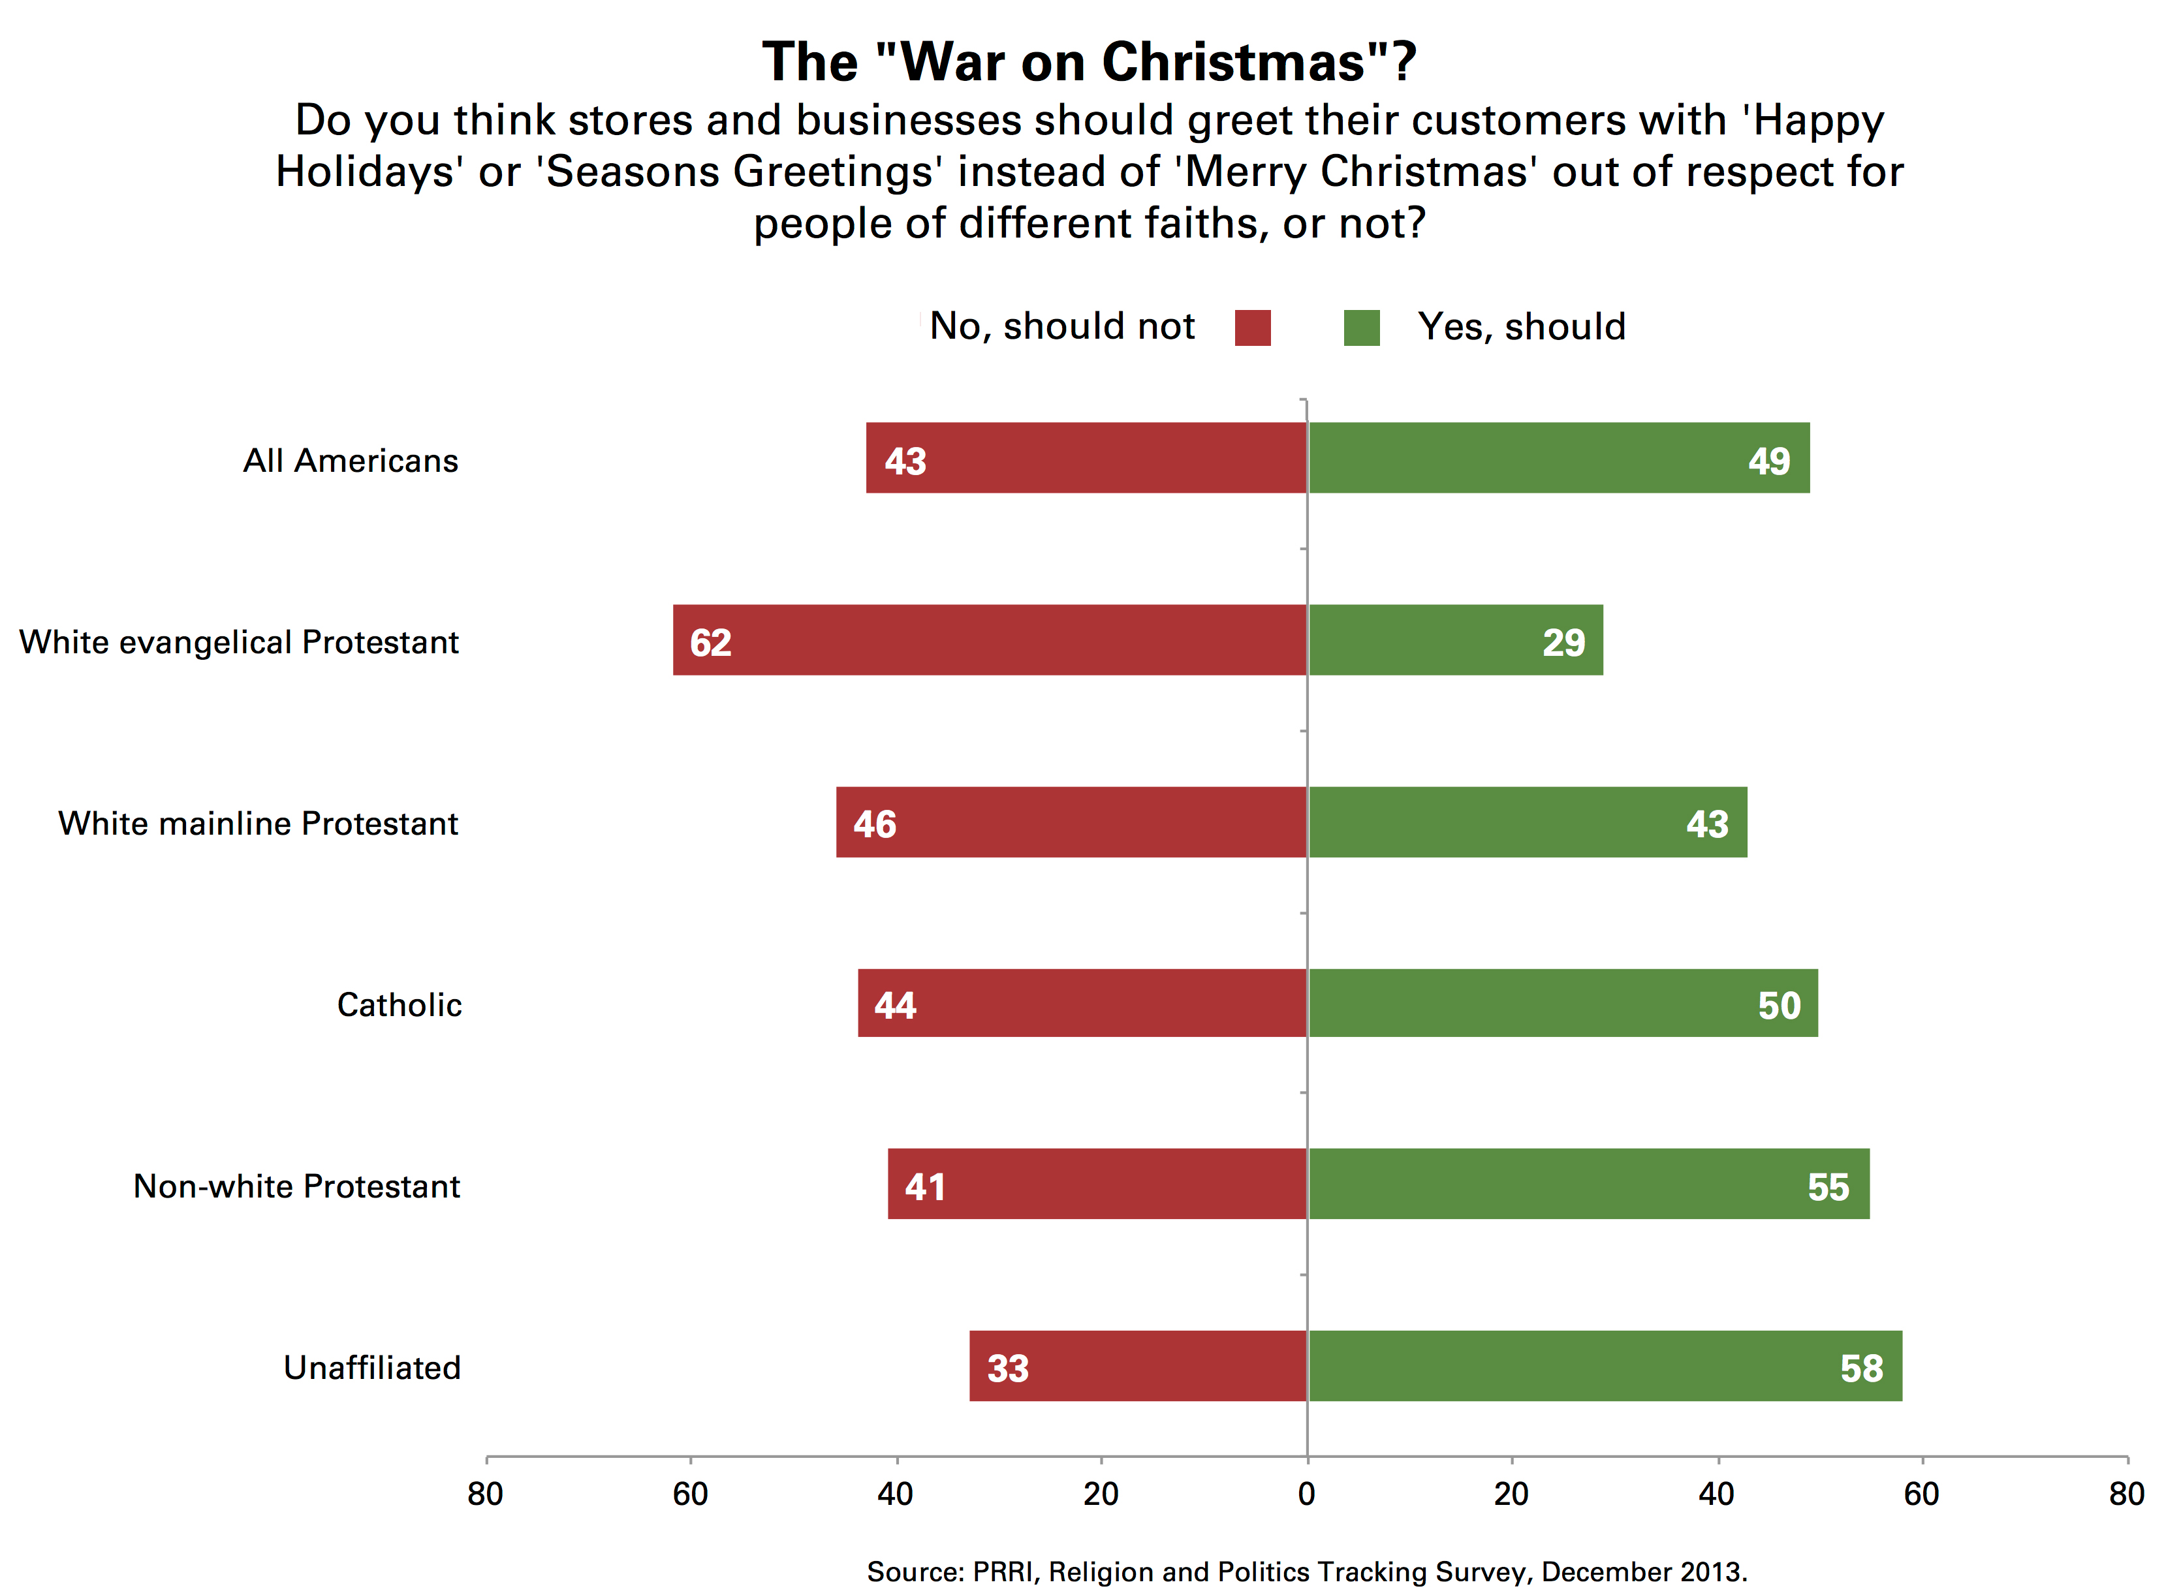
Secularization Case Study
The Starbucks Red Cup
There was a significant controversy about the 2015 cup and the so-called “War on Christmas”
How do these debates relate to secularization, religion, politics, the economy, and culture?
Is secularization happening?

Slide 17
Suggested Assessments
Essay questions for exam:
Compare and contrast religious affiliation in the US and religious affiliation globally. What structures, institutions, and historical patterns led to the particular, current religious landscape?
As religious “nones” increase, will secularization also increase, thus leading to a world without religion? Why or why not?

Slide 18
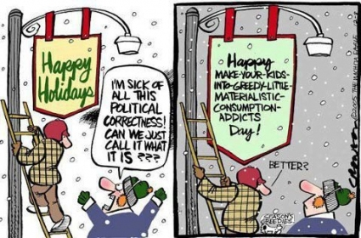
Suggested Assessments
Short paper assignment:
Have students examine this political cartoon and analyze it sociologically in 2 pages. Responses must address 1) religion, 2) culture and consumption, and 3) globalization.

Slide 19
Suggested Readings
Abad-Santos, Alex. 2016. “Starbucks’s Red Cup Controversy, Explained.” Vox https://www.vox.com/2015/11/10/9707034/starbucks-red-cup-controversy
Berger, Peter. 1967. The Sacred Canopy. Garden City, NY: Random House.
Bruce, Steve. 2002. God is Dead: Secularization in the West. Malden, MA: Blackwell Publishing.
Bruce, Steve. 2011. “Defining Religion: A Practical Response.” International Review of Sociology 21(1):107-120.
Cadge, Wendy and Elaine Howard Ecklund. 2007. “Immigration and Religion.” Annual Review of Sociology 17.1-17.21.

Slide 20
Suggested Readings
Chishti, Muzaffar, et al. 2015. “Fifty Years On, the 1965 Immigration and Nationality Act Continues to Reshape the United States.” Migration Policy Institute https://www.migrationpolicy.org/article/fifty-years-1965-immigration-and-nationality-act-continues-reshape-united-states
Hirschman, Charles. 2004. “The Role of Religion in the Origins and Adaptation of Immigrant Groups in the United States.” International Migration Review 38(3):1206-1233.
Pew Research. 2010. Religion Among the Millenials. Pew Research Forum on Religion and Public Life.
Pew Research. 2010. “Nones” on the Rise. Pew Research Forum on Religion and Public Life.
Pew Research. 2019. Religious Landscape Study. https://www.pewforum.org/religious-landscape-study/

